Slide 1
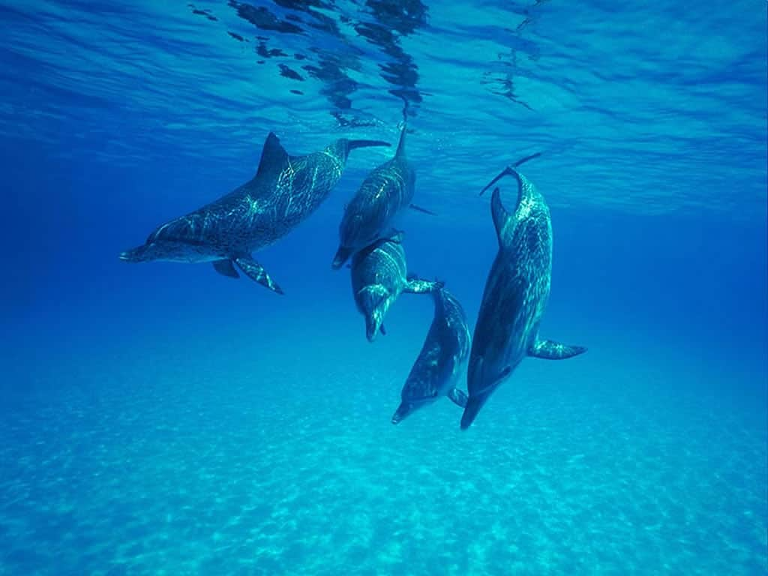
GOOD MORNING
Dr.Deepa.katgalkar

Slide 2
CELL ULTRA STRUCTURE AND FUNCTION

Slide 3
References
TEXT BOOK OF HUMAN HISTOLOGY-INDERBIR SINGH 5TH EDITION
TEXT BOOK OF HISTOLOGY-HAMS-5TH EDITION
TEXT BOOK OF MEDICAL PHYSIOLOGY-GUYTON HALL 11TH EDITION
CONCISE MEDICAL PHYSIOLOGY-CHOUDHARI 5TH EDITION
GRAYS HUMAN ANATOMY
ROBINS BASIC PATHOLOGY-ROBINS 7TH EDITION
GOOGLE SEARCH

Slide 4
CONTENTS
Introduction
Cell membrane
Cell organelles
Cytoskeleton
Nucleus

Slide 5
INTRODUCTION
Cell is defined as structural and functional unit of the living body. All the living things are composed of cell. A single cell is the small unit that has all characteristics of life.

Slide 6
Structure of the cell can be studied under 3 headings :-
Cell membrane
Cytoplasm
Nucleus

Slide 7
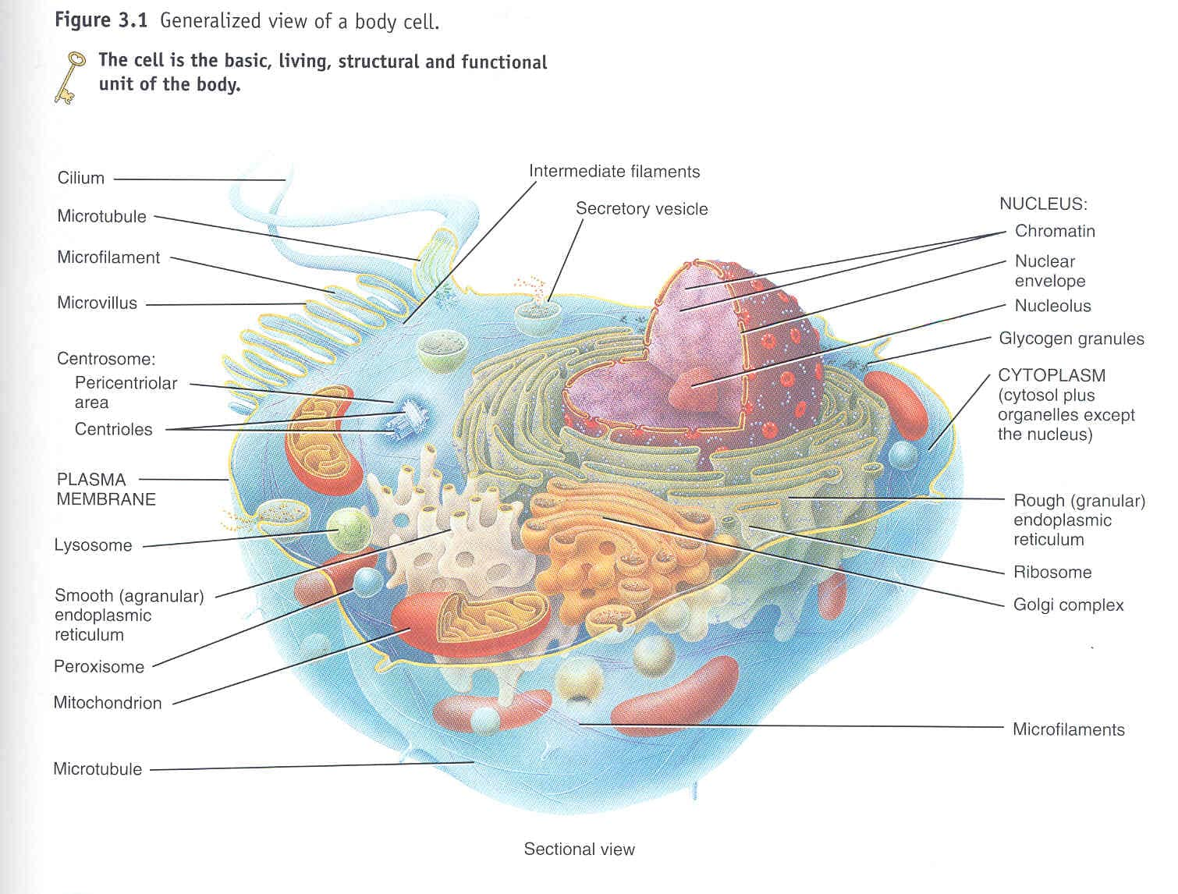

Slide 8
CELL MEMBRANE / PLASMA MEMBRANE/PLASMALEMMA
Cell membrane is selectively permeable lipid bilayer found in all cell. It is a protective sheath enveloping the cell body. It measure about 7.5nm-10nm thick as seen under E/M.

Slide 9
STRUCTURE OF CELL MEMBRANE
Danielli-Davson Model.
First model proposed.
Sand witch of lipids covered by proteins on both sides.
Unit Membrane Model.
It is an E/M study by J.D Robertson which replaced Danielli-Davson Model

Slide 10
Fluid Mosaic Model
Proposed by SJ Singer and GL Nicholson
According to them membrane is a fluid with mosaic of proteins
In this Model the proteins are thought to float within bi-layered lipid. Instead of forming the layers of sand witch type.
The model is widely accepted till now.

Slide 11
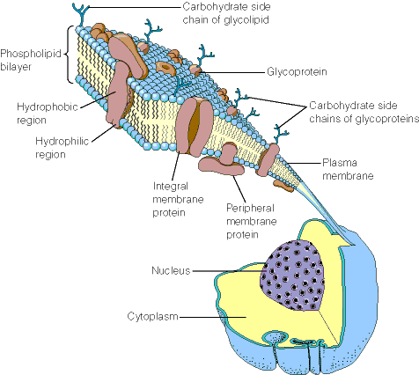
PLASMA MEMBRANE

Slide 12
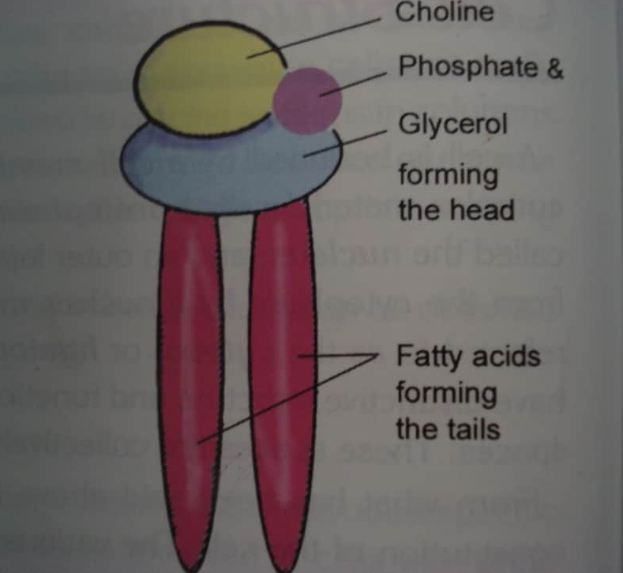
STRUCTURE OF LIPID BI-LAYER
Each phospholipid molecule consist of enlarged polar head end In which phosphate is located & 2 nonpolar thin tail end having fatty acid group. The head end is hydrophilic & tail end is hydrophobic.

Slide 13
In an aqueous medium ,they arrange themselves as bilayer with polar head toward the outside and nonpolar tail toward the inside facing each other.
Major lipids are :-
a) Phospholipids
b) Cholesterol
Phospholipids→ These are amino phospholipids, Sphingomyelins,phosphatidyl choline, phosphatidyl etholamine,glycerol,serine,inositol

Slide 14
Cholesterol→ They are arranged in Between the phospholipids and help to pack them. Hence they maintain structural integrity of membrane.
Glycolipid such as galactocerebroside (Myelin) are present only over the outer surface of cell membrane

Slide 15
PROTEINS IN CELL MEMBRANE
These are glycoproteins & cover two surface of central lipid layer. They are mainly 2 types:-
Integral proteins/ Transmembrane proteins.
a) Pass through the entire thickness of the cell membrane and are tightly bound to the cell membrane.
b) provide structural channels through which water molecules, ions diffuse between ECF & ICF.

Slide 16
c) Act as enzyme
d) Provide structural integrity
e) Convey information about environment to cell interior .
Peripheral proteins→
Found attached to integral proteins and inside or outside the cell membrane
a) They act as enzymes ,receptors for hormones and neurotransmitters
b) They can act as Ag and induce process of antibody formation

Slide 17
CARBOHYDRATES IN CELL MEMBRANE
THESE ARE GLYCOPROTEINS AND GLYCOLIPIDS .THEY FORM THIN LOOSE COVERING OVER THE ENTIRE CELL MEMBRANE CALLED GLYCOCALYX
HELP IN ADHESION, ACT AS RECEPTORS AND CONTAIN Ag (BLOOD GROUP Ag)

Slide 18
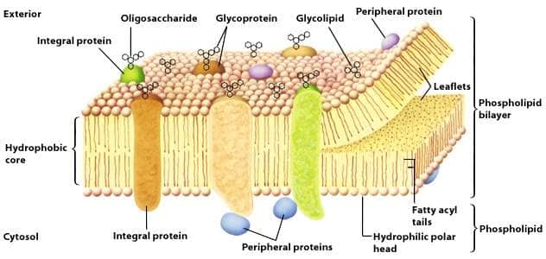

Slide 19
Function of cell membrane
Protective function
Selective permeability
Absorptive function
Excretory function
Exchange of gases
Maintenance of shape and size of the cells

Slide 20
Transport across the cell membrane
Diffusion
Passive mediated transport / facilitated diffusion
Active mediated transport
Vesicular transport
a. Endocytosis
b. Exocytosis
c. Receptor mediated endocytosis
Osmosis
Bulk flow

Slide 21
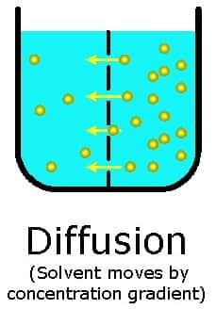
Diffusion
The selective permeability of the cell membrane plays a major role in this mode of transport. The cell membrane allows certain molecules to diffuse freely in /out of the cell membrane according to the concentration gradient. These molecules are follows :

Slide 22
Hydrophobic molecules
O₂, N₂
Small uncharged polar molecules
Water, Urea, glycerol, Co₂
Large uncharged polar molecules
Glucose, Sucrose
Ions
H⁺, Na⁺, K⁺, Ca⁺⁺, Cl⁻

Slide 23
Passive mediated transport / facilitated diffusion
The characteristics of this mode of transport is that it is
Faster than simple diffusion
Down the concentration gradient
No energy input is required
Carrier exhibits specificity for the structure of the transported substance, saturation kinetics and specific inhabitants.
Examples : Glucose transport and chloride bicarbonate transport.

Slide 24
Active mediated transport
This process requires energy and this comes from 2 sources.
(i) ATP hydrolysis and (ii) energy of Na⁺ gradient
Characteristics
Can move substances against a concentration gradient
Requires energy
Unidirectional

Slide 25
Vesicular transport - Endocytosis
Process by which substances enter the cell without actually passing through the membrane
Pinocytosis
Phagocytosis
Receptor mediated endocytosis

Slide 26
Pinocytosis.
It is also called as cell drinking. The macromolecules like bacteriaand antigens enter the cell by this process. The fate of the materials that enter the cell by pinocytosis is still unclear. There are indications that some become localized within structures known as multivesicular bodies that contain hydrolytic enzymes and are accordingly considered a type of secondary lysosome.
The material engulfed should be less than 5mm and the pinocytotic vesicle is 80nm in diameter.

Slide 27
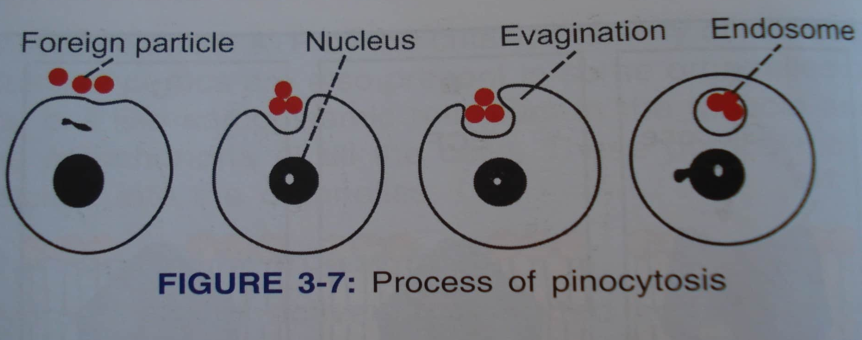
Pinocytosis

Slide 28
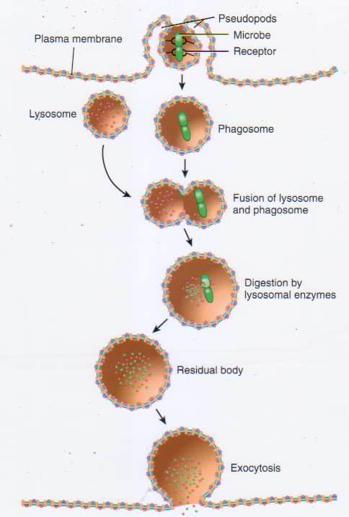
Phagocytosis
In phagocytosis the cell takes up particles or macromolecular aggregates from its surrounding.
Phagocytic vesicle → phagosomes → secondary lysosome → residual body

Slide 29
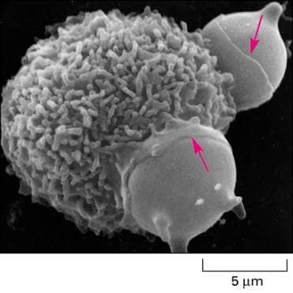
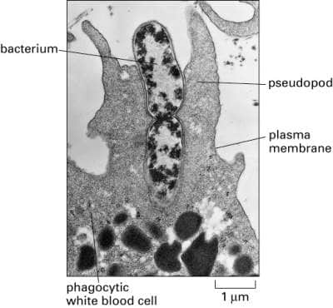

Slide 30
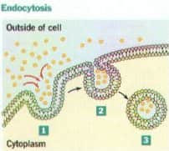
Receptor mediated endocytosis
This process is highly selective. Cell surface receptors pick up certain macromolecular substance whenever they become available in the cell’s micro environment. Substances that bind selectively and cell surface receptors are termed ligands. These ligands then become internalized.

Slide 31
Receptor mediated endocytosis
Almost all receptor mediated endocytosis occur at sites on the cell surface known as coated pits → shallow surface indentations where a fibrous protein called clathrin is intimately associated with the cytosol facing aspect of the cell membrane → coated vesicle → clathrin becomes detached before this vesicle fuses with a lysosome or any other membranous organells.

Slide 32
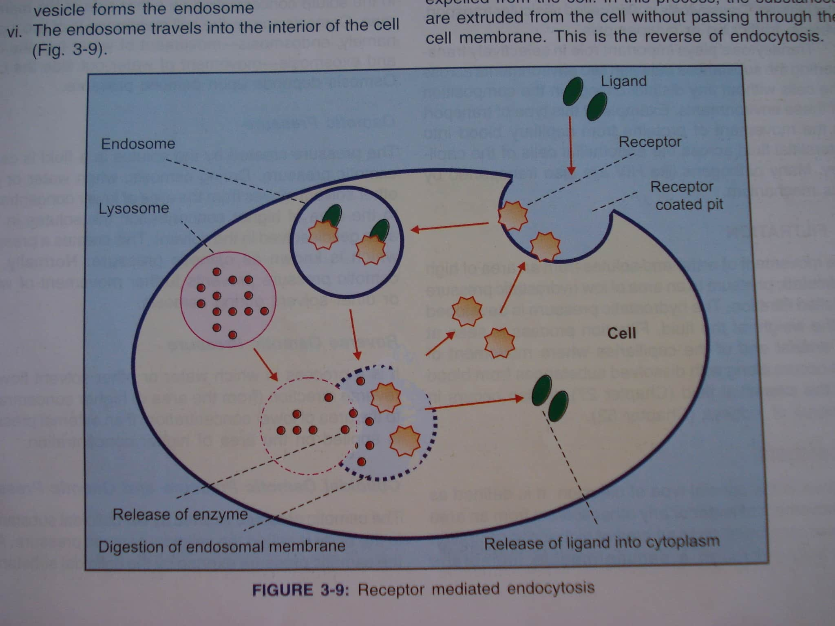
Receptor mediated endocytosis

Slide 33
Osmosis
Diffusion of water across a semi permeable membrane.
It occurs when a solute cannot pass through the membrane but the solvent can. Osmotic pressure is the force of osmosis. Tonicity is the relative concentration of solute on either side of the membrane.

Slide 34
Isotonic
The concentration of solutes on both sides are equal.
Hypotonic
The concentration of solutes is less in hypotonic solutions. Animal cells can lyse after gaining water due to osmotic pressure.
Hypertonic
The concentration of solutes is more Animal cell when in hypertonic solution undergoes crenation → a condition where the cell shrivels up as it loses water.

Slide 35
Bulk flow
Diffusion of large quantity of substances from a region of high pressure to a region of low pressure is known as bulk flow.
Bulk flow is due to the pressure gradient across the cell membrane and the best example for this is the exchange of gases across the respiratory membrane in lungs.

Slide 36
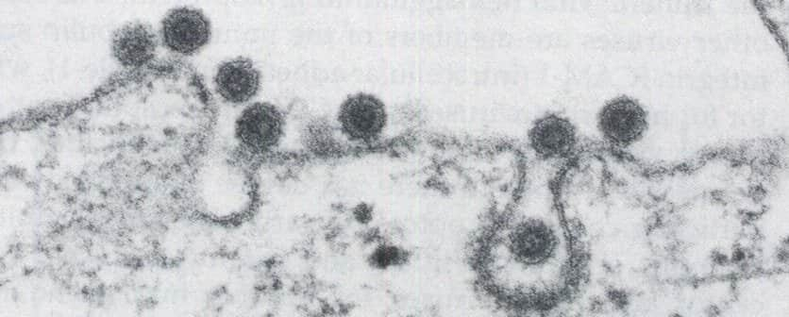
Exocytosis
Materials are expelled to the extracellular fluid. The residual bodies may be extruded from the cell by exocytosis.

Slide 37
Cell signaling
Achieved by signals like
Hormones
Neurotransmitter
Growth factor
This signal produces a response on the second cell

Slide 38
Signal transfer
Directly diffuse thru the membrane and act on its target site
Nitric oxide
Steroid hormones
Indirectly thru signal transduction mediated by a receptor

Slide 39
Signal transduction
It is an indirect mechanism in which the signal molecules act on the membrane to generate another compound that functions as a second messenger
It is mediated by a receptor

Slide 40
Signal transduction mechanisms
Auto phosphorylation of the receptor
Protein phosphorylation
Activation of
Protein phosphatase
Phospholipase
Adenyl cyclase
Sphingomyelinase
Ion channel activation

Slide 41
Cell signalling pathways
cAMP
Ras like proteins
Inositol 1,4,5 triphosphate (IP3)
Transcription factors belonging to steroid hormone receptor family

Slide 42
Most involve protein are kinases and protein phosphatases
Phosphorylation plays a central role
Serine, Threonine and Tyrosine kinases are the also commonly involved

Slide 43
cAMP and Adenyl cyclase
Present virtually in all organisms including bacteria
Adenyl cyclase synthesizes cAMP from ATP
Resides on cytoplasmic side of plasma membrane

Slide 44
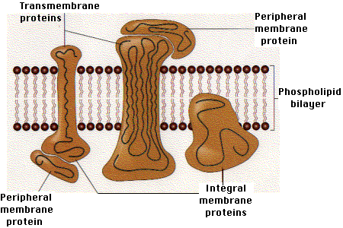
Receptor
Trans-membrane glyco-proteins
Extra cellular and cytoplasmic domains

Slide 46
Cell surface receptors
Ion linked receptors
G –protein coupled receptors
Receptors that linked to enzymes system

Slide 47
G – proteins linked receptors
They are guanine nucleotide binding proteins
Links cAMP with the receptors
Has 3 sub units
Belong to structural group of proteins
They pass through the membrane 7 times in a series of serpentine loops

Slide 48
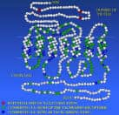
G-PROTEIN LINKED RECEPTORS
7 transmembrane loops(seven spanning receptors)
Associate with a variety of important features
Ex: receptors for the inflammatory chemokines as well as hormones epinephrine and glucagon

Slide 49
G- proteins
Inactive state
Bound with GDP
No receptor contact
Mutation in G proteins is found to be a genetic etiological factor in Fibrous dysplasia and Meccure-Albright’s syndrome

Slide 50
Disease | Abnormality
Achondroplasia | Mutations in the gene encoding the fibroblast growth factor receptor
Familial hypercholesterolemia | Mutations in the gene encoding the LDL receptor
Cystic fibrosis | Mutations in the gene encoding the CFTR protein, Cl transporter
Congenital long QT syndrome | Mutations in genes encoding ion channels in the heart
Wilson disease | Mutations in the gene encoding a copper dependent ATPase
I-cell disease | Mutations in the gene encoding GIcNAc phosphotransferase, resulting in absence of the Man 6-P signal for lysosomal localization of certain hydrolases
Hereditary spherocytosis | Mutations in the genes encoding spectrin or other structural proteins in the red cell membrane
Metastasis | Abnormalities in the oligosaccharide chains of membrane glycoproteins and glycolipids are thought to be of importance
Paroxysmal nocturnal hemoglobinuria | Mutation resulting in deficient attachment of the GPI anchor to certain proteins of the red cell membrane

Slide 51
CYTOPLASM
Cytoplasm is the fluid present inside the cell. It contain a clear liquid portion called as Cytosol and various particle of different shape & size. It surrounds the nucleus and bounded by plasma membrane

Slide 52
CYTOPLASMIC ORGANELLES
Membrane organelles
→Cell membrane
→Mitochondria
→Endoplasmic reticulum
→Golgi apparatus
→Secretory granules
→Lysosomes
→Perioxomes

Slide 53
Non Membrane organelles
→Ribosomes
→Microtubules
→Filament
→Cilia & Flagella

Slide 54
CYTOPLASMIC INCLUSIONS
Stored food
→ Glycogen, Fat
Pigments
→Carotene,Hb,Haemosiderin,
Bilirubin,Melanin,Lipofuschin

Slide 55
Endoplasmic reticulum
Reticulum -means Strands and vesicles arranged in the form of network.
Endoplasmic - means that they are located within the cytoplasm of the cell.
Location in the cell
Next to the nucleus and the Endoplasmic Reticulum has direct contact with nucleus since it descends from the nucleus.
The ER is a network of membrane-sacs or tubules called cisterns that extend throughout the cytoplasm and connect to nuclear envelope.

Slide 56
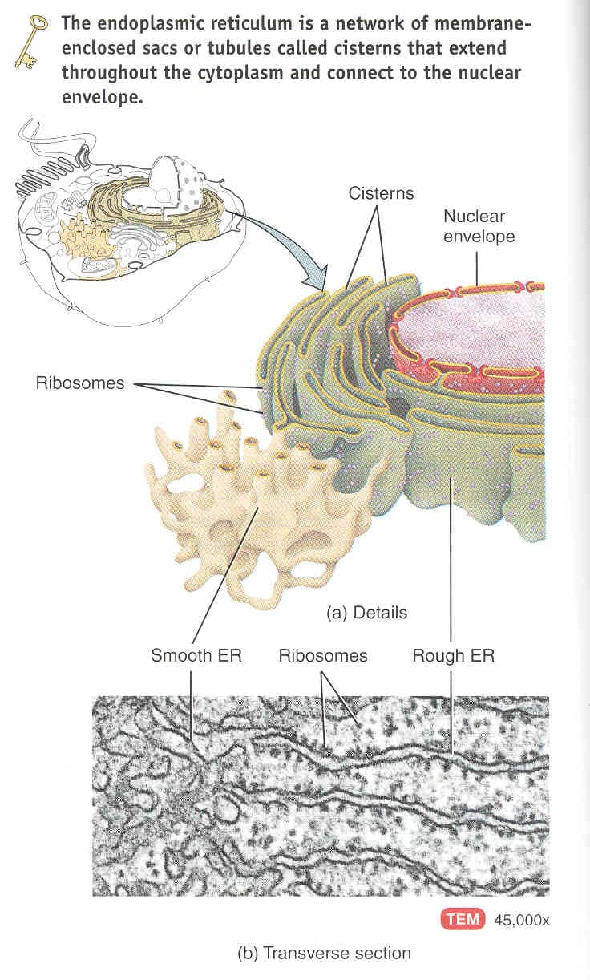
.
ROUGH ENDOPLASMIC RETICULUM
The Ribosomes studded region of ER is termed as Rough ER.
It is made up of large parallel flattened membranous sacs called Cisternae, the limiting membrane of which is studded with ribosomes.
SMOOTH ENDOPLASMIC RETICULUM
Continuation of Rough ER is made up of ramifying smooth surfaced membranous tubules.

Slide 57
Smooth Endoplasmic Reticulum
Smooth ER extends from the rough ER to form a network of membranous tubules.
Smooth ER does not have ribosomes on the outer layer of its membrane.
Smooth ER contains unique enzymes that make it functionally more diverse than rough ER.
Functions of Smooth ER
Smooth ER synthesizes phospholipids, fats and steroids such as estrogens and testosterone.
In liver cells, enzymes of smooth ER help release glucose into the blood stream and inactivate or detoxify drugs and other potentially harmful substances for example Alcohol.

Slide 58
Functions of Rough ER
Protein synthesis
Sequestration of calcium
Insertion of membrane protein
Segregation of lysosomal enzyme as well as secretory protein from the remainder of the cytoplasm.

Slide 59
Role of Rough ER
Their main function is to elaborate secretory proteins or glycoproteins so they are present abundantly in the following cells:
Enzyme producing cells of pancreas
Protein secreting cells such as fibroblast and osteoblast.
Plasma cells which synthesize humoral antibodies.

Slide 60
GOLGI COMPLEX
Discovered by Camillo Golgi in 19th century by silver Impregnation Technique.
It is made up of membranes which form the walls of number of flattened sacs that are stacked over one another . Towards their margins the sacs are continuous with small rounded vesicles.

Slide 61
It has 3 regions
Near the nucleus →CisGolgi/Cis face
Opposite side → Trans face/Trans Golgi
Intermediate part → Medial Golgi

Slide 62
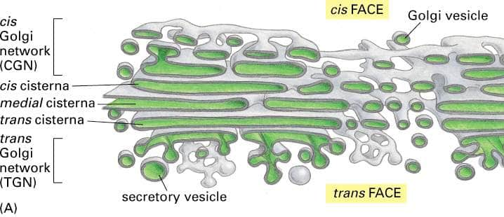

Slide 63
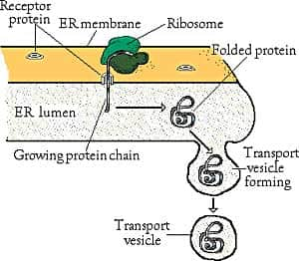
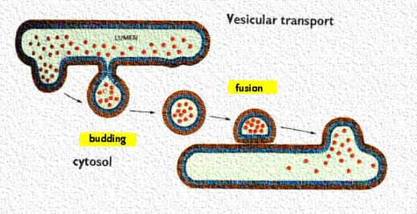
Transportation of Proteins to Golgi Apparatus
Proteins that are synthesized are transported through the tubules towards the portions of smooth ER that lie nearest to the golgi apparatus.
Small transport vesicles composed of small envelopes of smooth ER continually break away and defuse to the cis-part of the gogi apparatus.
The movement of the special transport vesicles is an energy requiring process. If the production of ATP is blocked the transport will not happen.
A drug Brefeldin-A blocks the transfer of proteins to the golgi complex.

Slide 64
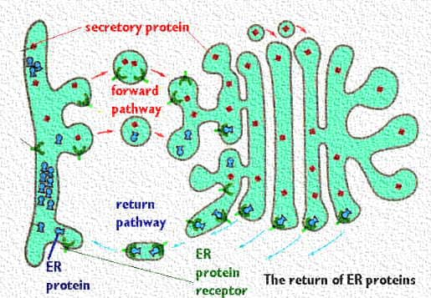
Proteins transported back to Rough ER
Sometimes vital proteins needed in the rough ER are transported along with the other proteins in the golgi complex. The golgi complex has a mechanism for trapping them and sending them back to rough ER.
RER has inserted a receptor protein on the membrane which it sends to golgi complex in the vesicles.
ER protein receptor captures all of the protein that carries the ER residency signal.
Vesicles then bud from the golgi complex and move back to the rough ER. The receptor can circulate and continue to return the proteins needed by the ER.

Slide 65
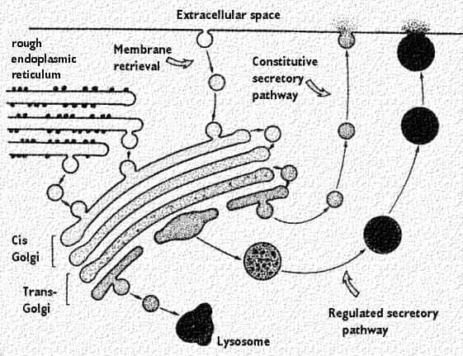
Protein Packaging

Slide 66
Golgi is not a static cell organelle . It Break up & disappears at the onset of mitosis .By telophase it reappears

Slide 67
LYSOSOMES
MEMBRANE BOUND VESICULAR ORGANELLES
FORMED FROM GOLGI COMPLEX
CONTAIN HYDROLYTIC ENZYMES
60 DIFFERENT HYDROLYTIC ENZYMES HAVE BEEN IDENTIFIED
HAVE HIGH ACIDIC PH-5
MEASURE ABOUT 200- 800 nm

Slide 68
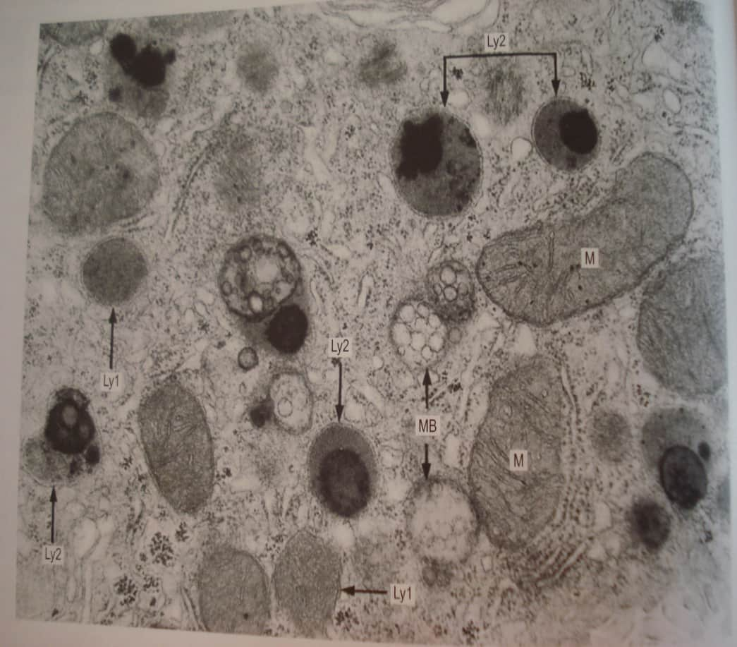
Types
PRIMARY – PINCHED OF FROM GOLGI AND IS IN ACTIVE
SECONDARY-ACTIVE AND FORMED FROM PRIMARY LYSOSOMES

Slide 69
2 mechanisms are involved in its function
1) heterophagy
2) autophagy
Degradation of macro molecules
Degradation of worn out organelles
Removal of excess secretory products in the cells
Secretory function

Slide 70
Lysosomal storage diseases:--
If any of the lysosomal enzymes are defective due to gene mutations,the materials accumulate within late endosomes and lysosomes .
e.g---Tay- sachs diseases
hurlers syndrome

Slide 71
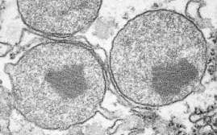
PERIOXOMES
MEMRANE BOUND STRUCTURES
CONTAIN ENZYMES WHICH REACT WITH SUBSTANCES TO FORM HYDROGEN PEROXIDE
DETOXIFY VARIOUS SUBSTANCES
PROMINENT IN CELLS OF LIVER,RENAL TUBULES

Slide 72
CENTROSOMES AND CENTRIOLES
THESE ARE THE ORGANELLES SITUATED NEAR THE CENTER OF THE CELL CLOSE TO THE NUCLEUS AND CONSIST OF 2 STRUCTURE CALLED CENTRIOLES.
THEY ARE CYLINDRICAL IN SHAPE AND MADE UP OF PROTEINS
THEY ARE SEEN AS SHORT CYLINDERS THAT ARE ARRANGED AT RIGHT ANGLES TO EACH OTHER
THERE ARE 9 GROUP OF TUBULES AND EACH GROUP CONSIST OF 3 TUBULES
FORM MITOTIC SPINDELS, CILIA ,FLAGELLA

Slide 73
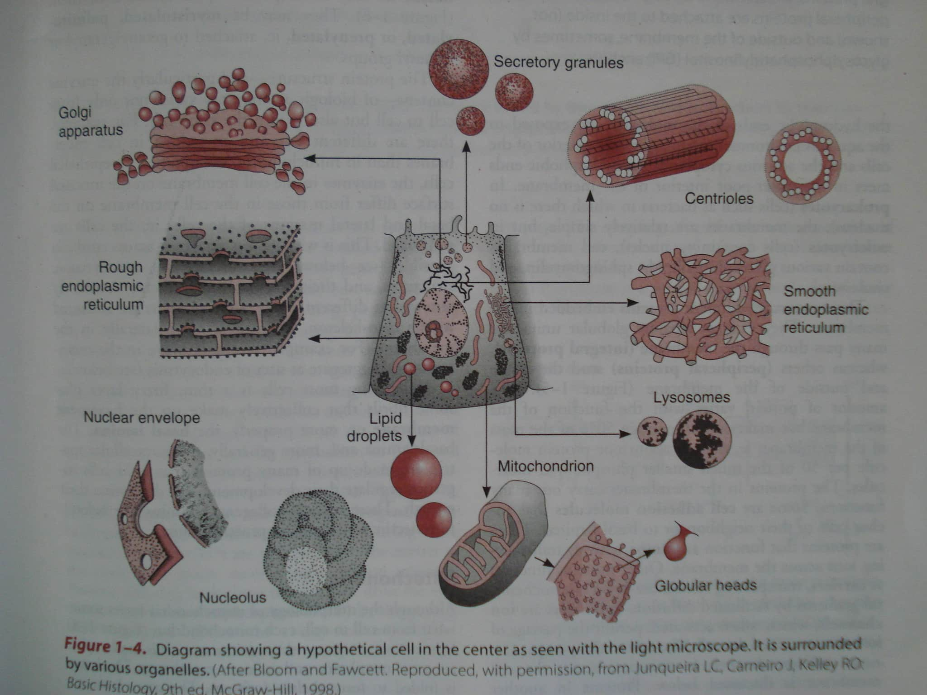

Slide 74
MITOCHONDRIA
MITOS-GRANULES CHONDRIUM –ROD
THEY ARE BILAYERD MEMBRANOUS ORGANELLE
SIZE -.5-1µm
NUMBER VARIES IN DIFFERENT CELLS AND IS HIGHEST IN SECRETORY CELLS

Slide 75
DIVIDE BY BINARY FISSION AND CAN MOVE FREELY IN THE CELL
THEY ARE ALL DERIVED FROM THOSE FOUND IN FERTILISED OVUM AND ARE OF MATERNAL ORIGIN
CAN BE SEEN IN L/M BY SPECIAL STAINS –JANUS GREEN B,PINACYANOL

Slide 76
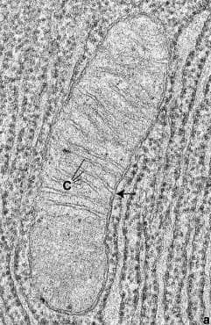
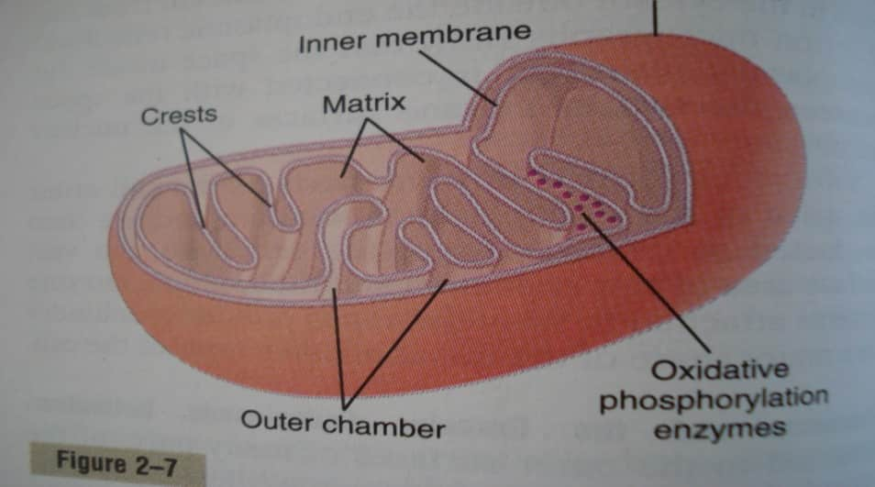
STRUCTURE
OUTER MEMBRANE
INNER MEMBRANE
CRISTAE
MATRIX
ELEMENTARY
PARTICLES WHICH
CONTAIN F-I COUPLING
FACTORS

Slide 77
FUNCTION
They are the sites of citric acid cycle and electron transport (cytochrome) pathway by which complex organic molecules are oxidised to carbon dioxide and water. This process provides energy to drive the production of ATP from ADP and in organic phosphate(oxidative phosphorylation)

Slide 78
Mitochondria and cell injury
Mitochondrial integrity is critical for cell survival
It directly or indirectly end up as targets of most types of injury
Increase in cytosolic ca,intracellular oxidative stress ,lipid breakdown products all culminate in the formation of high conductance channels of inner mitochondrial membrane also called as the mitochondrial permeability transition

Slide 79
These non selective pores allow the proton gradient across the mitochondrial membrane to dissipate, there by preventing ATP generation
Cytochrome C also leaks out in to the cytosol and activates apoptotic death pathways

Slide 80
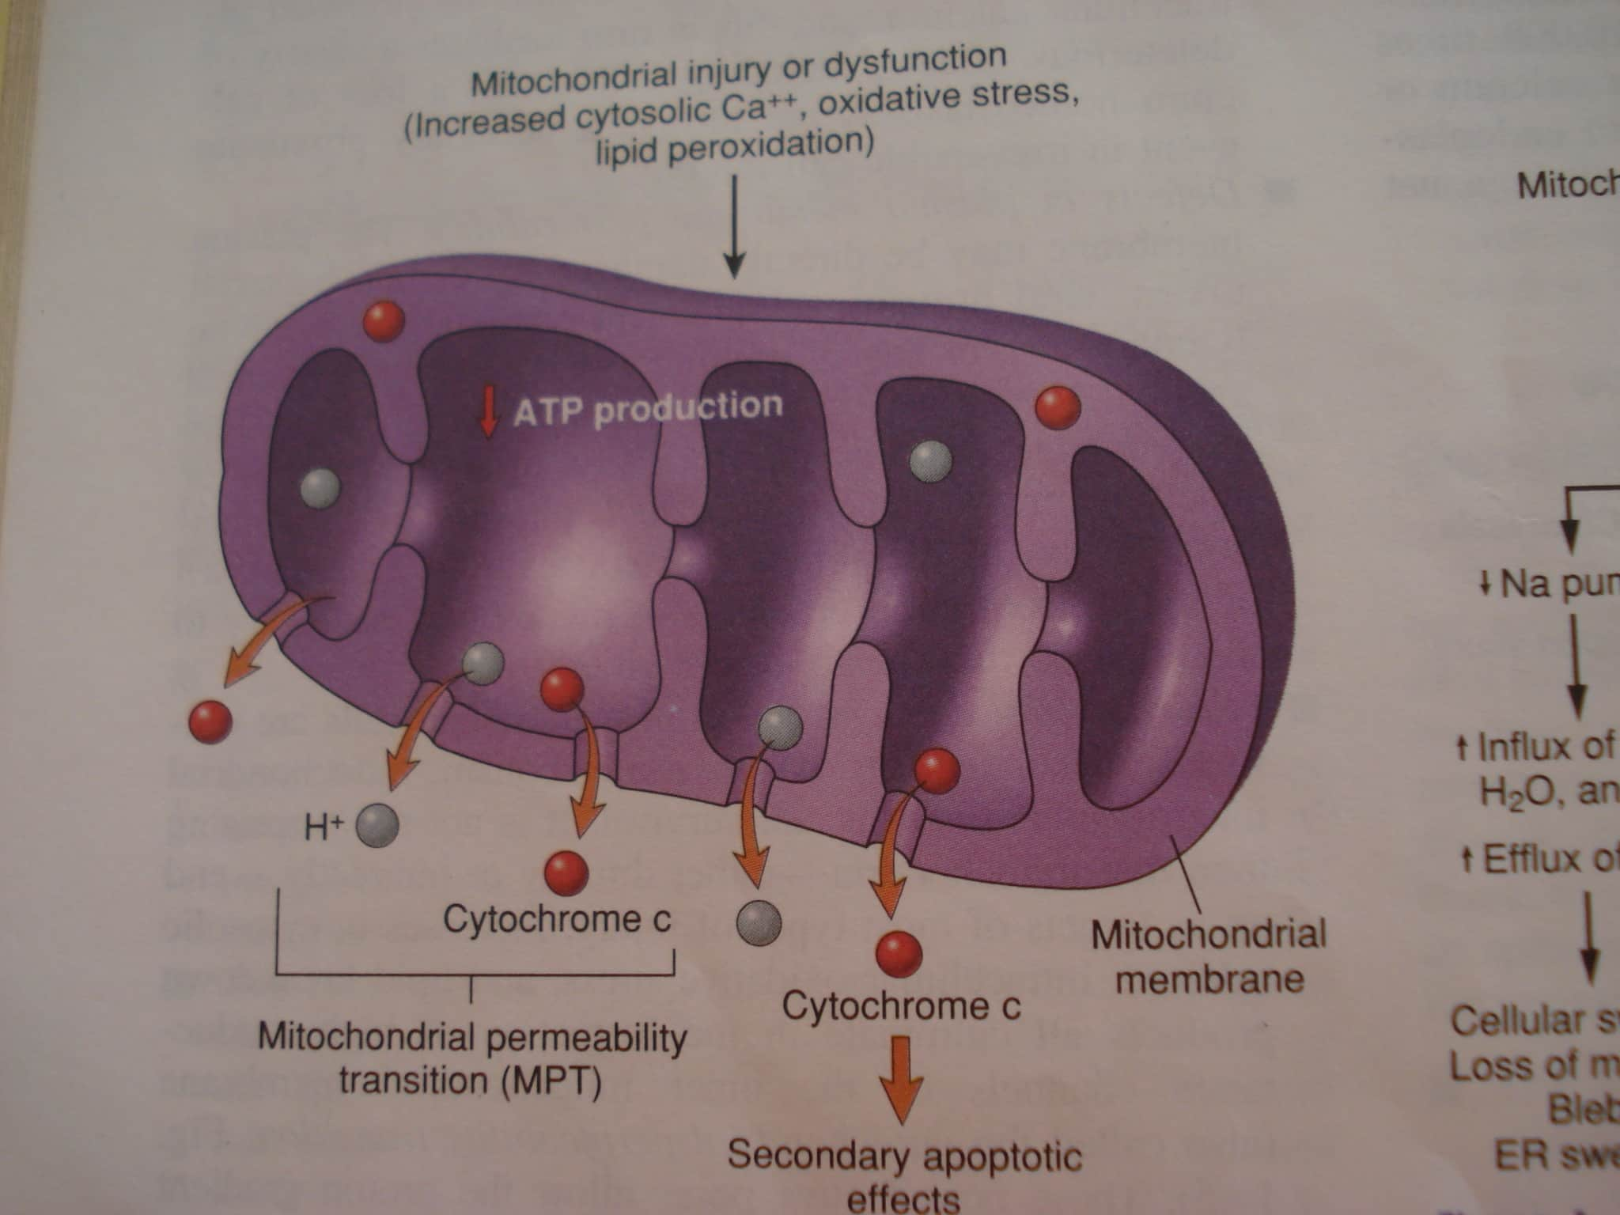

Slide 81
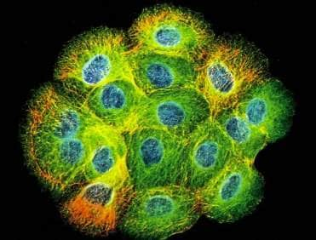
Cytoskeleton
Immunofluorescence micrograph showing immunostaining of cytokeratin fibers in human keratinocytes (green fluorescence)
Nuclei are stained with a DNA-specific dye (blue fluorescence)
Eukaryotic cells possess a cytoskeleton
Mechanical support for cells (and tissues via junctions)
Mediates changes in cell shape (movement and cytokinesis)
Responsible for movement of chromosomes during mitosis
Required for phagocytosis and vesicle movement (motors)
Does not extend into or through nucleus or other organelles
Notes:
Clump of 16 cells. Cytoskeleton not found in prokaryotes and archaea.

Slide 82
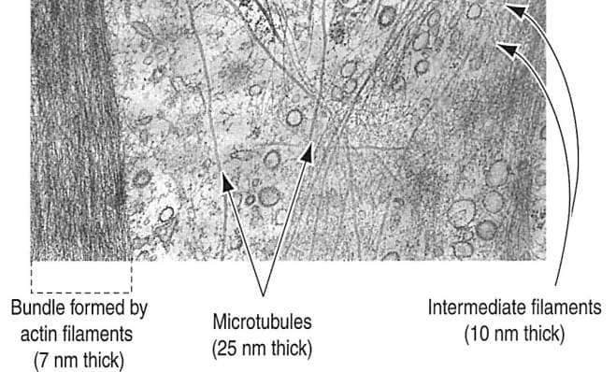
Cytoskeleton
Microfilaments - composed of actin, ~7 nm in diameter
Intermediate filaments - composed of IF proteins (e.g., keratin, vimentin), ~10 nm in diameter
Microtubules - composed of tubulin, ~25 nm in diameter
Notes:
Cytoskeletal fibers are often difficult to visualize by traditional EM. Special EM techniques enhance their detection. Many EMs are of regions of cells in which cytoskeletal fibers are abundant, but their are not visible.

Slide 83
Microfilament
Made up of protein actin and individual unit are globular G-actin polymerise to form long chains called as F actin filaments
Actin filaments form a network adjacent to cell membrane called as Cell cortex. They are held together by protein called as Filamen. The mesh work of cell cortex is labile & filaments can separate &reform in different direction

Slide 84
These are associated with soluble myosin and serve as intracelluar junction as a web beneath cell membrane

Slide 85
INTERMEDIATE FILAMENTS
They are not contractile but maintain cell shape & contact between adjacent cell & ECM.
Link cell together & are attached to transmembrane protein at desmosomes .
They facilitate cell attachment to EC elements at hemidesmosomes

Slide 86
They are divided into 5 subclasses :-
Keratin →Epithelial cell
Glial filaments →Astorocytes
Neuro filament →nerve cell
Vimentin →Muscle fibers , fibroblast
Desmin → muscle fibers

Slide 87
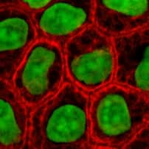
Cytokeratins
These are present in tonofilaments of epithelial cells
These are multigene family of proteins with which 2 sub families are recognised
1)Basic proteins(52-67kDA)
2)Smaller(40-56kDA)
3)More acidic proteins (9-20kDA)

Slide 88
CYTOKERATINS OCCUR AS LINKED ACID &BASE PAIR WITH DIFFERING DISTRIBUTIONS IN DIFFERENT TYPES OF EPITHELIA
ITS EXPRESSION PATTERN HAS BEEN USED TO DETERMINE THE RELATIONSHIP B/W DIFFERENT CELLS AND AS INDICATION OF ORIGIN OF VARIOUS TUMORS

Slide 89
MICROTUBULES
CONTAIN PROTEIN TUBULIN
CHAINS OF TUBULIN FORM PROTOFILAMENTS
WALL OF MICROTUBULES MADE UP OF 13 PROTOFILAMENTS THAT RUN LONGITUDINALLY
PROVIDES INTERNAL SUPPORT FOR THE CELLS
ACT AS GUIDE PATHS AND PART OF THE MOTOR MECHANISMS FOR THE MOVEMENT OF SECRETORY VESICLES &OTHER ORGANELLES THEY ALSO POSITION CERTAIN ORGANELLES WITHIN THE CELL

Slide 90
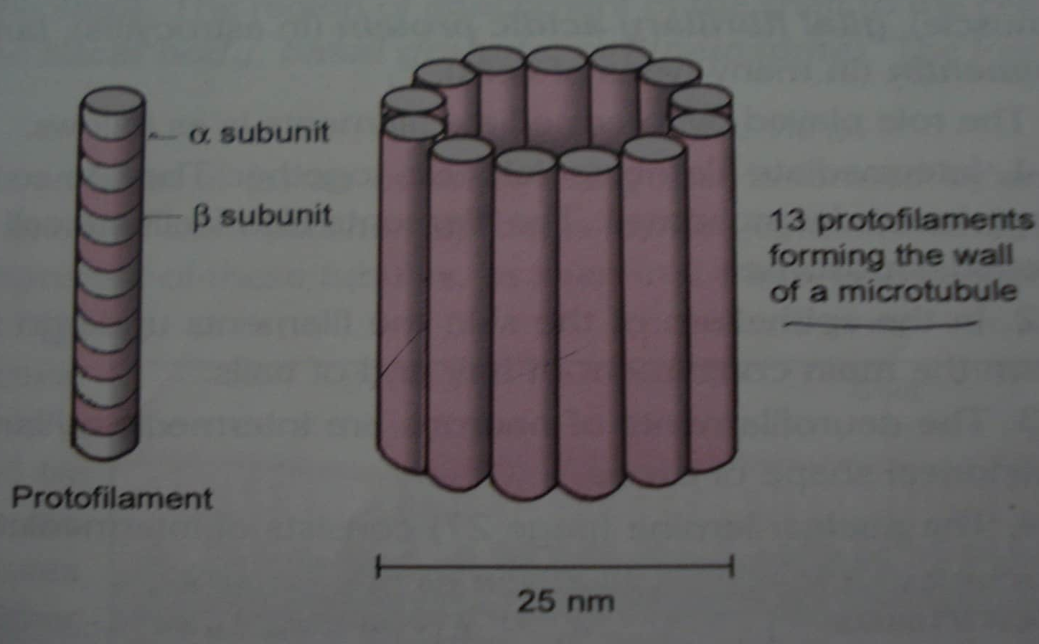

Slide 91
Projections from the cell surface
Cilia
Flagella
Micro villi
Basolateral folds

Slide 92
CILIA
HAIR LIKE PROJECTIONS
.25µm in diameter
Contain protein dyenin and nexin
Movement is in co ordination with one another and the total effect being like wave
They can also serve as sensory organelles

Slide 93
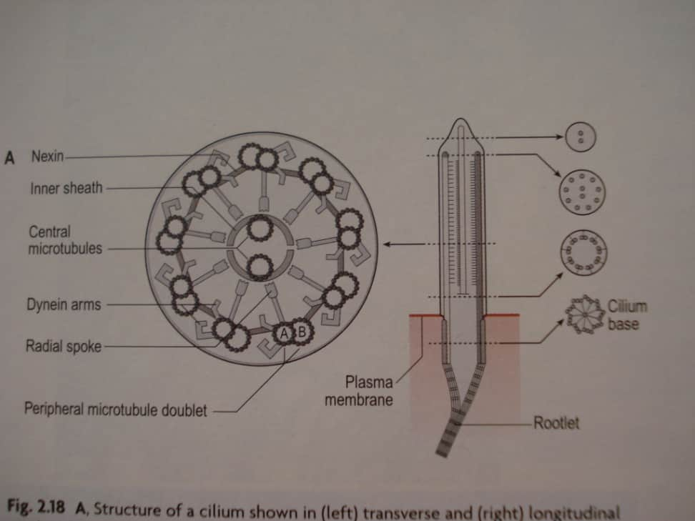
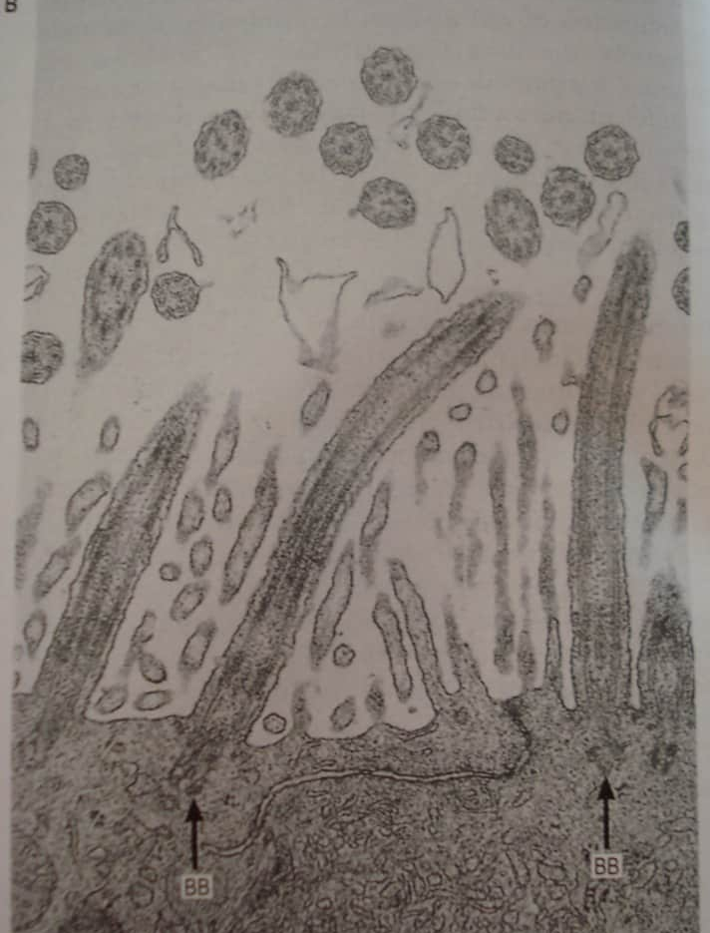

Slide 94
Flagella
Large process having basic structure as cilia
Movement is different from that of cilia
Segment near the base bends in one direction followed by bending of succeding segments in opp direction

Slide 95
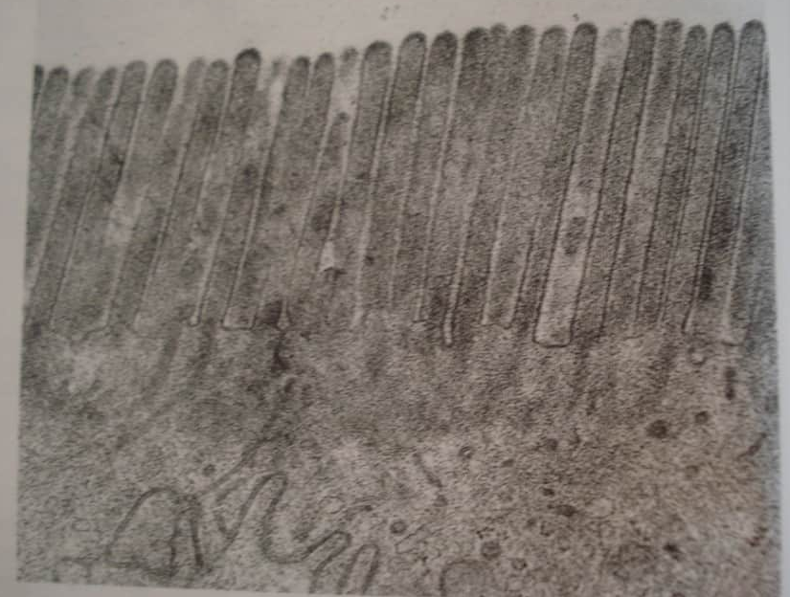
Microvilli
Increase the surface area of the cell and are seen at the site of active absorption
Finger like projections from the cell surface

Slide 96
Nucleus
It is the largest intra cellular structure and the most dense part of the cell
It is usually rounded or ellipsoid and occasionally it may be elongated ,indented or lobed .
It is 3-10µm in diameter
In H/ E it stains dark purple or blue and cytoplasm stains pink

Slide 97
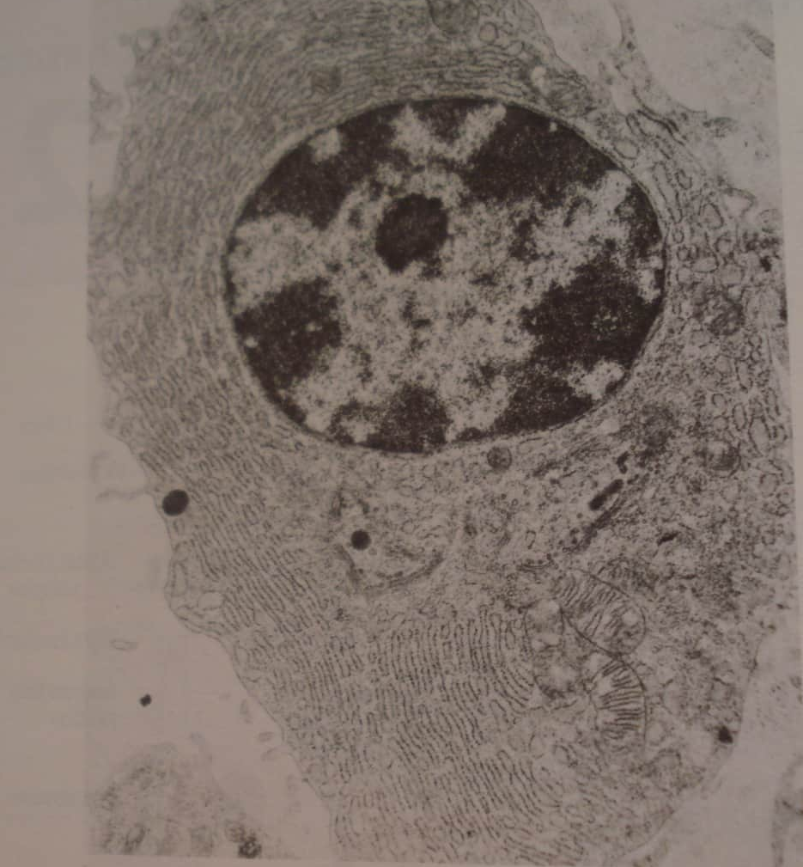
Heterochromatin –irregular dark masses of chromatin that stain darkly in some areas of the nucleus
Euchromatin –network of chromatin which is loose and stains lightly

Slide 98
Open face nuclei-nuclei which contain large areas of euchromatin
Closed face nuclei-nuclei that are made up of mainly heterochromatin

Slide 99
Structure of the nucleus
Nuclear membrane or nuclear envelope
Nuclear pore complex
chromatin
DNA and proteins called histones
Nucleoli
DNA concentrations
Control RNA synthesis

Slide 100
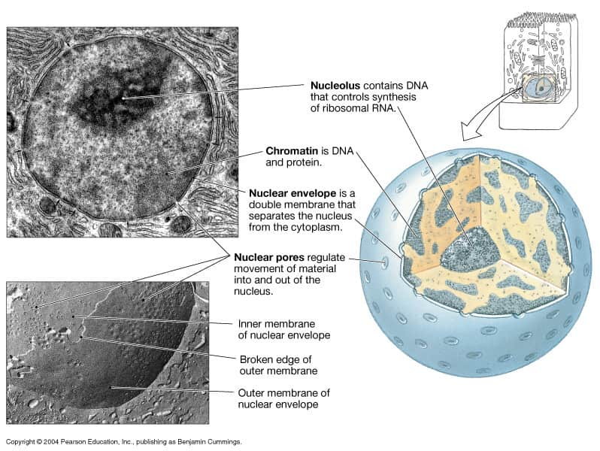
Nucleus

Slide 101
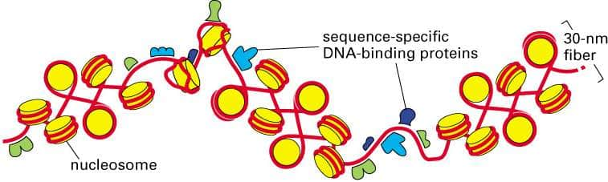
chromatin
Chromatin - DNA and DNA-binding proteins
Histones - most common DNA-binding proteins
Nucleosome - short cylinder of histones and DNA
Chromatin (30 nm) fiber - packages DNA in nuclei
Compaction - DNA is highly compacted (>1000-fold)
Sequence-specific DNA-binding proteins - regulate structure and function of chromatin fiber

Slide 102
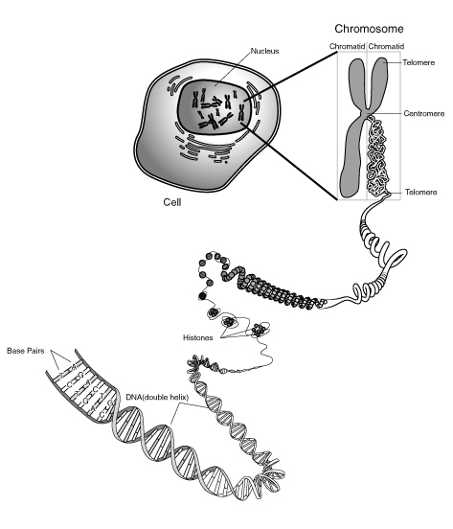

Slide 103
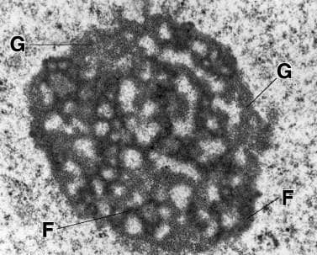
Nucleolus
Synthesis of ribosomal RNAs and ribosomal subunits
Different regions carry out transcription, processing, and assembly of pre-ribosomal RNA into subunits
Large and small subunits are exported to cytoplasm, where they bind an mRNA to form functional ribosome

Slide 104
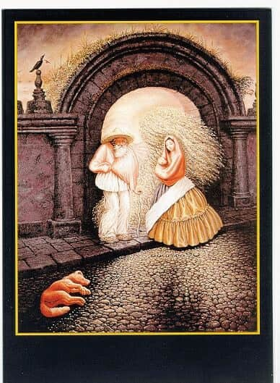
Thank you

