Slide 1

DIET COUNSELING

Slide 2
During pre eruptive period food exerts nutritional effect on formation of teeth & during post eruptive periods exert a dietary & topical effect.
Notes:
Underconsumption: iron deficiency anaemia, calcium inadequacies making the child to become more prone for osteopetrosis at an elderly age. Zinc inadequacies may result in dwarfism, hypogonadism and delayed sexual maturation. Its also needed for proper wound healing. Also neonatal vitamin A deficiency may cause defective formation of teeth. Acute deficiencies of ascorbic acid/ folic acid can severely alter epithelial functions, particularly sulcular epithelium as found by Alfano et al.
Severe Vitamin C deficiency causes petechial hemorrhages, tenderness of lower extremities and swelling of joints. Bone is thin and bone trabeculation is diminished. Failure of odontoblast to form osteoid at the epiphyseal plate. Teeth are qualitatively and quantitatively defective.
Vitamin A,C,D defi cause enamel hypoplasia.
Increased fat consumption may make kids prone to hypercholesterolemia, also obesity…but one should not skip breakfast .. eating breakfast helps to reduce dietary fat intake and minimizes impulsive snacking, thereby contributing to overall weight reduction program.
Anorexia nervosa – characterized by self-imposed weight loss, amenorrhea and a distorted attitude toward eating and body weight. Bulimia nervosa characterized by binge eating and invariably self-induced vomiting.

Slide 3

Frequency of between- meal snacking
Physical form & retentiveness of sugar-sweetened snacks on and between teeth
Amount of sugar added to food or beverages for sweetening
Diet
Counselling give attention ..
“The frequency of eating the amount of food retained in the mouth particularly on tooth surfaces and length of time that food residues are retained in critical areas are imp than the amount of sugars consumed.”
Nizel: Diet counselling involves giving advice on food selection based on the individual reason for liking or not liking certain food.
Notes:
Shaw stated that…The frequency of eating, the amount of food retained in the mouth particularly on tooth surfaces and length of time that food residues are retained in critical areas are more important than the total amount of sugars consumed.”
Involves giving advice on food selection based on the individ reason for liking or not liking certain food.

Slide 4
Caries prevention
Age appropriate anticipatory guidance
Diet Imbalance
Objectives
Notes:
Main objective of dietary councelling in pediatric oral health is caries prevention
Every dental patients diet should be screened & age appropriate anticipatory guidance should be provided
Correction of diet imbalance, that could affect the patients general health & sometimes reflect his oral health

Slide 5
What should a diet prescription consist of ????
A nutritionally balanced varied diet from the high-density nutritious basic four food groups
Eliminate high-sugar snacks
Restrict sugar containing foods to mealtime when the organic acids may undergo neutralization
Recommend hard cheese and nuts as between-meal snacks
Notes:
nizel

Slide 6
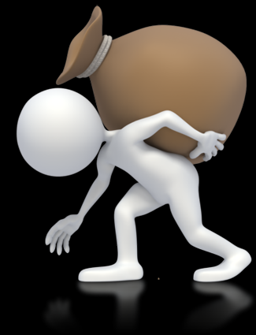
Patient bears the Responsibility
Active patient involvement
Evaluation of diet before & after counselling
Follow up to tailor the diet
Consider patient’s likes, dislikes if possible
Notes:
Diet counselling won’t work with all types of patients. They must be willing to improve current undesirable food selections & eating habits. Patients need to have a positive attitude.
Patient not the councellor bears the responsibility for making the change. Councellor should explain the need for full cooperation & a sincere effort by the patient to modify the diet & patient should agree

Slide 7
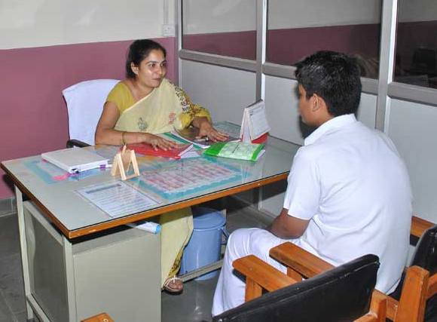
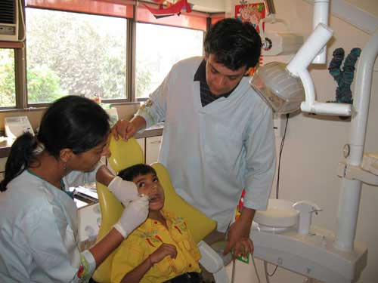



Where should counselling take place?

Slide 8

Who should provide diet counselling?
Dentist
Dental hygienists
Professional nutritionist or dietician
Notes:
Shobha tondon

Slide 9

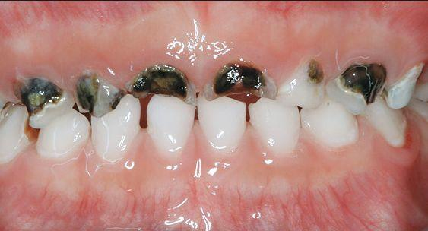
Who should receive counselling?

Slide 10

Sedentary women and some older adults
Most children, teenage girls, active women and sedentary men..
Teenage boys, active men and very active women
Notes:
..sample diet for 1 day at different calorie levels…*1..being greater for preg and breast feeding women..young adults to age 24..
Mc donald pg 221

Slide 11


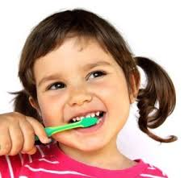
Patient selection
Notes:
Attitude
Demonstrable need for dietary improvement
Diet councellin will not succed with every dental patient. Persons who need councelling must also wants information about their potential dental caries problem & must be willing to improve current undesirable food selections & eating habits.

Slide 12

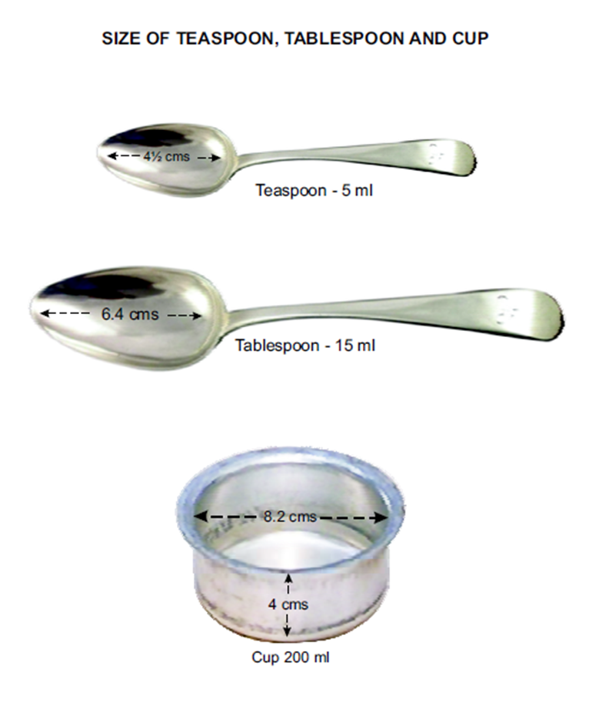
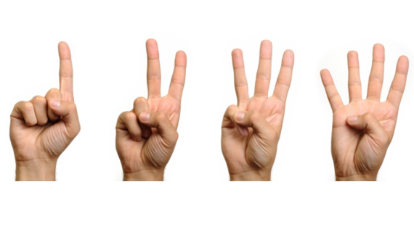
Calculating a Dental Health Diet Score…
List everything you have eaten/drank
ORDINARY WEEKDAY!
Amount ingested
Time
How was the food prepared?
No. of teaspoons of sugar added

Slide 13
Circle the foods sweetened with added sugar or are concentrated with natural sugars
The other foods…FOUR FOOD GROUP
Notes:
Natural sugars…foods like honey, raisin, figs etc

Slide 14
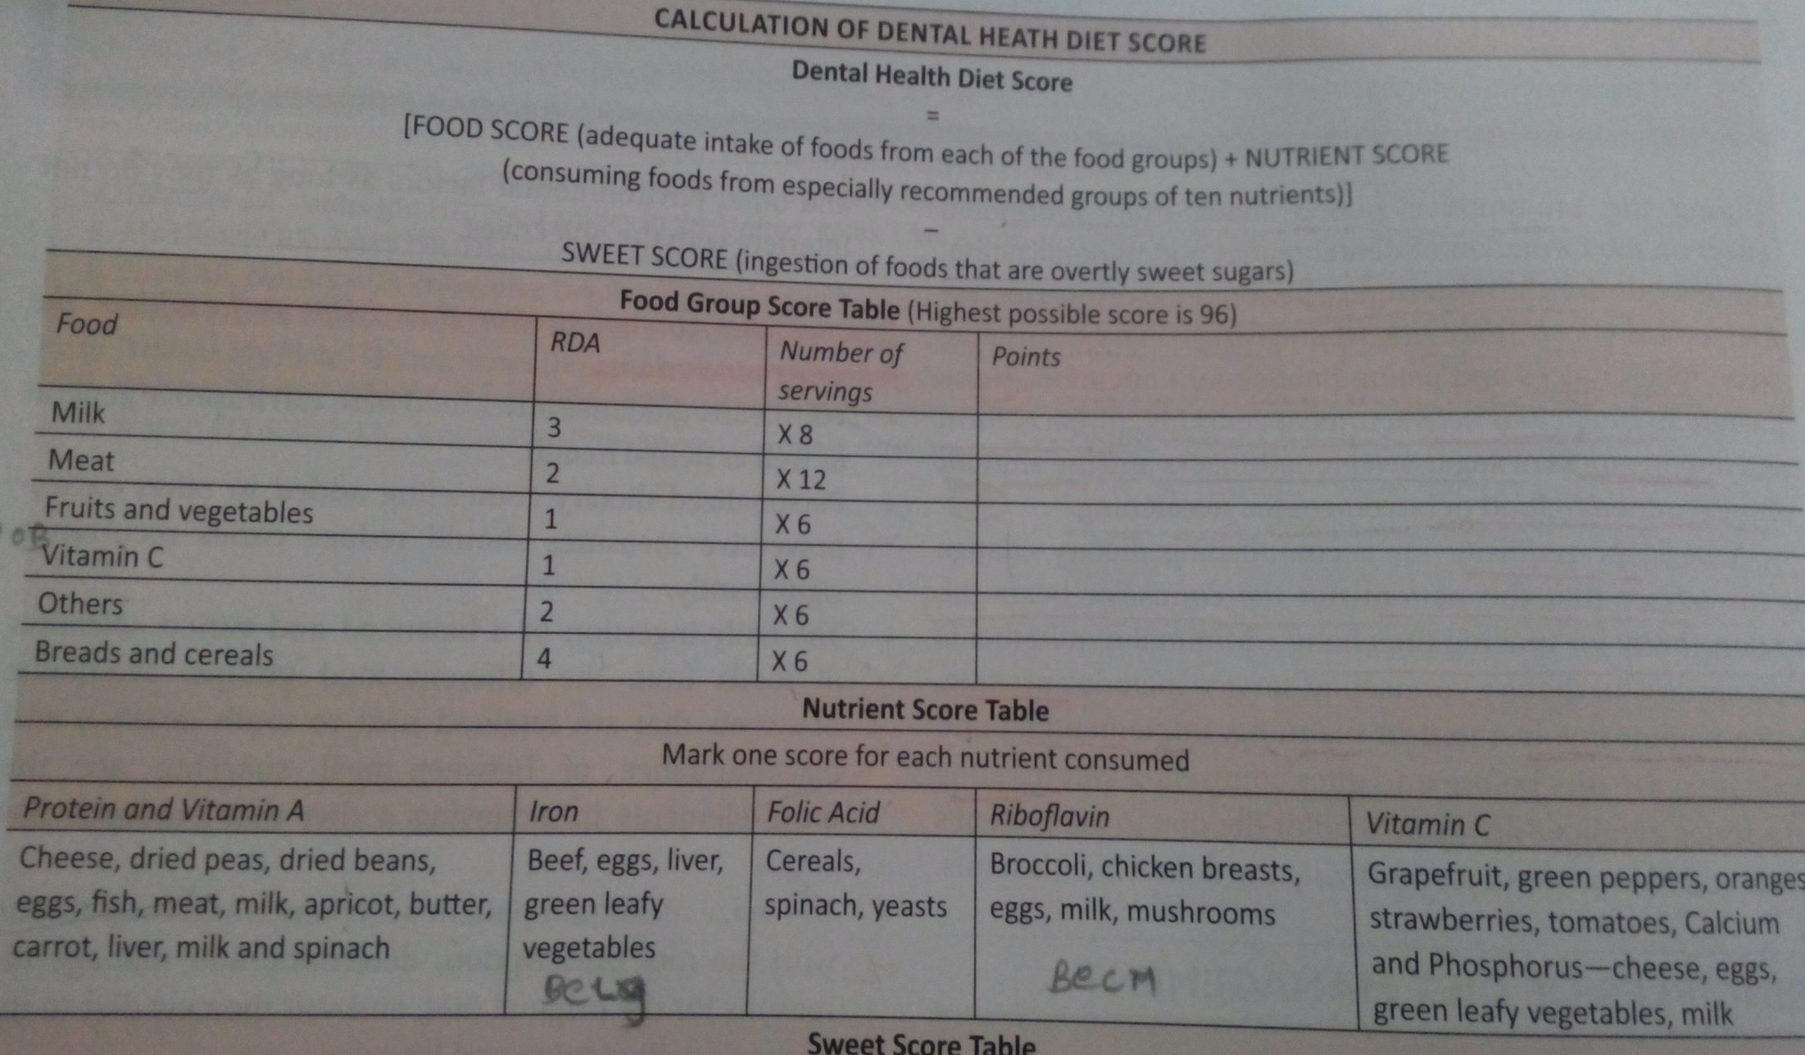

Slide 15
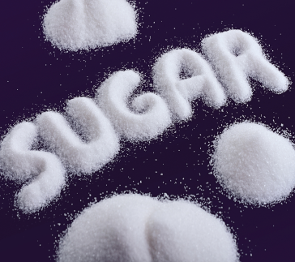

Form | Frequency | Points
Liquids (Soft drinks, fruit drinks, cocoa, sugar and honey in beverages, nondairy creamers, ice cream, sherbet, gelatin dessert, flavoured yogurt, pudding, custard, popsicles) | X 5 =
Solid and sticky (Cake, cupcakes, donuts, sweet rolls, pastry, canned fruit in syrup, bananas, cookies, chocolate candy, caramel, toffee, jelly beans, other chewy candy, chewing gum, dried fruit, marshmallows, jelly, jam) | X 10 =
Slowly dissolving (Hard candies, breath mints, antacid tablets, cough drops) | X 15 =
Sweet evaluation chart
Notes:
Classify the foods in the diet..on a ordinary weekday…each sweet taken at a gap of 20 minutes can be considered as a separate episode.

Slide 16


Sweet score | Interpretation
5 or less | Excellent
10 | Good
15 or more | “Watch-out” Zone
Score | Interpretation
72-96 | Excellent
64-72 | Adequate
56-64 | Barely adequate
56 or less | Need nutrition counselling
Notes:
Barely adequate/ not adequate…one needs to do nutrition counseling
If sweet score falls in watch out zone…improvements are required!

Slide 17

COMMUNICATION TECHNIQUES
Giving & receiving information
3 mantras:
    Face-to-face interviews ( eye contact, powerful, persuasive)
    Verbal & nonverbal means ( facial expression, gestures, sincerity, enthusiasm)
    Adapted to pts. needs
Notes:
Basic tool
Giving + receiving – information
3 rules for effective communication-
Face to face interview keeping eye contact
Verbal/non verbal
Personalization of message according to patients needs and level of understanding

Slide 18
Interviewing
Purpose -
-Understand the prob, factors contributing to it & personality of patient
Physical setting –
- Relaxed comfortable environment, with chairs, table, blackboard & visual aids

Slide 19
Diet interviewer:
Skill, time,
Knowledge of science & nutrition,
Familiarity with ways in which food habits formed &
Factors that affect this habit.
Physical setting:
Relaxed atmosphere,
Separate counselling room…
Discuss food habits & respect patient feelings.

Slide 20
INTERVIEWING
THE PATIENT
Brief introductory statement- purpose of interview
Questions that encourage patients to speak out
Listen before you speak
Allow patient to make choices.
End by recapitulating what the patient has learned and the future action agreed upon.
Notes:
Interview should be relaxed & help patient…
Brief introductory statements…
Ask questions that are encourage…
Allow patient to talk freely.
Listen before speaking.
Encouraging & sympathetic

Slide 21

TEACHING
AND
LEARNING
Not just simply giving information but also presentation of information so as to have an impact strong enough to bring about the change.
The num of teaching aids includes:
Booklets
Pamphlets
Visual aids
Blackboard & chalk
Paper pad & pencil
Notes:
Patient education Is more than simply giving information, it requires the presentation of information with sufficient impact to stimulate action by learner.
Not just simply giving information but also presentation of information so as to have an impact strong enough to bring about the change.
The num of teaching aids includes:
Booklets
Pamphlets
Visual aids
Blackboard & chalk
Paper pad & pencil

Slide 22
COUNSELLING
DIRECTIVE
NON-DIRECTIVE
Patients role- passive
Patient- decisions
Counselor- decisions
Counselor- clarifies and helps patient to understand his own situation.

Slide 23
GUIDELINES
GATHER INFORMATION- likes, dislikes ,pts perception
EVALUATE & INTERPRET INFORMATION- adequacy of diet & eating habits
DEVELOP & IMPLEMENT PLAN OF ACTION- qualitative modifications of diet
PARTICIPATION OF PATIENT’S FAMILY
FOLLOW UP
Notes:
GATHER INFORMATION
EVALUATE & INTERPRET INFORMATION
DEVELOP & IMPLEMENT PLAN OF ACTION
SEEK ACTIVE PARTICIPATION OF PATIENT’S FAMILY
FOLLOW UP TO ASSESS THE PROGRESS MADE
Gather information- likes/dislikes
Evaluate and interpret information-adequacy of the diet and eating habits...
Development and implementation of the plan- qualitative modifications.
Participation of the patients family.
Follow up.

Slide 24
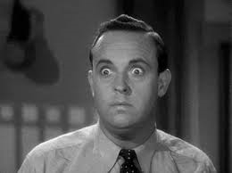

PREREQUISITES OF COUNSELING
1.Elicit a true response
Give neither positive nor negative feedback when patient is recalling his food intake!!
Keep the patient
RELAXED

Slide 25

2. Phrase the questions properly
Do not put words into patients mouth!!!
Open ended questions
Response other than yes/no
Allow patient to take his time to think and answer.
Do not Rush!!!

Slide 26
Principles of diet management:
Application to caries prevention
1. Maintain overall nutritional adequacy…
2. Variation from normal diet pattern…
3. Body’s requirements for essential nutrients
4. Take into consideration likes, dislikes, other…
4

Slide 27
GENERAL PRINCIPLES OF
DIET MANAGEMENT:
Limit eating to 3 meals/day…,,,avoid b/w meal snacks.
Increase intake of….
Decrease CHO intake so as to provide 30-50 % calories.
Recommend drinking & cooking with F water or ingestion of F supplements. If a person lives in Non-F area, use of F dentrifice & mouthrinse.
Restrict sweets only to meals.
Recommend use of detergent food as an alternative to sticky, retentive food.

Slide 28


COUNSELING
VISIT
24 hour Recall $$
No dentistry only counseling
Use of diet workbook should be emphasized.
Pursue diary for completion
Diaries are often inadequate
What if patient forgets the diary!!!
1
Notes:
Pursue diary for completion
Diaries are often inadequate- keep your eyes and ears open.
What if patient forgets the diary!!!

Slide 29
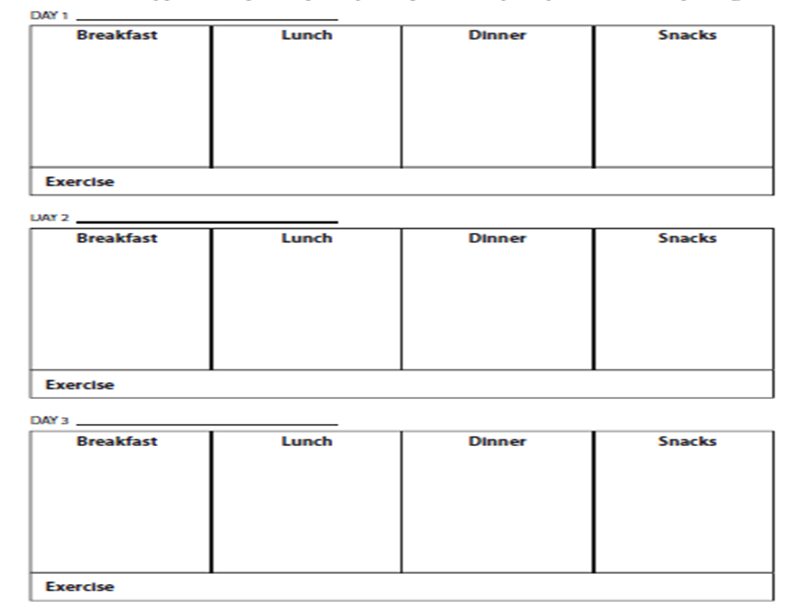
Three day
Single day
Seven day

Slide 30
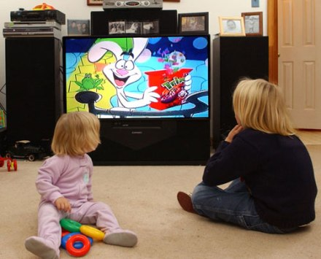
History Taking
Personal history-
No. Of hours /day of watching T.V
Other spare time activities
Emotional status

Slide 31

Family history
Whether both parents are working?
Who looks after the children in their absence?
Dental status of other family members.
Any special diet followed in the family.

Slide 32
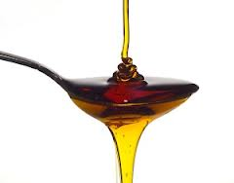
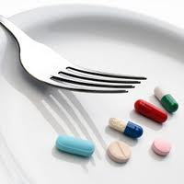
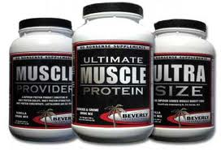
Medical history
Diet supplements
Medications
Mouth breathing

Slide 33
DIET HISTORY
Appetite-
  Good
  Fair
  Poor
Person responsible for food preparation at home?
Eating-alone??
Craving for sweets??
Religious/ethnic dietary practices
Candy dish/cookie jar full of sweets at home??????
Bedtime snacks
Fluorides-communal water/supplements???

Slide 34
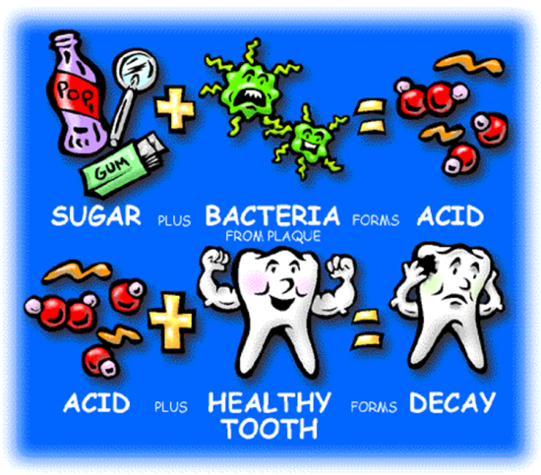
COUNSELING
VISIT
Analyse sweet intake
Quantity vs frequency and form
Circles that can be deleted.
Determine the adequacy of the diet
Dental health diet score- put score
Isolate sugar factor
Scan the food intake
Encircle the sugar consumed in red (also dried fruits)
What time child gets up in the morning?
What does she do after getting up?
Does she eat breakfast?
Where does she eat lunch?
What does she do after school?
What time she has supper?
6
5
Explain- cause of the decay
Sugar + bacteria- acid
Acid- attacks the tooth- decay
Determine the daily routine
What and why of eating???
4
3
2
1
Notes:
Pursue diary for completion
Diaries are often inadequate- keep your eyes and ears open.
What if patient forgets the diary!!!

Slide 35
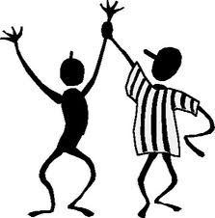
Food | Include | Avoid
Vegetable protein | All
Vegetable fats and oils(polyunsaturated) | All
Vegetables | Frozen,canned,dried-without sugar Raw vegetables and their juices | Candied Sweet potatoes Raisins in dressings
Animal protein | Any meat,fish,milk,cheese, yoghurt | Sugar sauces Syrup in milk yoghurt
Whole grain breads and cereals | Toast dry and cooked cereals | Raisins,cinnamon,bread,sweet rolls,donuts,pastry,jam, jelly,sugar sugar coated cereals,sugar added to cereals
Beverages | Coffee,tea, | Soft drinks,sugar flavoured drinks
COUNSELING
VISIT
8
7
Diet prescription AND suggested menu
Reinforcement by
follow up evaluation
6
5
4
Good job mythri!!!
Good girl!!
3
2
1

Slide 36
MOTIVATION
Garn… self preservation, recognition, love, money
4 stages: awareness
interest
involvement
action
Habit
Notes:
According to Garn the above mentioned all four factors influence desires of each person.
A person passes through four preliminary decision stages in changing a dietary pattern.
Awareness-is recognition that a problem exist, but without an inclination to solve it
Interest- greater degree of awareness but with no inclination to act
Involvement- interest n definite intention to act
Action- trial performance
Habit- commitment to perform this action regularly over a sustained period of time

Slide 37
Helping the patient to select an adequate non-cariogenic diet
Commend the patient
Allow patients to suggest improvements. Write his/her own diet prescription
Allow patient to delete from the diet plaque forming sugar sweetened foods
Allow patient to select non plaque promoting snack substitutes
Allow patient to select menus
Compare new diet with old
Reinforcement by follow-up re-evaluation
Finally what we must do!!

Slide 38
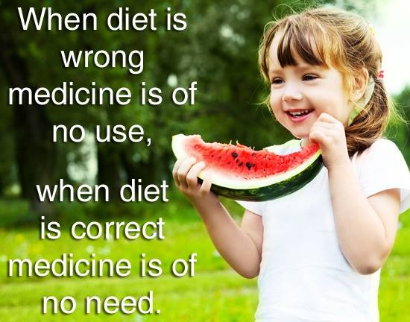

Notes:
Basal metabolic rate- number of kilocalories expended by the organism per square meter of the body surface per hour .

