Slide 1
Intraoral Radiographic Techniques
By
Dr.Sujata.M.Byahatti
Dept of Oral Medicine & Radiology

Slide 2
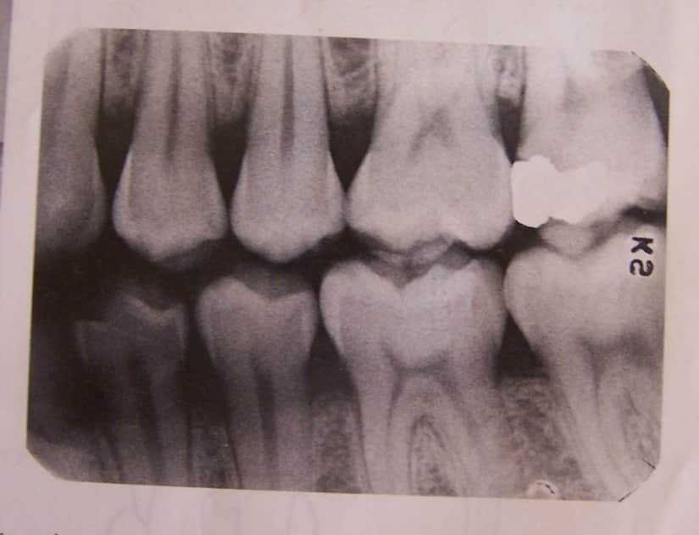
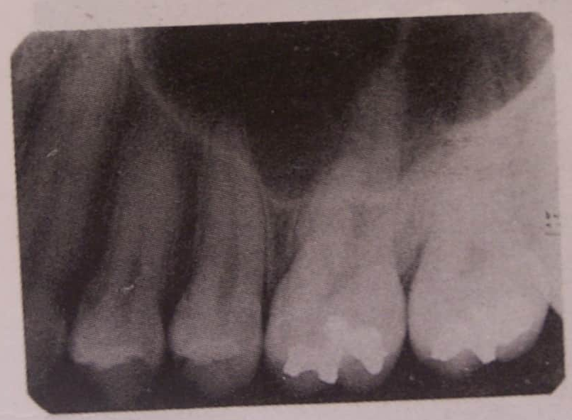
A radiograph is a two-dimensional representation of a three dimensional object

Slide 3
Intraoral radiographic techniques
They are divided as
Periapical Projections-Bisecting and paralleling
Bitewing Projections- Vertical and Horizontal
Occlusal Projections- 3 types for 2 jaws
Anterior topographic
Lateral occlusal
Cross sectional
Buccal shift Rule – Right angle technique
- SLOB technique

Slide 4
Intaoral Periapical Radiograph (IOPA)
Periapical radiograph show the individual teeth and their tissues around the apices.
Each film should show 2-4 teeth with their surrounding structures
Size 0,1,2 films are used.

Slide 5
Criteria for quality
Radiograph should record complete areas of interest
i. In IOPAs the full length of roots and at least 2mm of the periapical bone must be visible.
ii. The area of entire lesion plus some surrounding normal bone if not possible take occlusal radiograph.
Radiographs should have least possible amount of distortion
Radiographs should have optimal density and contrast

Slide 6
Film Holding devices
XCP
Precision x-ray film holder
Stabe bite block
Snap-A-Ray
Hemostat and Rubber bite-block
Drawbacks
Height of palatal vault
Displacement by tongue

Slide 7
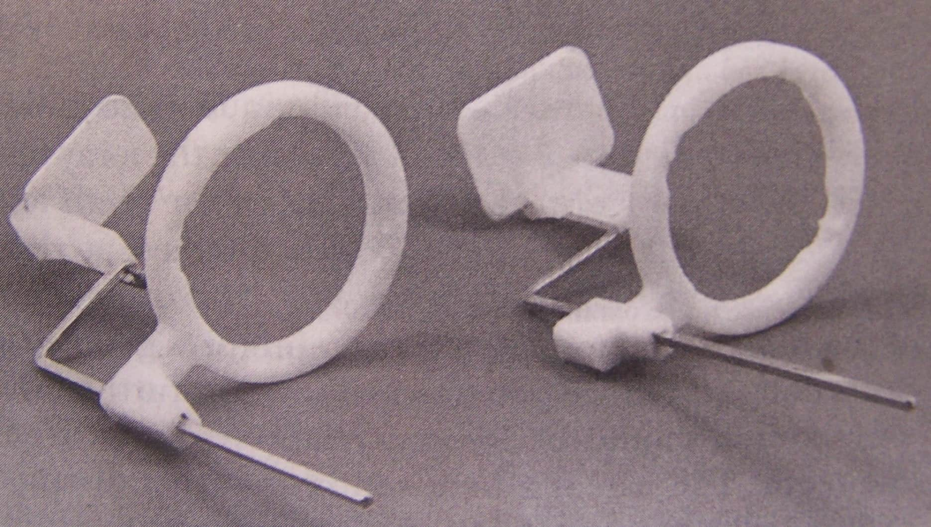
XCP instruments
For Anterior and Posterior views

Slide 8
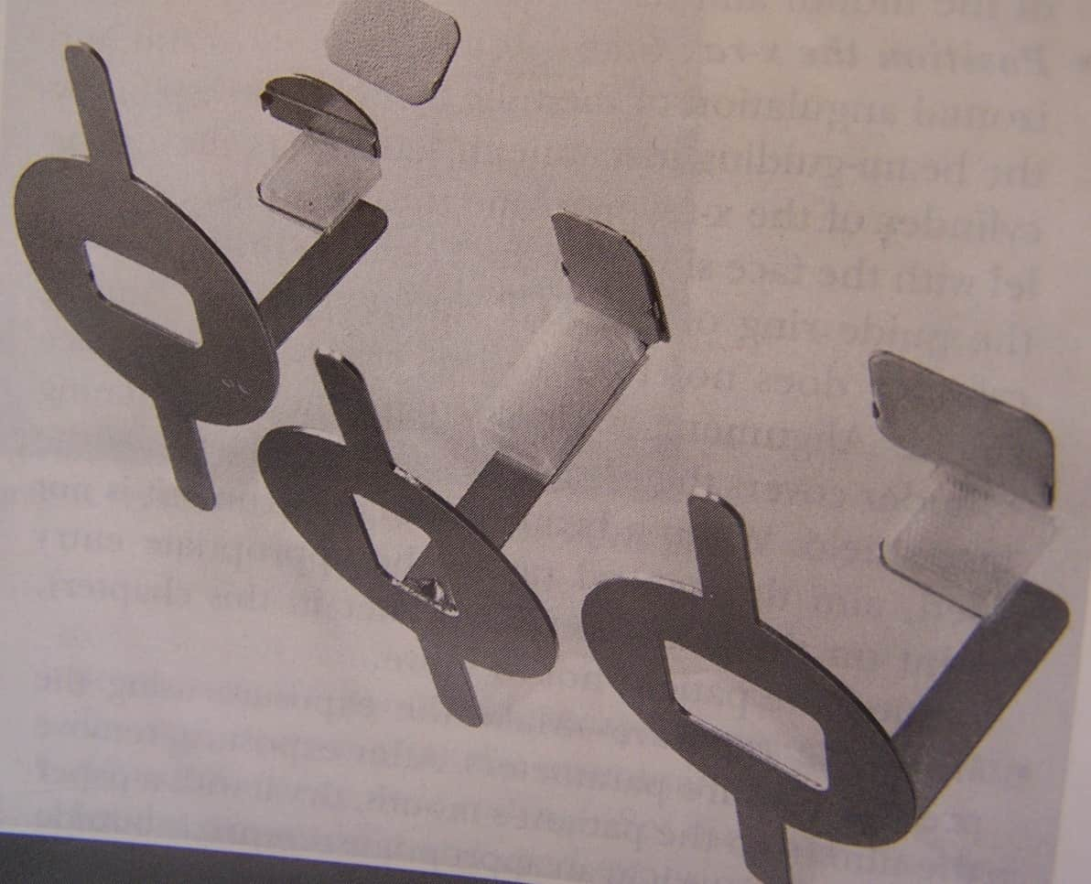
Precision X-ray film holder
Anterior (Central) and Posterior (Lateral) views

Slide 9
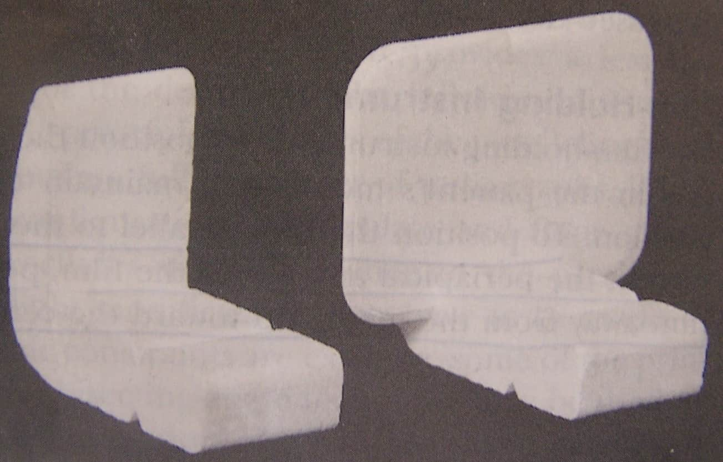
Stabe bite blocks
For Ant and Posterior teeth

Slide 10
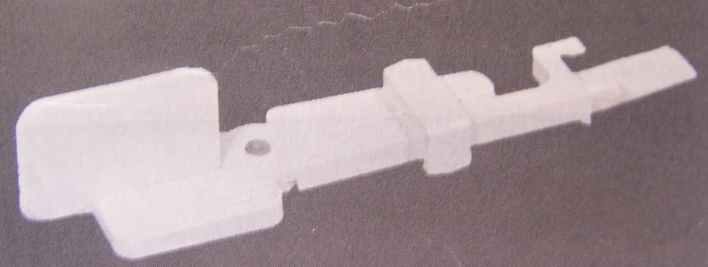
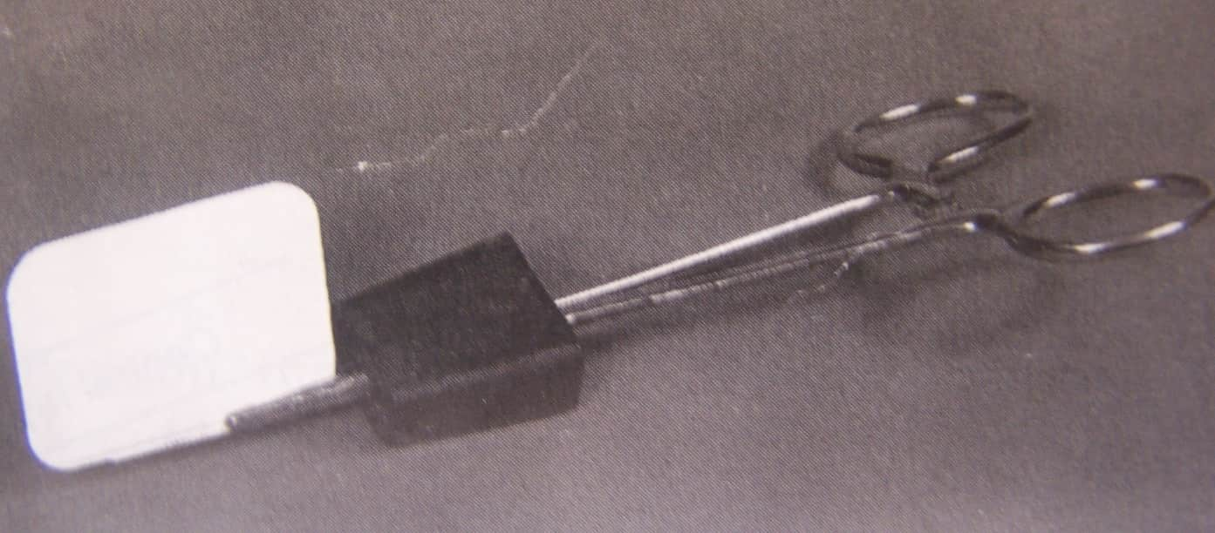
Snap – A-Ray
Hemostat and Rubber bite-block

Slide 11
Angulations
Vertical
Horizontal

Slide 12
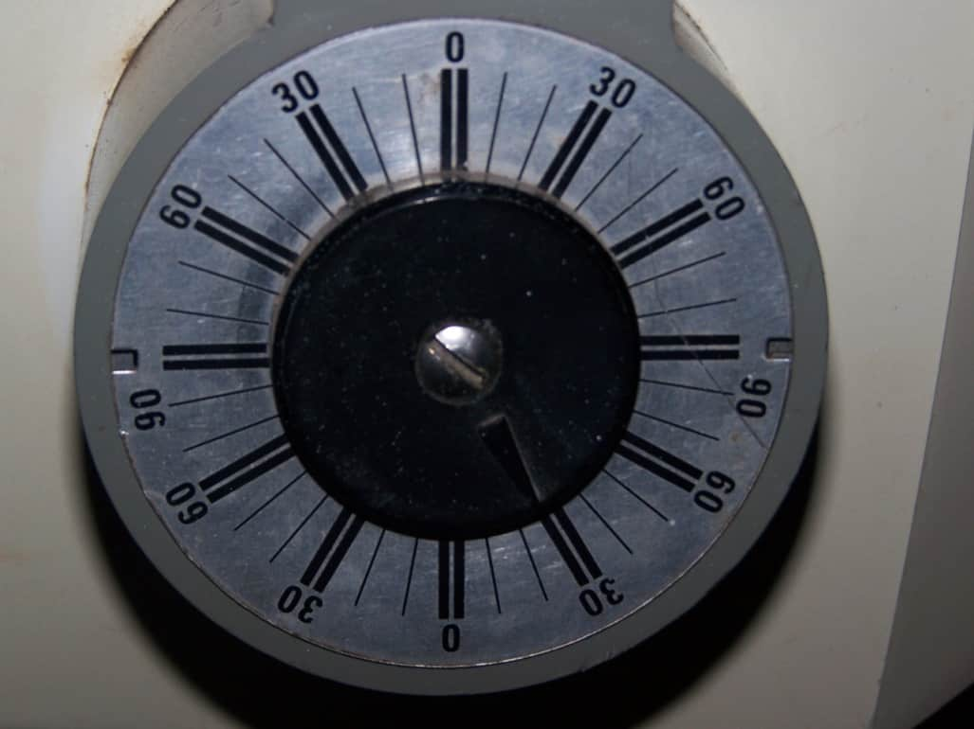
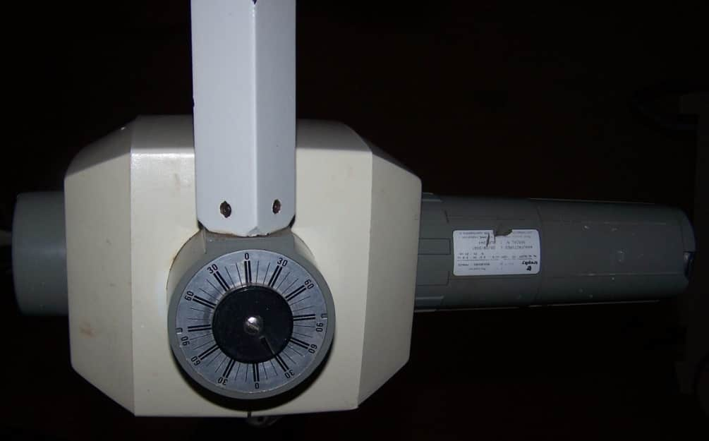
Vertical angulation
In +ve /-ve degrees, on the side of the tube head.
In long cone technique it is perpendicular to the film and long axis of the tooth

Slide 13
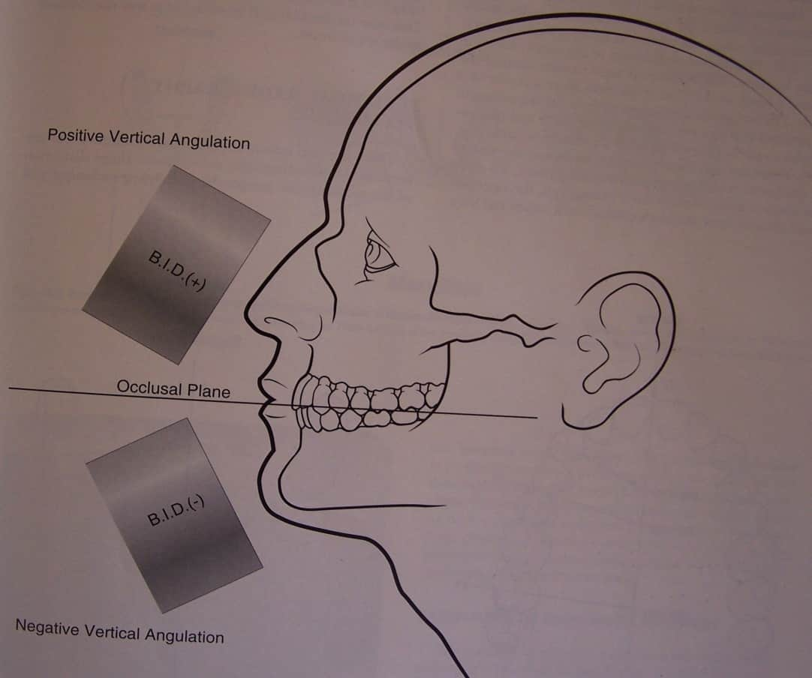
+ve angulations towards gravity
&
-ve angulations away from gravity

Slide 14
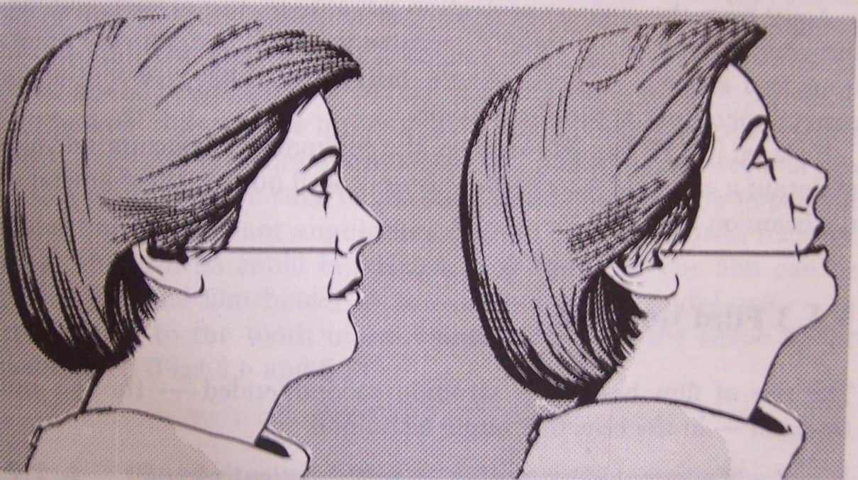
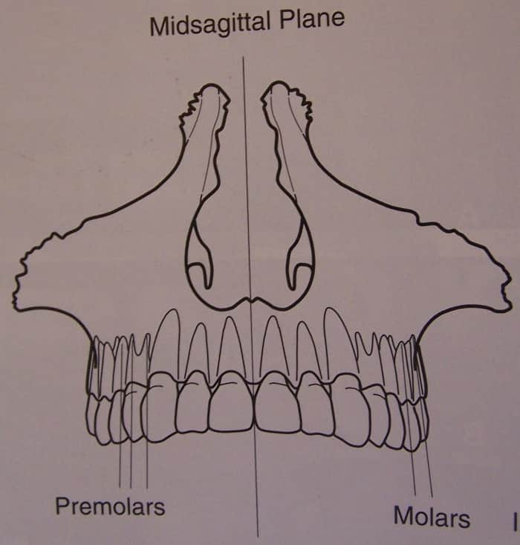
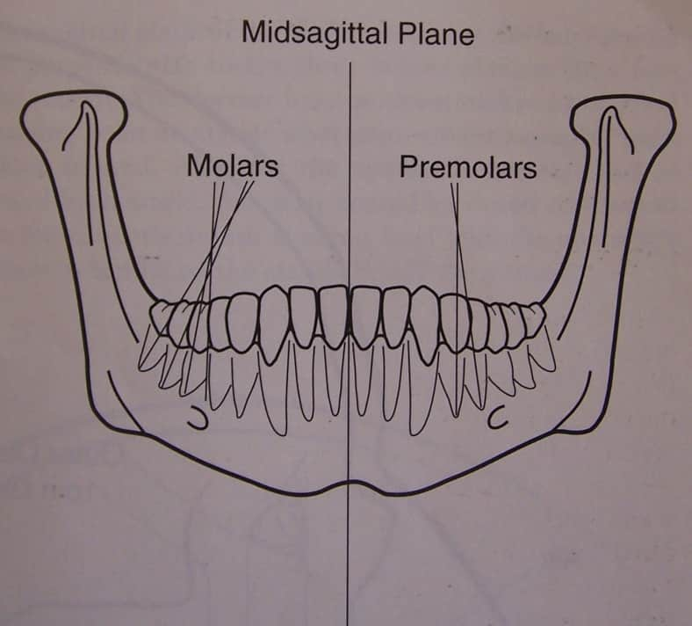
Anatomical landmarks

Slide 15
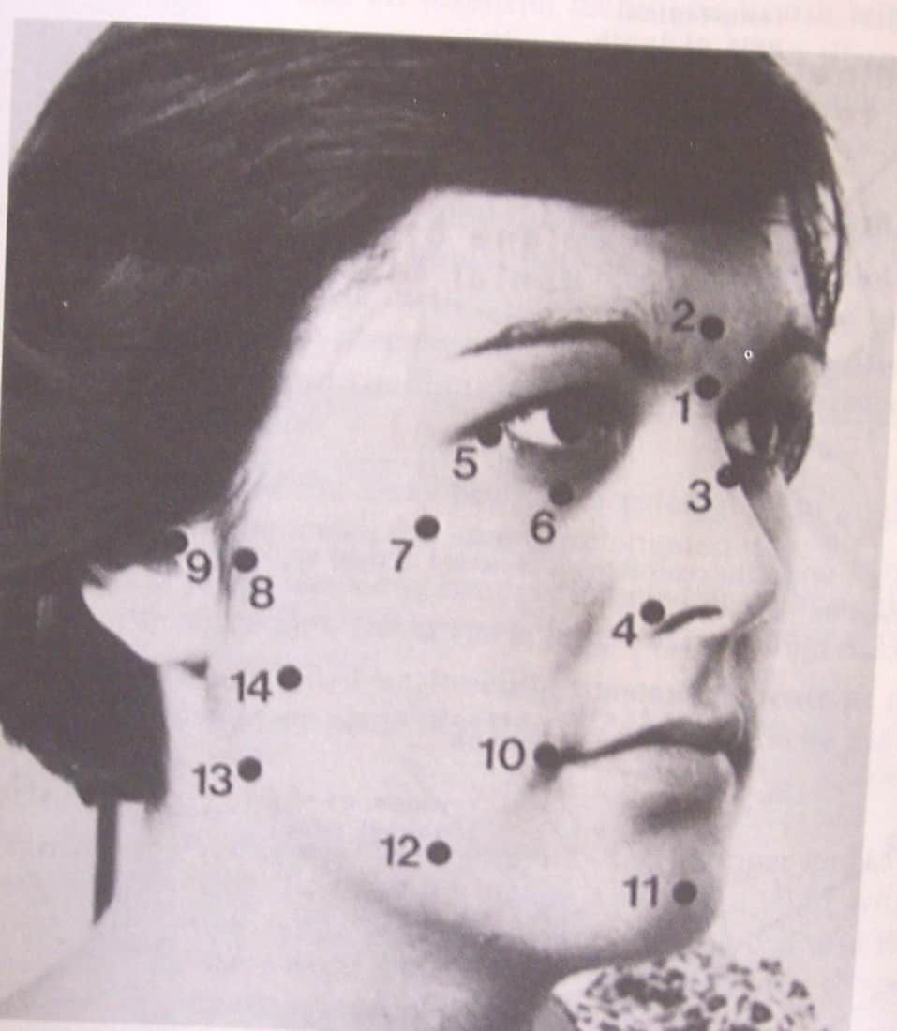
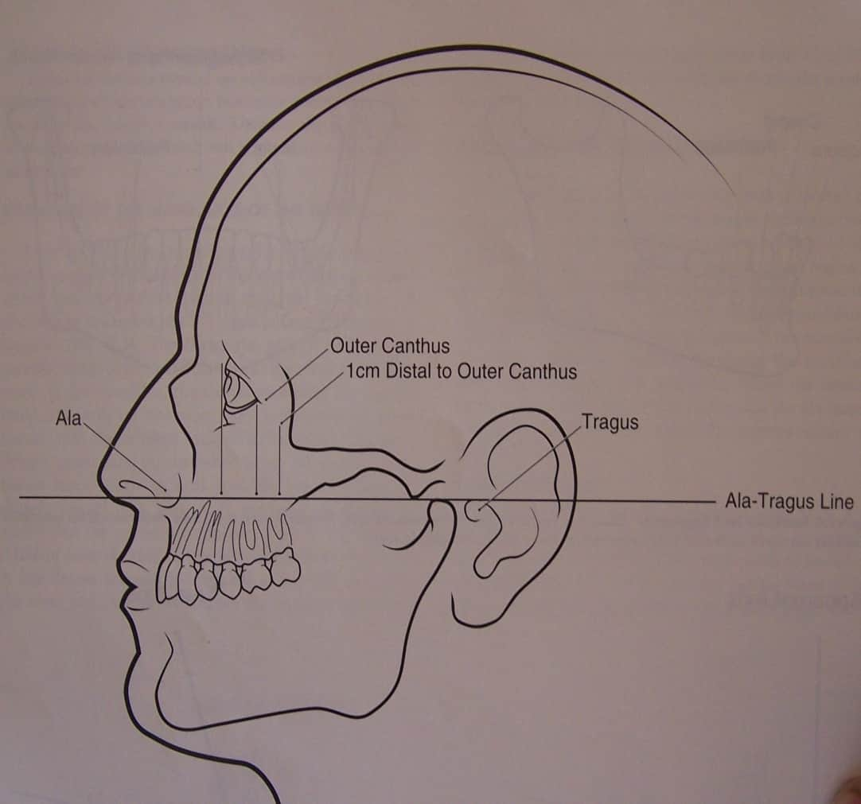
Anatomical landmarks

Slide 16
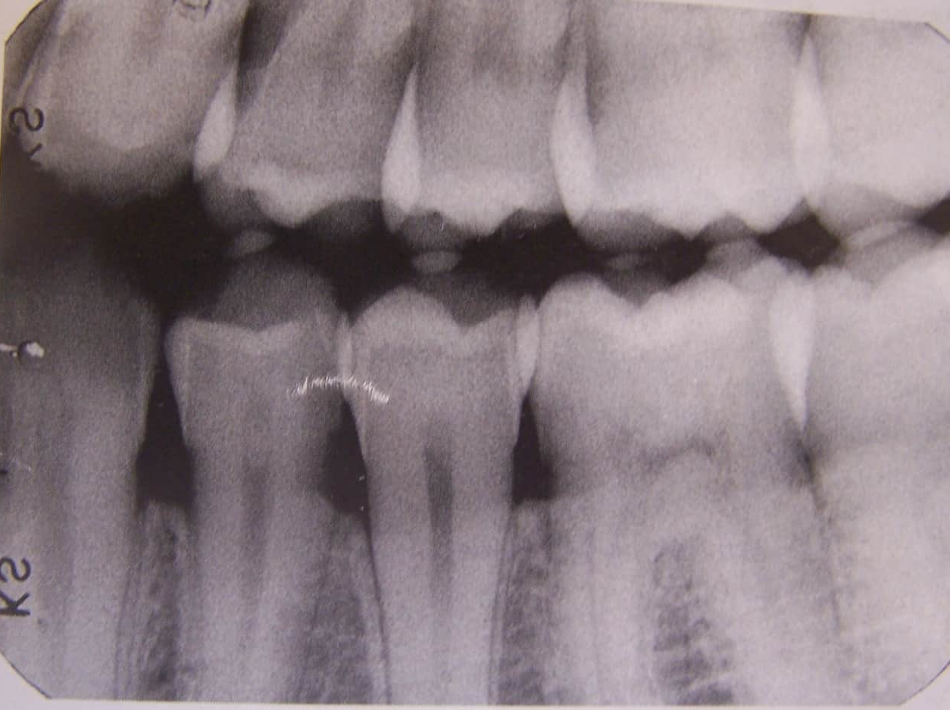
Horizontal angulation
Positioning of tube head and direction of the central ray in a horizontal or side to side plane.
Same for both techniques.

Slide 17
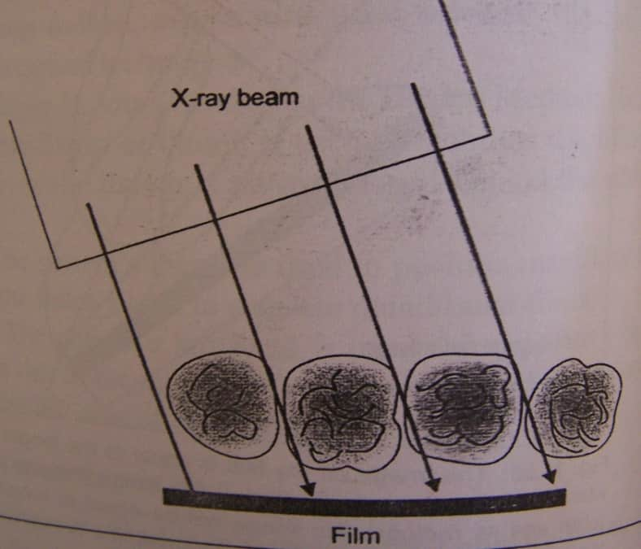
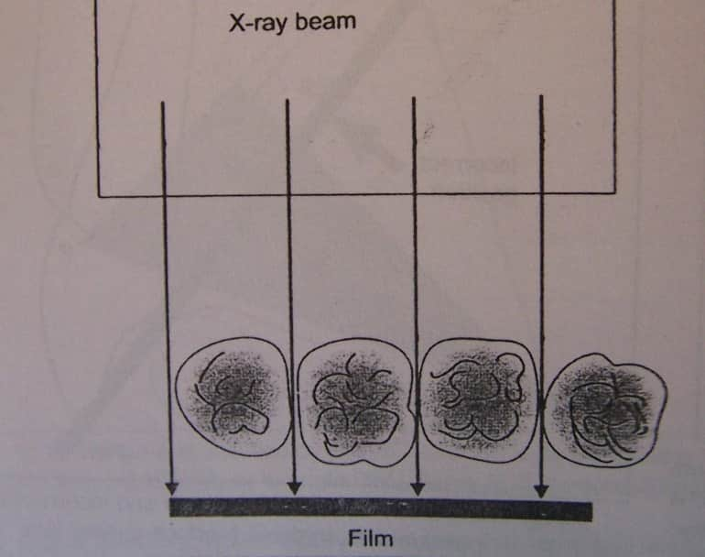
The correct HA obtained by directing the central ray perpendicular to the curvature of the arch and through contact areas of the teeth.
The contact areas appear opened.
Correct Incorrect

Slide 18
Periapical Radiography
Two intraoral projections are used
Paralleling technique
Bisecting angle technique
Peri= around
Apical –apex or end of root

Slide 19
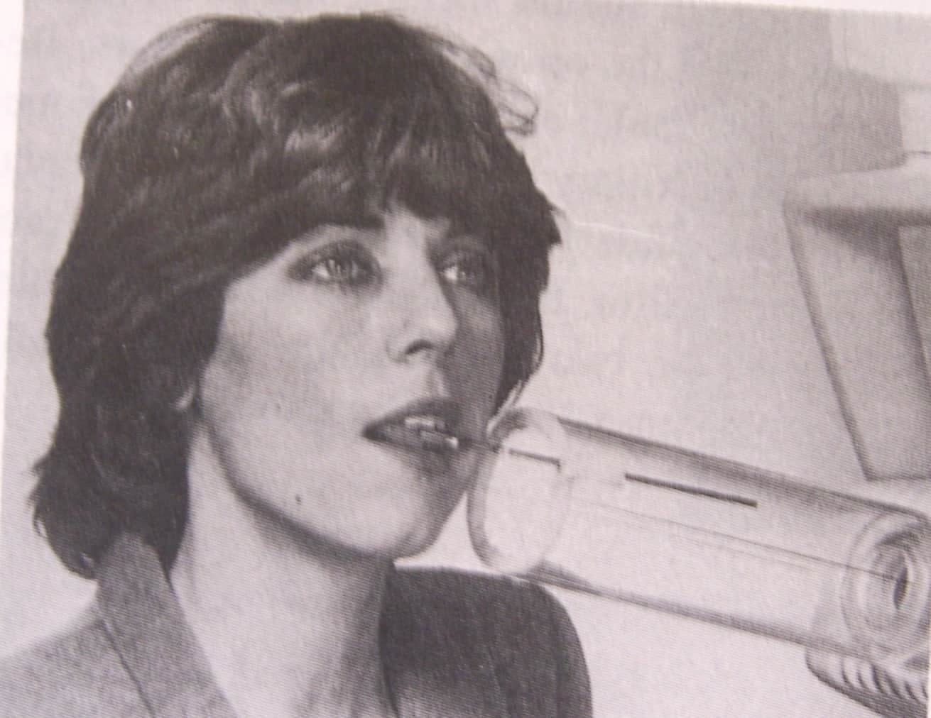
Full mouth set -21 radiographs
Ant then post
Tube head within 2cm of the patients face

Slide 20
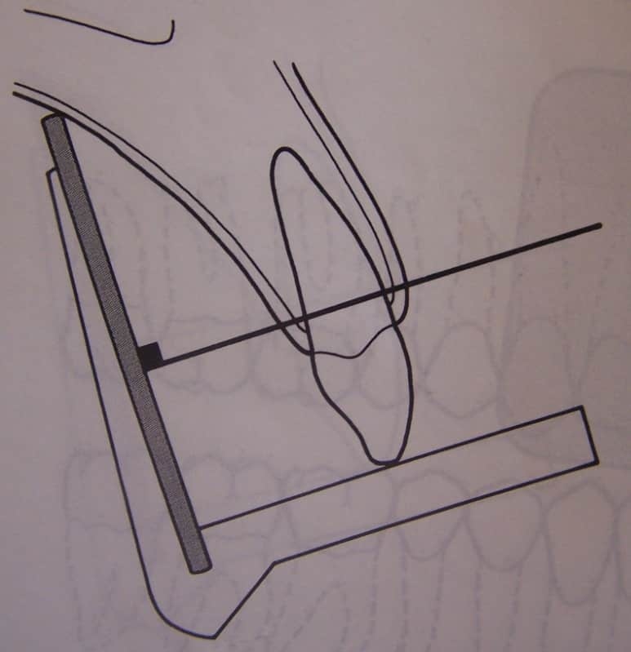
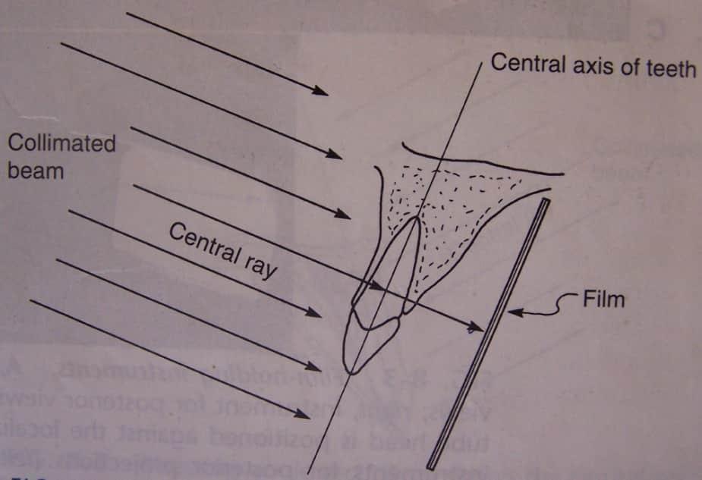
Paralleling technique
Target film distance is 16-18’’
Also called as right angle/Long cone technique

Slide 21
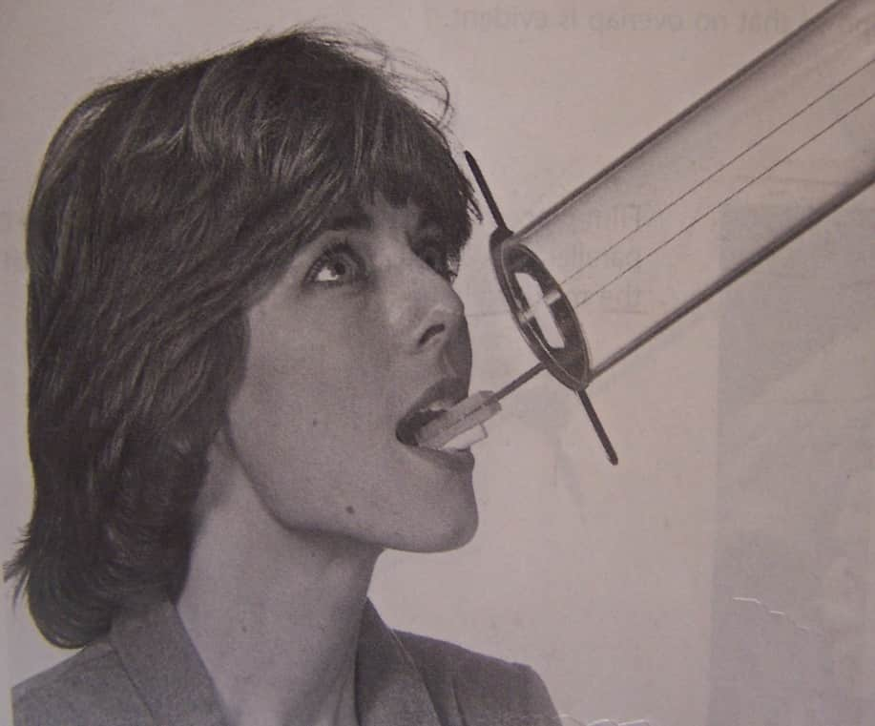
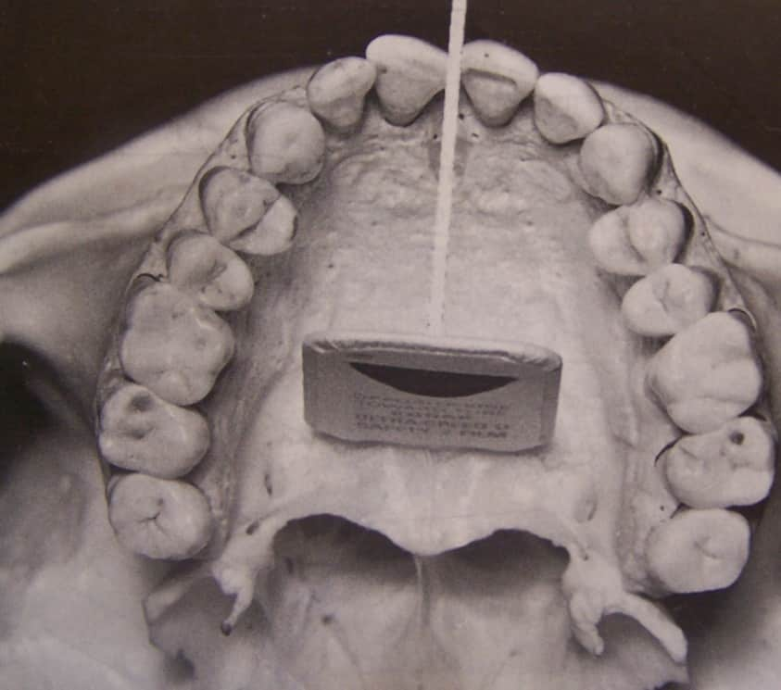
Object and film placed parallel

Slide 22
Advantages of paralleling Technique
Max superimposition of buccal and lingual cusps
Max superimposition of B and L alveolar crest
Max superimposition of proximal surfaces
No superimposition of zygomatic ps of the maxilla on the root apices of the teeth
Minimum magnification and max sharpness
Minimum foreshortening of the buccal roots of upper molars

Slide 23
Disadvantages of paralleling Technique
Difficulty in performing radiograph due to discomfort in tori and mand third molar region
Since TFD is more, the exposure time and KvP needs to be increased
A film holder is required
Its time consuming method
More chances of penumbra and magnification

Slide 24
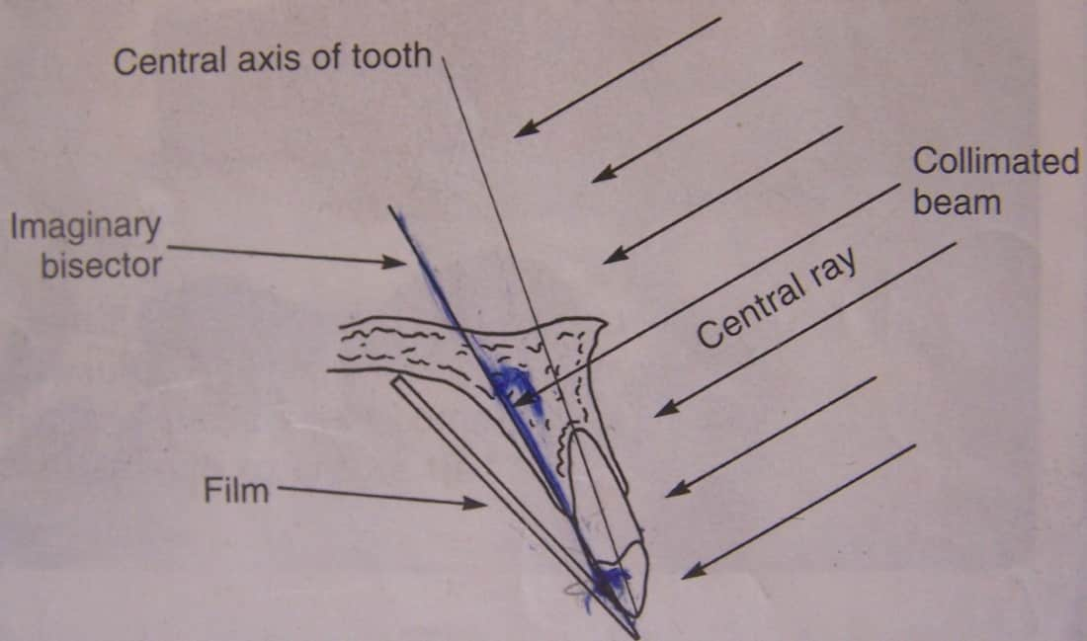
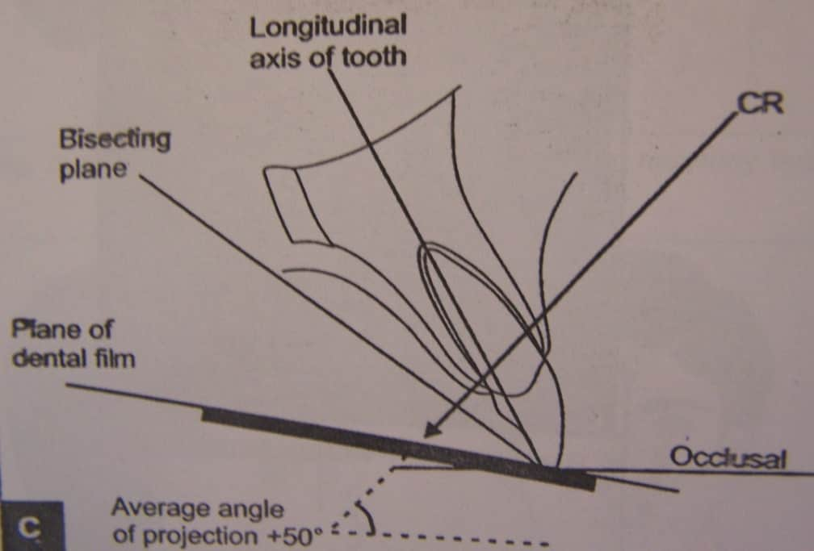
Bisecting-Angle Technique
Target to film distance 6-8”
Also called Short cone technique
Based on Ceiszynsky’s Rule

Slide 25
Advantages of bisecting angle technique
Simple, easy ,quick
No need of film holder & sterilization of these
Decreased exposure time
Disadvantages of bisecting angle technique
Foreshortening of the buccal roots.
Technique needs skill to obtain HA and VA
Poor in detecting initial caries
Image magnification and Elongation
Cone cut
Overlapping of proximal surfaces
Peiodontal bone poorly appreciated
More overlapping of zygomatic process of maxilla

Slide 26
Difficulty in the following patients
Mandibular molar regions
Gagging
Childrens
Edentulous ridges
Patients with disabilities

Slide 27
Limitations
In multirooted tooth needs different angulation for each tooth.
Alveolar ridge projects more coronally
Patient using finger can cause excessive force and bend the film causing distortion
Film might slip
More chances of conecut

Slide 28
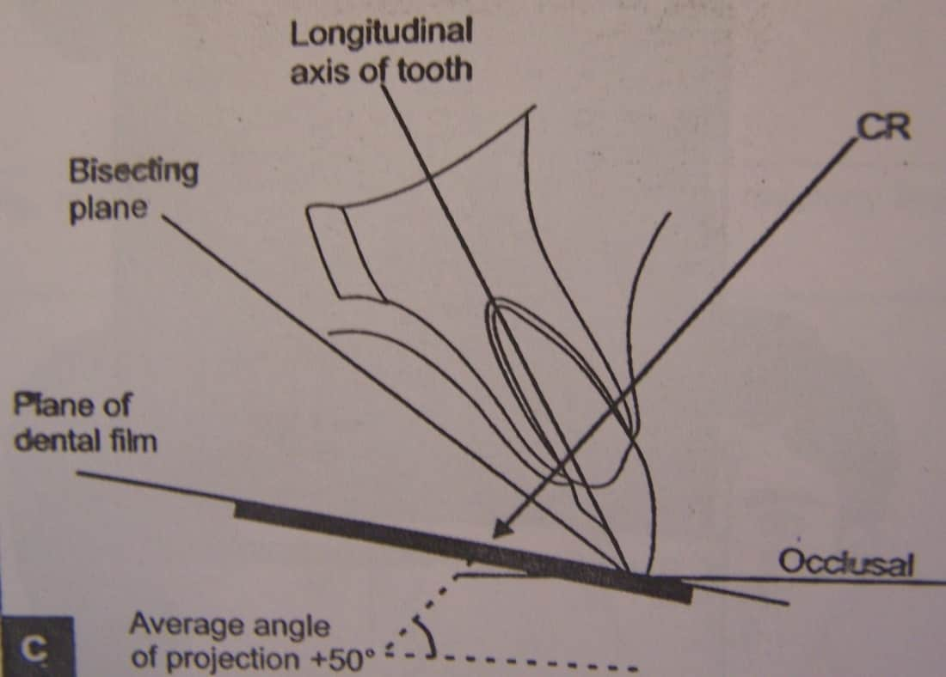
Angulations For Maxilla
Incisors +40⁰
Canines +45⁰
Premolars +30⁰
Molars +20⁰

Slide 29
Angulations For Mandible
Incisors -15⁰
Canines -20⁰
Premolars -10⁰
Molars -5⁰

Slide 30
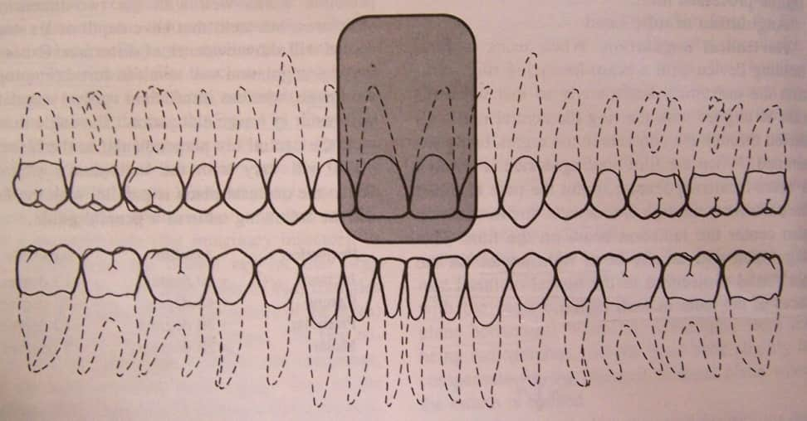
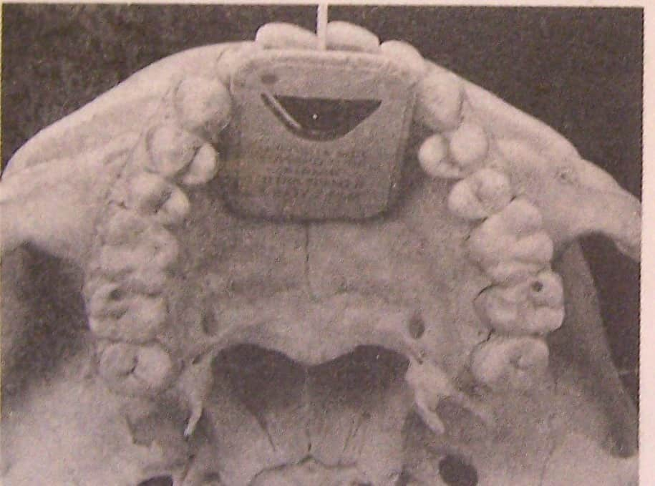
Central Incisor
Image field
The field of view should include both central incisors and their periapical areas
Film placement
No.2 film placed directly behind the maxillary incisors with inferior border extending beyond the incisal edges of the teeth

Slide 31
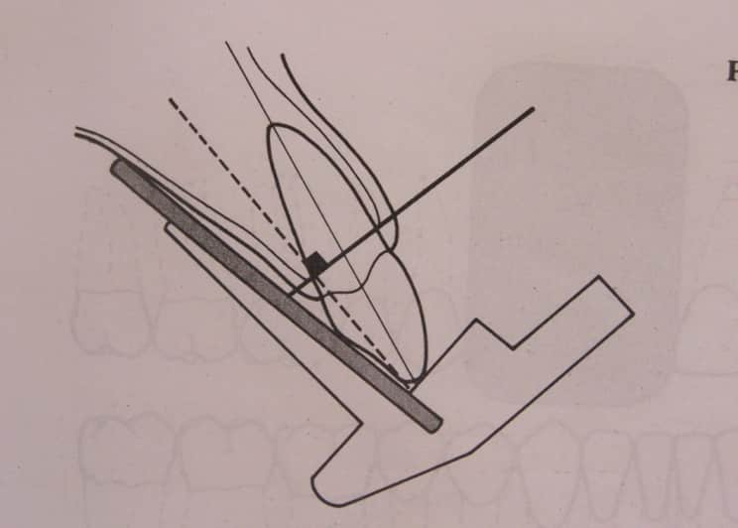
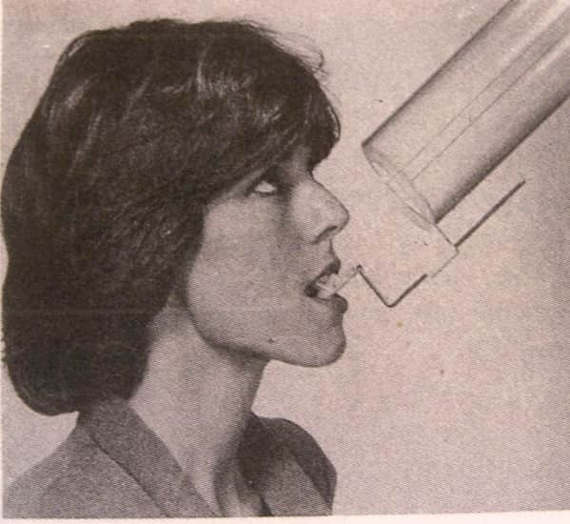
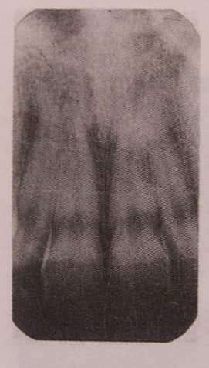
Vertical angulation +40⁰
Horizontal angulation 0
Projection of central ray
Direct the central ray through the contact point of the central incisors and perpendicular to the plane bisecting the angle betn the long axis of the film and roots of the teeth.
Point of entry
Midline through the tip of nose

Slide 32
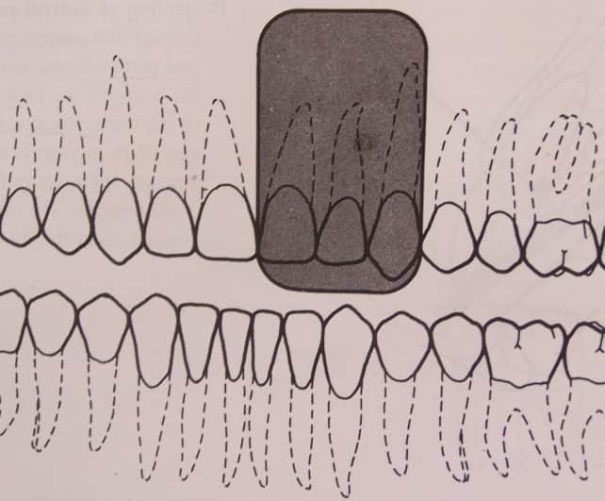
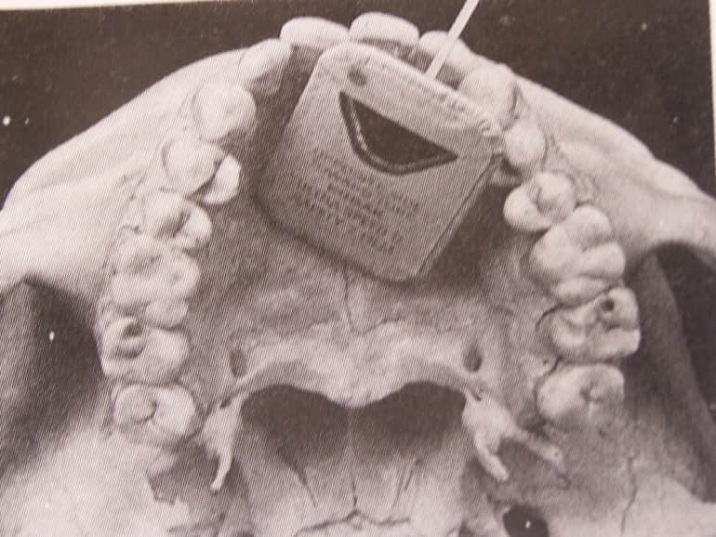
Lateral Incisor
Image field:
Lateral incisor and its periapical structures centered on the radiograph.
Film placement
Vertical angulation +40⁰
Horizontal angulation 0

Slide 33

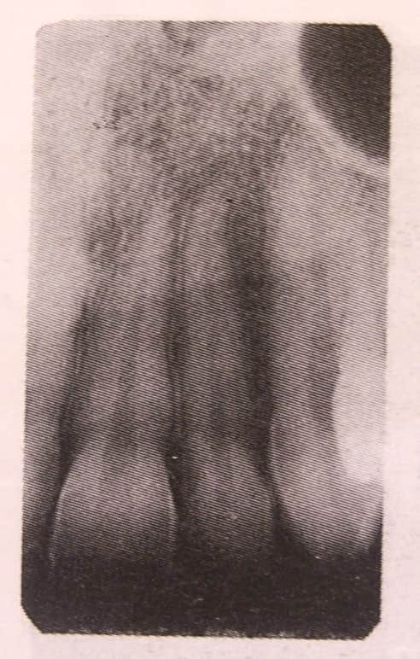
Point of entry
Central ray through ala of the nose about 1 cm from the midline

Slide 34
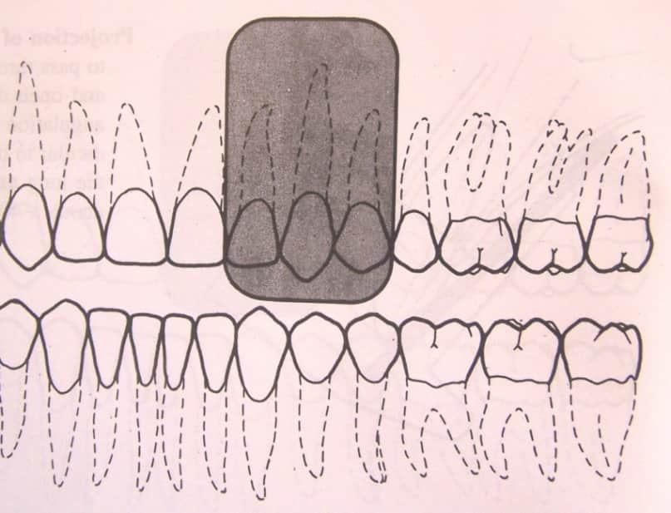
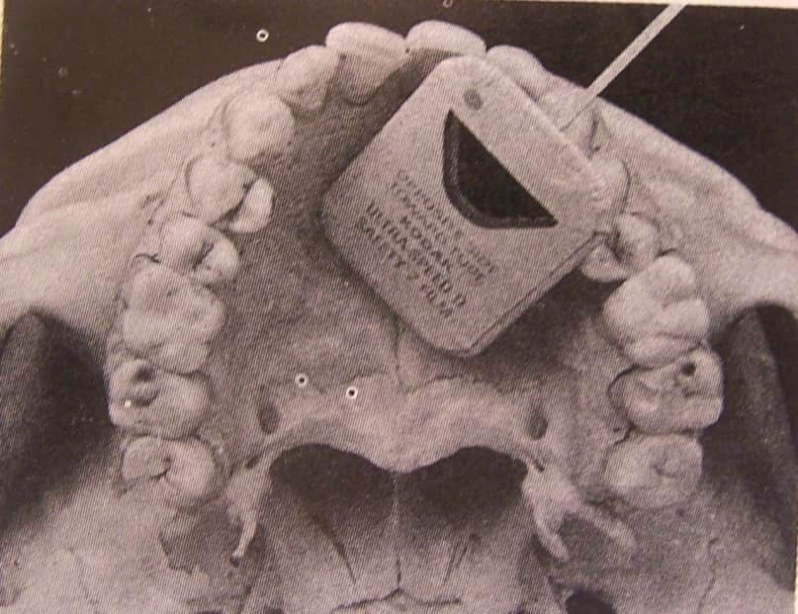
Canine
Image field: This projection demonstrates all the canine and its periapical area centered on the film
Film placement

Slide 35
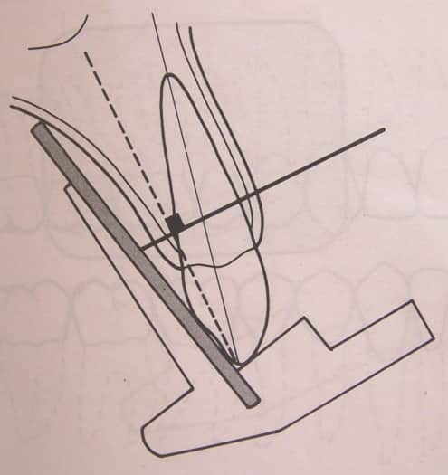
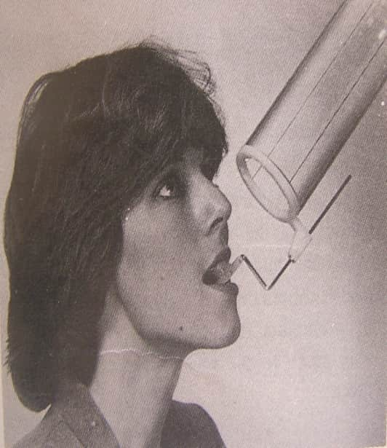
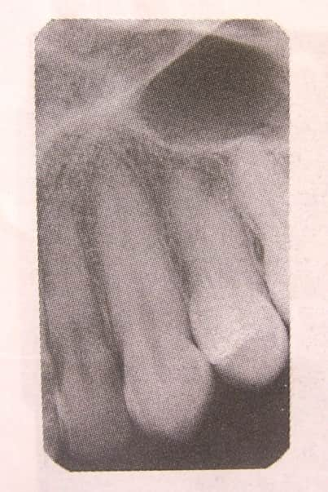
Projection of central ray
Vertical angulation +45⁰
Horizontal angulation 0
Point of entry
Orient the central ray through canine eminence. The point of entry through ala of the nose

Slide 36
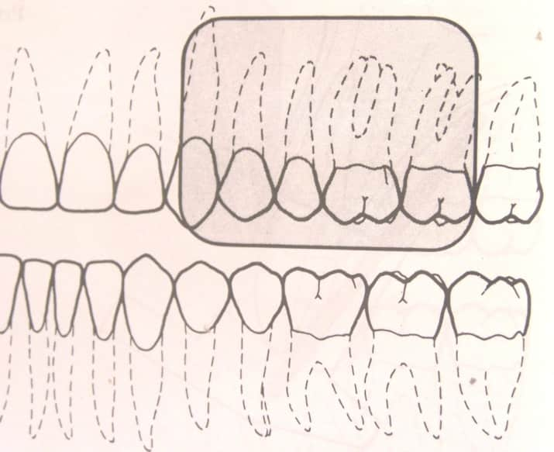
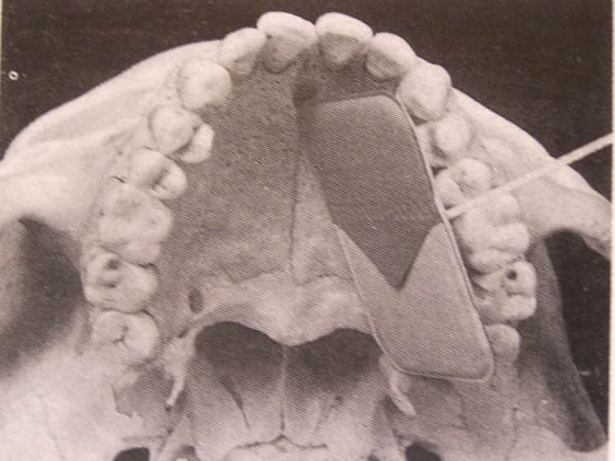
Premolar
Image field: The images of the distal half of the canine, premolars, first molar.
Film placement

Slide 37
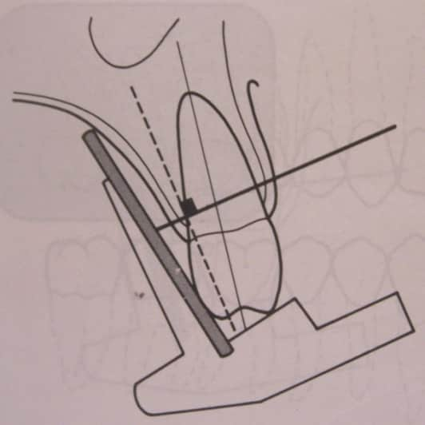
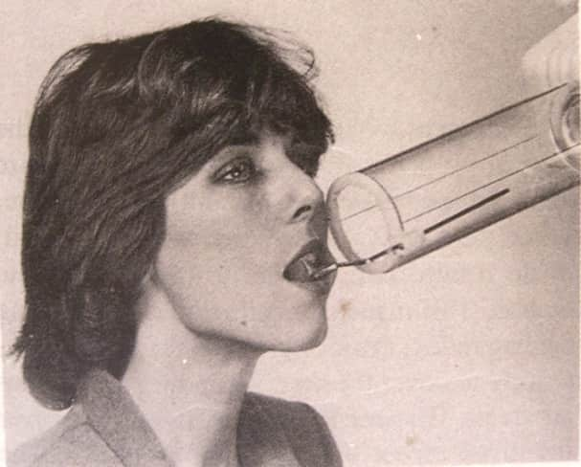

Projection of central ray
Vertical angulation +30⁰
Horizontal angulation 0
Point of entry
Orient the ray below pupil of the eye, close to the level of ala tragus line

Slide 38
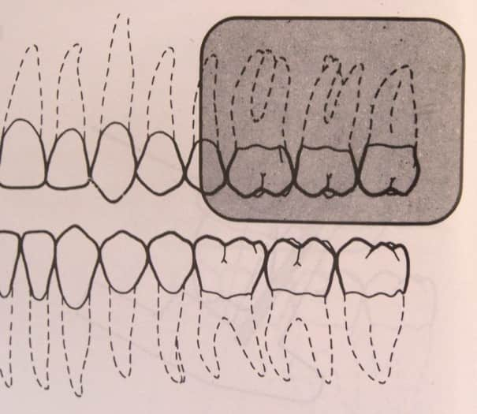
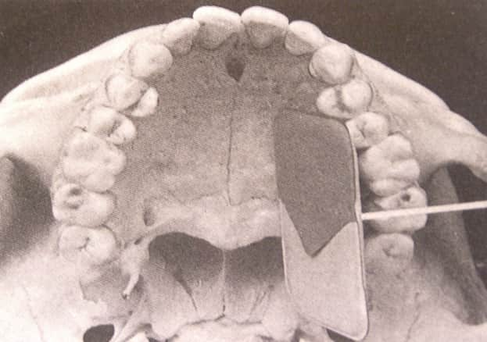
Molar
Image field: The image should show distal half of second premolar and 3 molars
Film placement

Slide 39
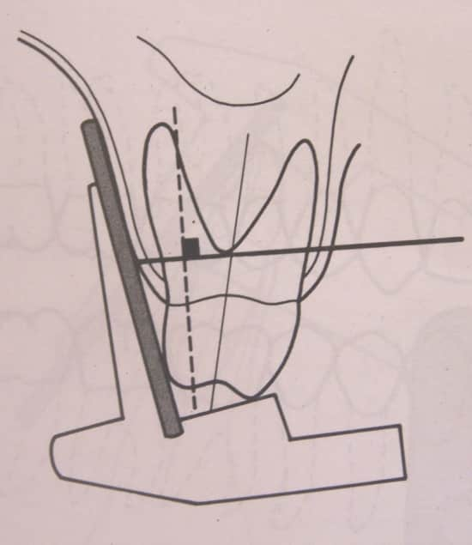
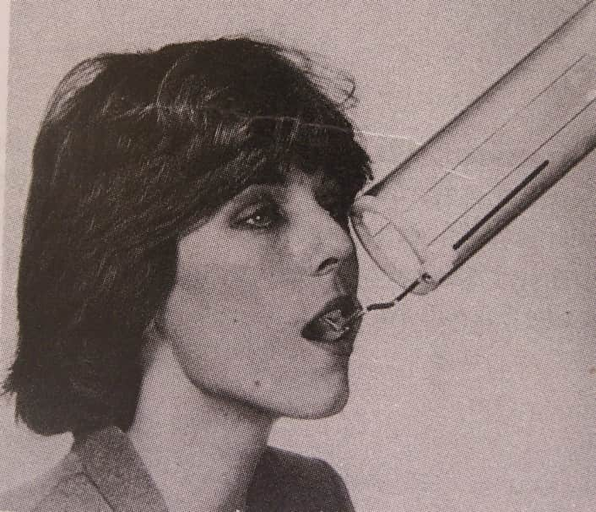
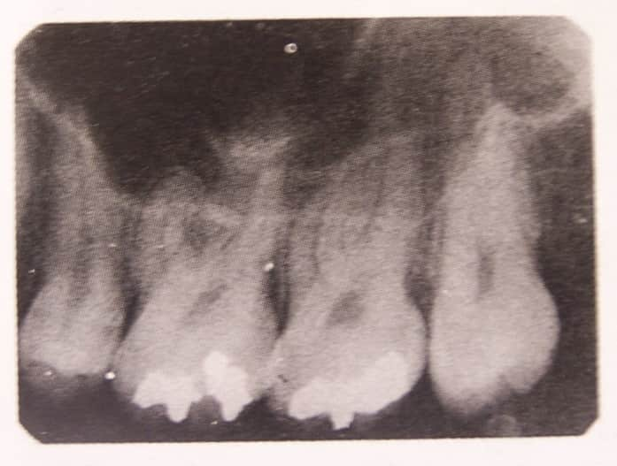
Projection of central ray
Vertical angulation +20⁰
Horizontal angulation 0
Point of entry
Outer cantus of the eye, below the zygoma

Slide 40
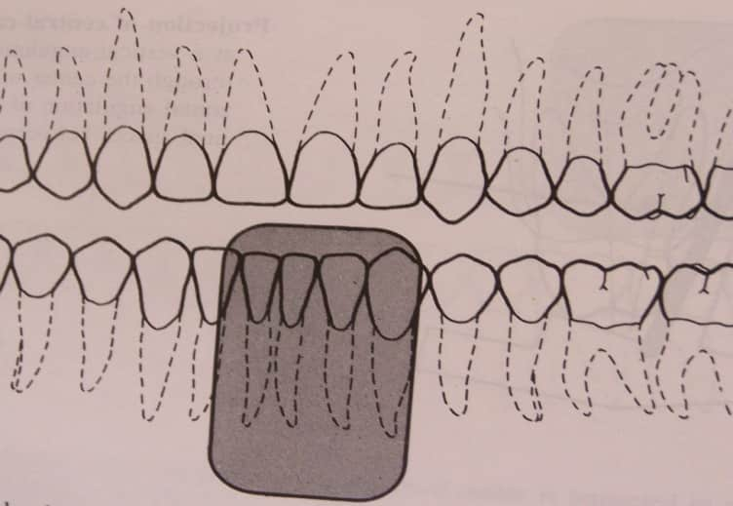
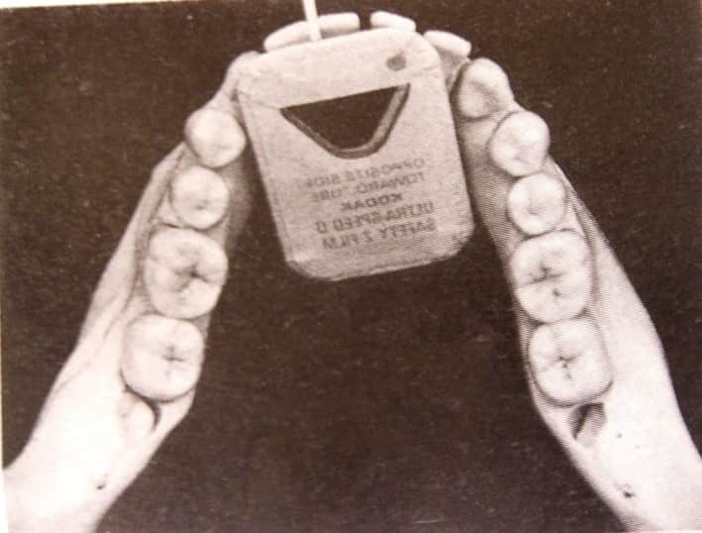
Lower anterior
Image field: This should show crowns, roots and periapical areas of mand central and lateral incisors.
Film placement

Slide 41



Projection of central ray
Vertical angulation -15⁰
Horizontal angulation 0
Point of entry
Below the vermilion border of the lip 1cm from the midline

Slide 42


Lateral canine
Image Field: This projection should center on the canine and its periapical area.
Film placement

Slide 43



Projection of central ray
Vertical angulation -20⁰
Horizontal angulation 0
Point of entry
Direct the central ray through canine 3cm from the midline

Slide 44


Premolar
Image field: The radiographic image of this region should cover distal half canine, premolars and first molar.
Film placement

Slide 45


Projection of central ray
Vertical angulation -10⁰
Horizontal angulation 0
Point of entry
Below the pupil of eye and 3cm above inferior border of mandible.

Slide 46


Molar
Image field: Images of the distal half of the second premolar and the three mandibular permanent molars.
Film placement

Slide 47



Projection of central ray
Vertical angulation -5⁰
Horizontal angulation 0
Point of entry
Below the lateral cantus of the eye,3cm above the inferior border of mandible

Slide 48

Bitewing radiograph
Also called Interproximal view
Paper tab projecting from the middle of the film on which the patient bites to support
so called bite wing
Size 0,1,2,3 films are used.

Slide 49

Two types
Horizontal - size 2 Vertical- size 1

Slide 50
Application of Bitewing
Coronal portion of maxilla & mandible together
secondary caries
Initial interproximal caries
Height of alveolar bone
Overhanging restorations
Periodontal status
Calculus deposits

Slide 51


Premolar bitewing Projection
Image field: This projection should cover the distal portion of the mandibular canine anteriorly and show equally the crowns of the maxillary and mand teeth.
Film placement
Place the film between the tongue and teeth with anterior border extending beyond the contact area between the mandibular canine and first premolar till patient closes the mouth.

Slide 52



Projection of central ray
Project HA through PM contact areas.
Vertical angulation +5⁰
Point of entry
Central ray will enter the line of occlusion at the point of contact between the second premolar and 1st molar.

Slide 53


Molar bitewing
Image field: Most distal tooth with all molars
Film placement
Distal margin extends 1-2mm beyond the most posterior erupted molar.

Slide 54



Projection of central ray
Central ray through the contact of first and second max molars. Vertical Angulation of +10⁰
Point of entry
CR enter the cheek below the lateral canthus of the eye at the level of occlusal plane

Slide 55
Occlusal Projection
Anterior occlusal /topographic view
Lateral occlusal
Cross sectional

Slide 56
Occlusal View
Patient bites on the film on occlusal surface
3 times larger than size 2 film 57x76mm
For larger areas of maxilla and mandible
Used at right angles to locate the objects
Useful when patient unable to open the mouth

Slide 57
Uses of Occlusal radiograph
To locate roots and supernumerary, unerupted, impacted tooth
Foreign bodies and stone in the duct
Evaluate integrity of anterior, medial and lateral outlines of maxillary sinus
to know,nature,location,extent and displacement of fractures
In trismus

Slide 58


Anterior maxillary Occlusal Projection
Image field: Anterior maxilla and its dentition, anterior floor of nasal fossa and canine to canine teeth
Film placement
The film with exposure side towards maxilla, posterior border touching rami.
The film stabilized by gently biting on it.

Slide 59


Projection of central ray
Orient the central ray through the tip of nose
+45⁰ vertical angulation
0 horizontal angulation
Point of entry
The CR enters the face through the tip of nose.

Slide 60


Cross sectional Occlusal Projection
Image field: The projection shows palate, zygomatic Ps of maxilla, antrum, nasolacrimal canals, nasal septum, teeth from molar to molar
Projection of central ray
+65⁰ vertical angulation
0 horizontal angulation
Point of entry
Through the bridge of nose

Slide 61


Lateral maxillary Occlusal Projection
Image field: Involve quadrant of the alveolar ridge of the maxilla, inferolateral aspect of the antrum, tuberosity, and teeth from the lateral incisor to contralateral third molar
Film placement
Place the film with its long axis parallel with the saggital plane and on the side of interest, with the tube side towards maxilla. push the film posteriorly until it touches the ramus.laterally extend 1cm

Slide 62

Projection of central ray
VA - +60⁰ to a point 2 cm below lateral cantus of the eye, directed towards center of film.
Point of entry
The central ray enters at a point approximately 2cm below the lateral canthus of eye

Slide 63


Anterior mandibular occlusal projection
Image field: This includes anterior portion of the mandible, dentition from canine to canine and inferior border of mandible.
Film placement

Slide 64

Projection of central ray
HA - -10⁰
VA - -55⁰
^{Point of entry}
The point of entry CR in midline and through the tip of the chin.

Slide 65


Cross sectional mandibular occlusal
Image field: The floor of the mouth and the lingual and buccal plates of mandible from second molar to second molar.
For sialolithiasis – ½ exposure time
Film placement
Seat the patient with head tilted back so that the ala-tragus line is almost perpendicular to the floor. The anterior border of the film 1cm beyond the mandibular central incisors.

Slide 66

Projection of central ray
Direct the CR at the midline through the floor of mouth approximately 3cm below the chin, at right angles to the the center of film
Point of entry
CR directed in the midline through the floor of the mouth 3cm below chin

Slide 67


Lateral mandibular occlusal projection
Image field: This projection covers the soft tissues of half the floor of the mouth, the buccal and lingual cortical plates of the mandible and teeth from lateral incisor to contralateral third molar.
Film placement
Ala tragus line almost perpendicular to the floor.
The film placed with its lateral border extending 1cm laterally

Slide 68

Projection of central ray
Direct the CR perpendicular to the center of film.
Point of entry
Beneath the chin,3cm posterior to the chin and approximately 3cm lateral to the midline

Slide 69
Location of foreign objects & impacted tooth within the jaw
2 methods
  Right angles to each other (best for mand)
  Tube shift – technique/SLOB

Slide 70

Right angle Technique
Impacted Canine on palatal side

Slide 71

SLOB
Also called as buccal object rule/ Clarks rule
Described by Clark in 1920

Slide 72
Radiographic examination for children
Children's have greater sensitivity for radiation based on age, Medical history, growth & general considerations.
Make minimal No. of films
Principles of radiography similar for children's
Small films with modification used for small teeth & jaws

Slide 73
Patient management
Apprehension reduced by familiarizing children with the procedure, making them touch the machine
Explain them x-ray Machine for photography/pictures
Converse with them to distract the attention to gain the confidence
Show elder bro/sis undergoing radiography

Slide 74
Examination coverage
The No. Of projections required depends on child's size
<10yrs – 50% reduction in mA
10-15yrs - <25% reduction in mA

Slide 75
Primary Dentitions (3-6yrs)
Two anterior occlusal films – No 2 Films
Two posterior bitewing films – 0 size
Four posterior IOPAs – 0 size
Mixed Dentition (7-12yrs)
Two incisor IOPAs – No.1 films
2-4 Bitewing – No.2 films

Slide 76
Radiographic technique for Endodontics
Follow paralleling technique –No.2 film
Sinus tract and periodontal defects tracked by No.40 gutta percha

Slide 77
Pregnancy
Low patient dose with optimal radiation safety prefered.
No radiography in the first Trimester
Second trimester is safe
Wear a lead aproan, thyroid collor
Minimal and required radiographs only

Slide 78
Edentulous patients
These may contain roots residual infection, impacted teeth, cysts which interfere with prosthetic appliances are removed.
Technique
Cotton rolls are placed between ridge abd film
14- IOPAs required
<25% of exposure

Slide 79
No. of Projections
Central incisors – 1 projection
Lateral canine – 2 projections
Premolars – 2 projections
Molar – 2 projections.

