Slide 1






MARATHA MANDAL'S NATHAJIRAO G. HALGEKAR INSTITUTE OF DENTAL SCIENCES & RESEARCH CENTRE, BELAGAVI.
(Accredited ‘A’ Grade by NAAC)
BLOOD DONATION CAMP
Date : 3 January 2026
Time : 9 a.m onwards
Venue : Maratha Mandal's NGH Institute
of Dental Sciences and
Research Centre, Belagavi.

Slide 2
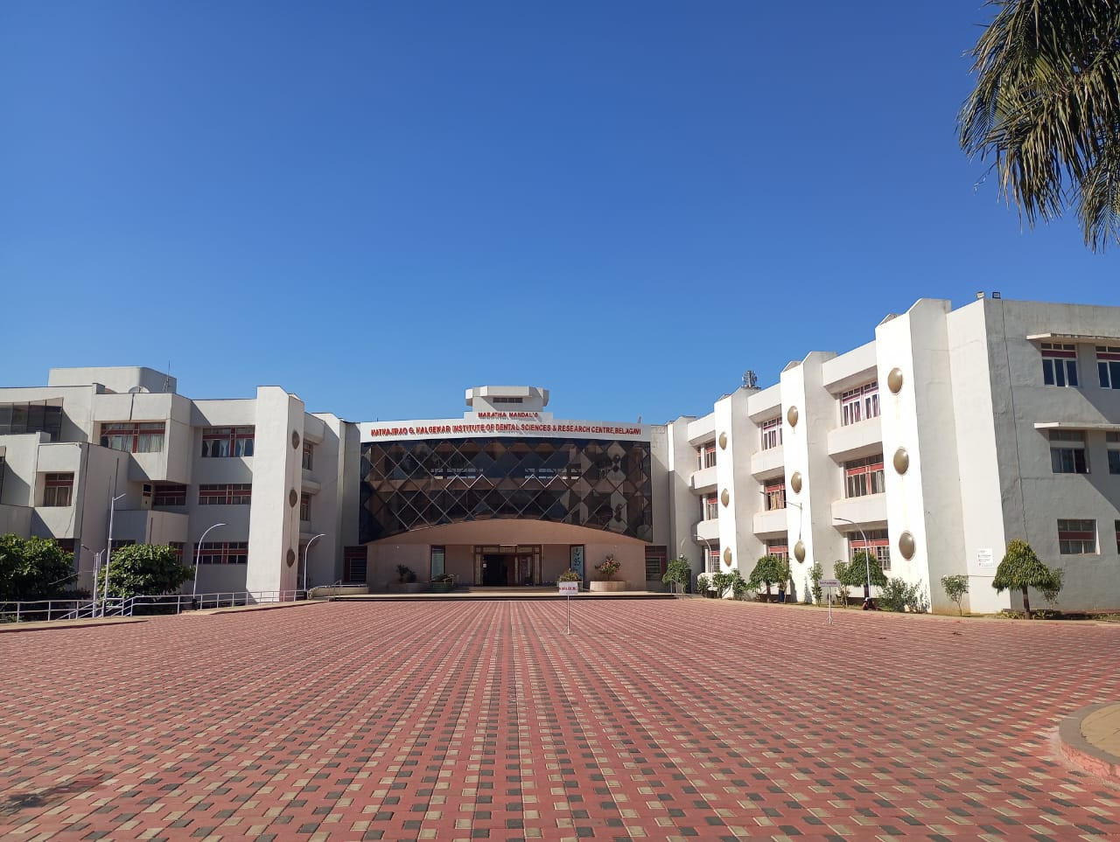
95TH MARATHA MANDAL'S FOUNDATION DAY

Slide 3

Importance of blood donation
Life-saving Act
Emergency Preparedness
Rare Blood Types
Health Benefits for Donors
Moral and Emotional Rewards
Encourages Voluntary Contributions
Supporting Medical Research

Slide 4
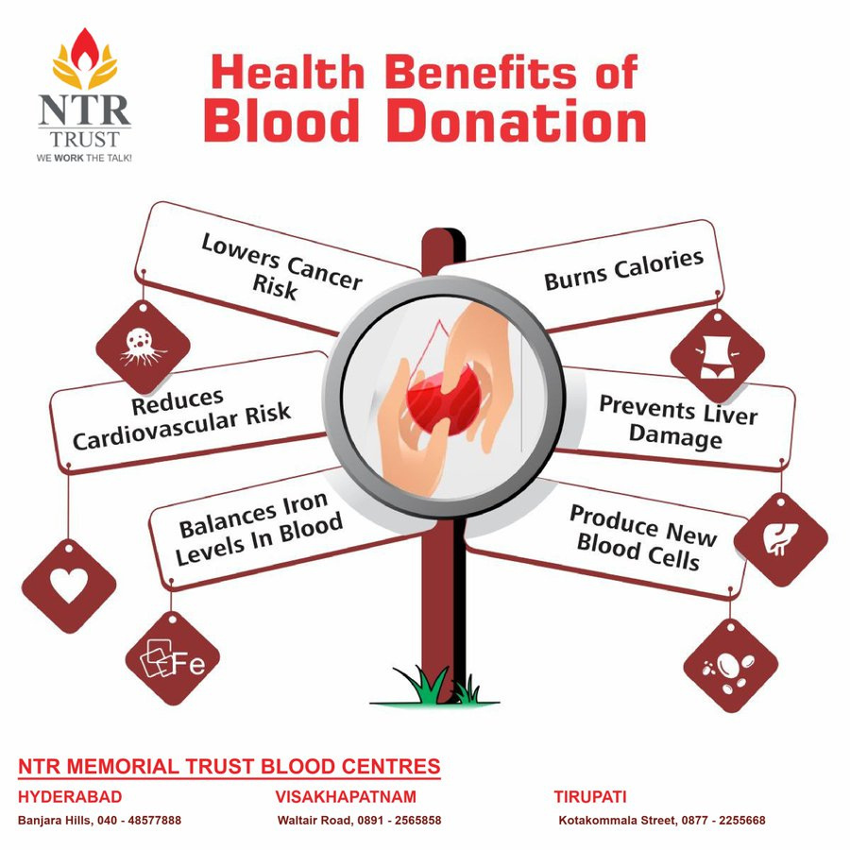
BENEFITS OF BLOOD DONATION

Slide 5
THANKYOU

