Slide 1
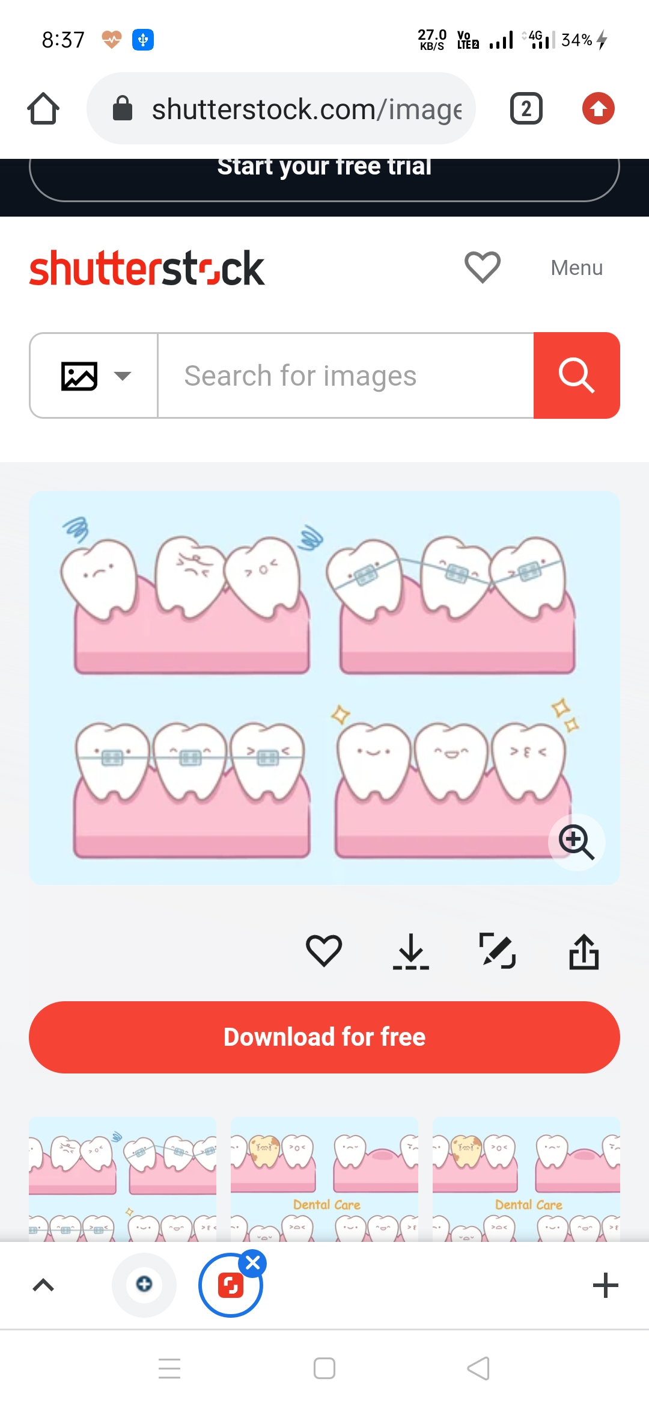
ORTHODONTIC TOOTH MOVEMENT

Slide 2
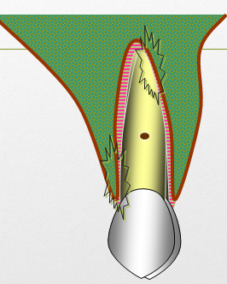
Introduction
Orthodontic tooth movement is a unique process where a solid object (tooth) is made to move through a solid medium (bone).
Orthodontic treatment is possible
due to the fact that whenever a
prolonged force is applied on a tooth,
bone remodelling occurs around
the tooth resulting in its movement.
BONE DEPOSITION + BONE RESORPTION

Slide 3
Behavior of a body when embedded within the bone

Slide 4
Force : An act upon a body that changes or tends to change the state of rest or the motion of that body.

Slide 5
Moment : Is defined as a tendency to rotate

Slide 6
Center of Rotation
This is the point around which the tooth rotates.

Slide 7
Center of Resistance
It is a point at which resistance to tooth movement is concentrated.
Center of Resistance

Slide 8
For single rooted tooth it is on the long axis of the tooth
between one third and one half of the root, apical to the alveolar crest

Slide 9
For a multi-rooted tooth, the centre of resistance is probably between the roots, 1 or 2 mm apical to the furcation.

Slide 10
Tooth Movement
Physiologic
Pathologic
Orthodontic

Slide 11

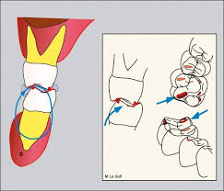
Physiologic Tooth Movement
Tooth eruption
The slight tipping movement of the functioning tooth in its socket during mastication

Slide 12
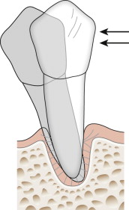
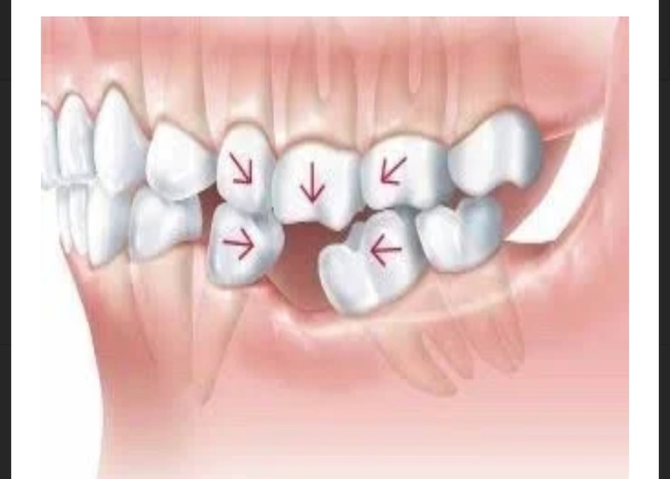
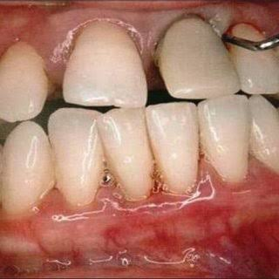
Pathologic Tooth Movement
Trauma from Occlusion
Tooth movement secondary
to sever periodontal breakdown (migration)

Slide 13
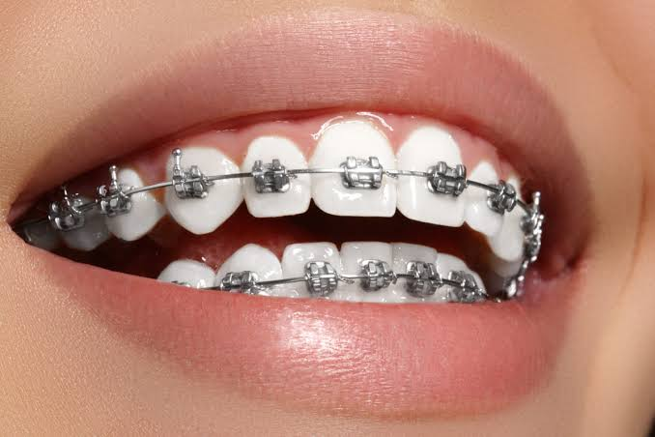
Orthodontic Tooth Movement
Basically there is slight difference between the tissues reactions observed in physiologic tooth movement and orthodontic tooth movement.

Slide 14
Types of Orthodontic Tooth Movement
Tipping:
Uncontrolled tipping
Controlled tipping
Bodily movement:
Intrusion
Extrusion
Torquing
Uprighting

Slide 15
TIPPING MOVEMENT
Simplest form of orthodontic movement
Requires force of very low magnitude
Crown movement is more than the root movement.

Slide 16
Uncontrolled Tipping
When the force is applied, the crown moves in one direction and the root moves in the opposite direction.
Here the centre of rotation lies somewhere near the centre of resistance of the tooth.

Slide 17
Controlled Tipping
Here the crown moves in one direction but the root position remains the same or gets minimally displaced.
The centre of rotation lies near or close to the apex.

Slide 18
Torquing
Buccolingual root movement

Slide 19
Uprighting
Mesiodistal root movement

Slide 20
BODILY MOVEMENT
Crown movement is equal to Root movement.
In this case, the total PDL area is loaded uniformly.
Since the root apex and crown move in the same direction the same amount the centre of rotation lies at infinity.

Slide 21
Extrusion
Extrusion is the bodily displacement of a tooth along its long axis in an occlusal direction.
Extrusion movements ideally would produce no areas of compression within the periodontal ligament, only tension.

Slide 22
Intrusion
Intrusion is the bodily displacement of a tooth along its long axis in an apical direction.
Light force is required for intrusion because the force will be concentrated in a small area at the root apex (compression).

Slide 23
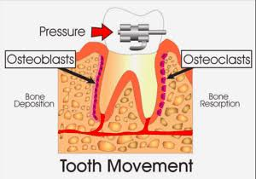
Orthodontic Tooth Movement
It is a pathological process from which the tissue recovers.
Histology of tooth movement:
Orthodontic movement bring about areas of pressure and tension around the tooth. The histologic changes seen during tooth movement vary according to the amount and duration of force applied.

Slide 24
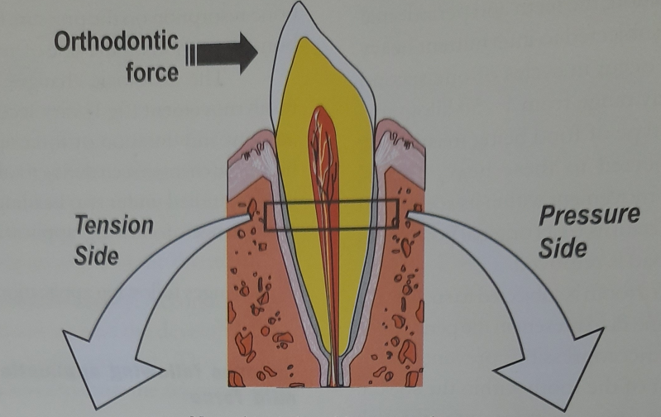

Slide 25
Changes following application of mild forces:
Classically the movement of teeth has been explained via the pressure: tension hypothesis in which PDL tissues in pressure side results in bone resorption, while placing the PDL tissues under tensile force lead to bone deposition.
Bone deposition
Bone resorption

Slide 26
Changes on pressure side:
The PDL in direction of tooth movement gets compressed to almost 1/3rd of it’s original thickness.
A marked increase in the vascularity of PDL
Increase in capillary blood supply.
This increase in blood supply helps in mobilization of cells such as fibroblasts and osteoclasts.
when forces applied are within physiologic limits, the resorption is seen in alveolar plate immediately adjacent to the ligament. This kind of resorption is called frontal resorption.

Slide 27
Changes on tension side:
PDL stretched
Distance between alveolar process & tooth is widened.
Increased vascularity.
Mobilization of fibroblasts & osteoblasts.
Osteoid is laid down by osteoblast in PDL immediately adjacent to lamina dura.
Lightly calcified bone mature to form woven bone.

Slide 28
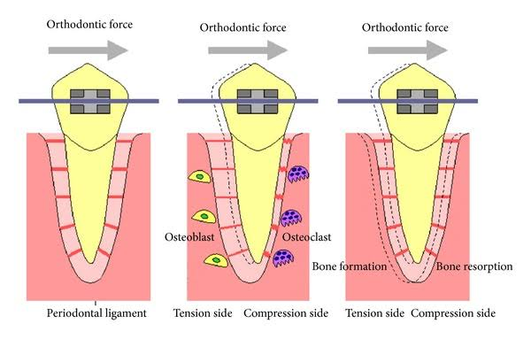

Slide 29
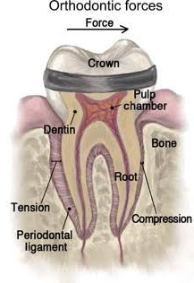
Change following application of extreme forces
On the pressure side :-
Root closely approximates the lamina dura .
Compresses the PDL and leads to occlusion of blood vessels.
The PDL is hence deprived of its nutritional
supply leading to regressive changes called
hyalinization .
Undermining/Rearward resorption
occurs in the adjacent marrow spaces
and alveolar plate below, behind &
above the hyalinized zone.

Slide 30
On the tension side:-
Over stretched PDL .
Tearing of blood vessels & ischaemia.
Extreme forces applied net increase in osteoclastic activity and tooth loosened in socket.

Slide 31
Optimum orthodontic force:
Is one which moves teeth most rapidly in the desired direction, with the least possible damage to tissue and with minimum patient discomfort.
Schwarz proposed the classic concept of the optimal force. He defined optimal continuous force as the force leading to a change in tissue pressure ,that approximated the capillary vessel & blood pressure. Thus preventing their occlusion in the compressed PDL.
A) Below the optimal level cause no reaction in PDL.
B)Forces exceeding optimal level would lead to areas of tissue necrosis, preventing frontal bone resorption.

Slide 32
Schwarz’s definition was slightly modified by Oppenheim who advocated the use of lightest force capable of bringing about tooth movement.
Oppenheim and Schwarz following extensive studies state that the optimum force is equivalent to the capillary pulse pressure which is 20-26gm/sq.cm of root surface area.

Slide 33
From a clinical point of view, Optimum orthodontic force has the following characteristics:
Produce rapid tooth movement.
Minimal patient discomfort.
The lag phase of tooth movement is minimal.
No marked mobility of the teeth being moved.

Slide 34
From a histological point of view the use of optimum force has the following characteristics:-
The vitality of the tooth and supporting PDL is maintained.
Initiates maximum cellular response.
Produces direct or frontal resorption

Slide 35
Phases of tooth movement
Burstone categorize the stages as:-
Initial phase
Lag phase
Post lag phase

Slide 36
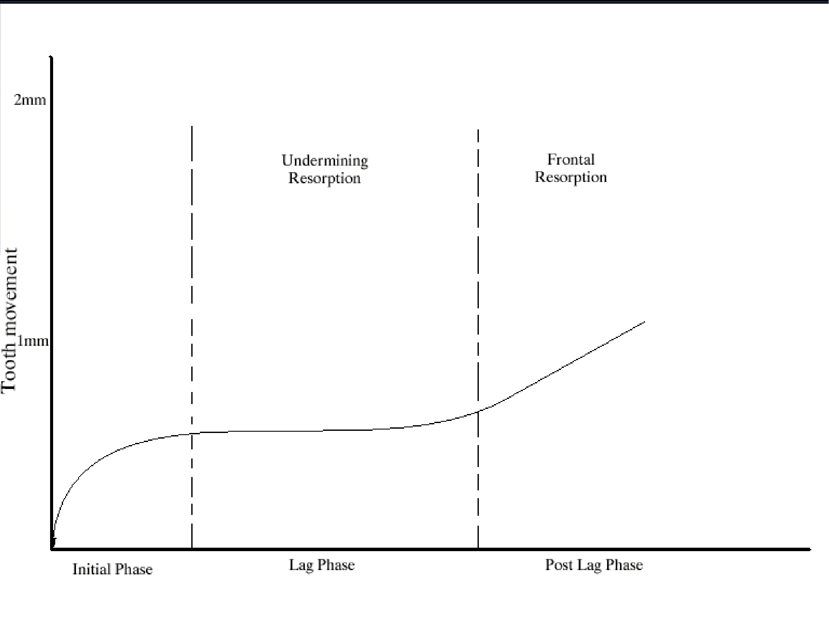
Initial phase:
Rapid tooth movement is observed over a short distance which then stops.
Represents displacement of tooth in PDL membrane space and probably bending of alveolar bone .
Between 0.4 to 0.9mm usually
occurs in a weeks time.
Both light & heavy forces
displace the tooth to the same
extent during this phase.

Slide 37
Lag phase:
Little or no tooth movement occurs .
Formation of hyalinized tissue .
Extent upto 2-3 weeks .

Slide 38
Post lag phase:
Tooth movement progresses rapidly as the hyalinized zone is removed and bone undergoes resorption .
Osteoclasts are found over a larger surface area .

Slide 39
* Rapid tooth movement
0.4-0.9mm
week
*Little / no tooth movement
Upto 4 weeks
*Rapid tooth movement
Frontal resorption

Slide 40
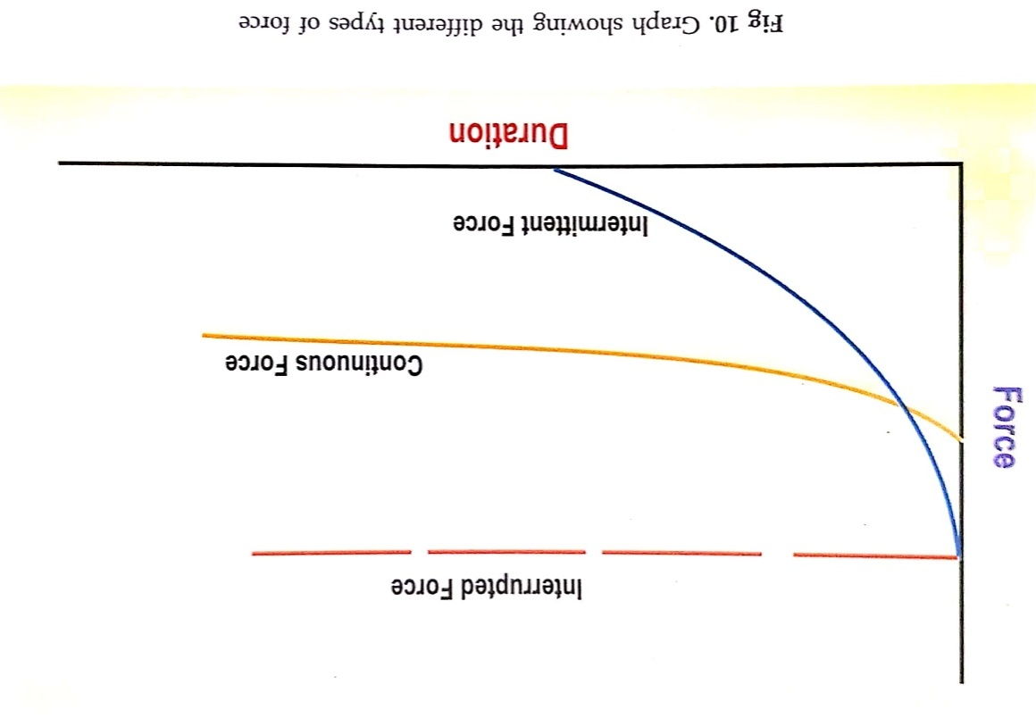
Types of Force
Based on the duration of application, forces can be divided into –
Continuous force
Intermittent force
Interrupted force

Slide 41
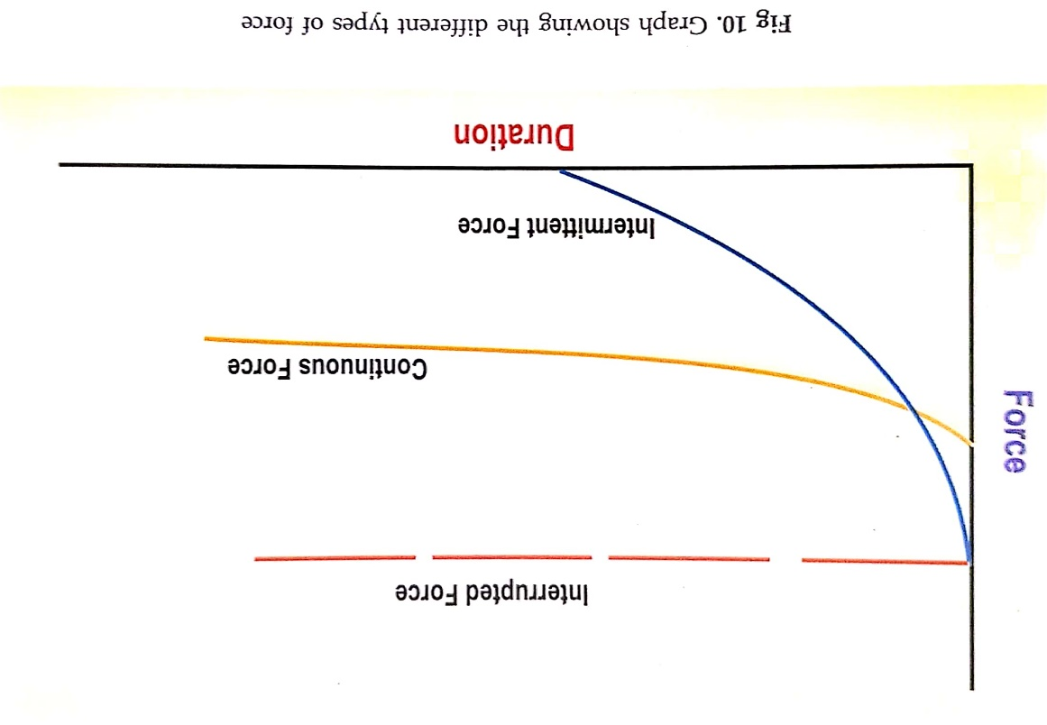
It is an active orthodontic
force that decreases little
in magnitude between
appointment periods
e.g. Light wire appliance.
.
Continuous force

Slide 42
Intermittent force
It is an active orthodontic force
that decays to zero magnitude
or nearly so prior to the next
appointment.
e.g. Removable active plates.

Slide 43
Interrupted force
It is an orthodontic or orthopaedic
force that is inactive for intervals
of time between appointments.
It often exhibits cyclic, long-term magnitude-time pattern.
e.g. Force exerted by an extra-oral appliance worn only at night.

Slide 44
Theories of tooth movement:
Pressure tension theory by Schwarz. (classic theory)
Fluid dynamic theory / blood flow theory:
Bone bending & piezoelectric theory:

Slide 45
Pressure tension theory by Schwarz. (classic theory)
Schwarz(1932) - author of this theory .
According to him ,whenever a tooth is subjected to an orthodontic force it results in areas of pressure and tension
Areas of pressure show bone resorption while areas of tension show bone deposition.

Slide 46
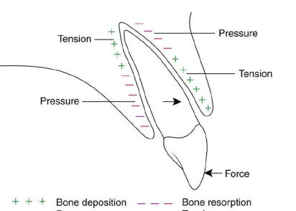

Slide 48
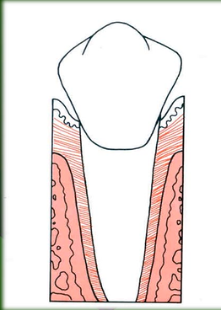
Fluid dynamic theory by Bien/Blood flow theory
According to this theory ,
alternations in fluid dynamics ( in PDL located in periodontal ligament space )
tooth movement
PDL space contains a fluid system made up of interstitial fluid, cellular elements , blood vessels and viscous ground substances in addition to PDL fibers.
.

Slide 49
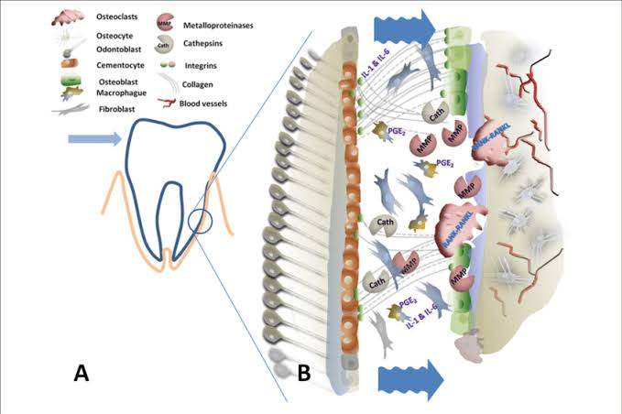
It is a confined space and passage of fluid in & out of this space is limited
The contents of PDL creates a unique hydrodynamic condition resembling a hydraulic mechanism & shock absorber .

Slide 50
.
The fluid is replenished by diffusion from
capillary walls & there is recirculation of
interstitial fluids.
Squeeze film effect by Bien .
orthodontic force
compression of ligament
trapping of Blood vessels of PDL between the principle fibers
stenosis.

Slide 51
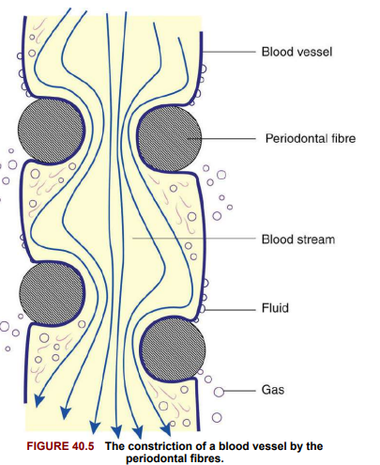

Slide 52
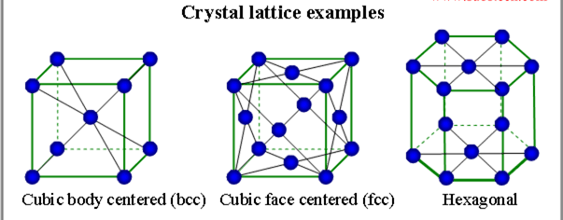
Bone bending & piezoelectric theory:
Farrar in 1876, first noted deformation or bending of interseptal alveolar bones.
This hypothesis was later confirmed with the experiments of Baumrind
bone bending tooth movement.
Piezo-electricity is a phenomenon
observed in many crystalline materials

Slide 53
Deformation of the crystal structure
displacement of electrons from one part of the crystal lattice to the other
A small electric current is generated
Piezo-electricity

Slide 54
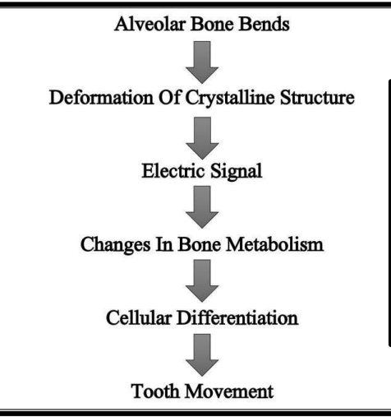
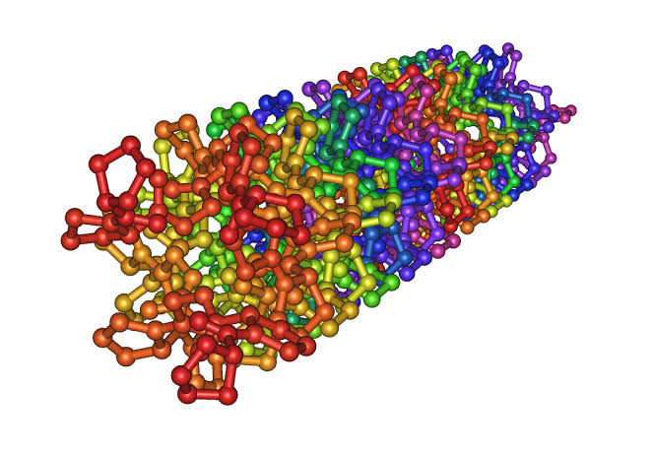

Slide 55
The possible source of electric current are :-
Collagen.
Hydroxyapatite.
Collagen hydroxyapatite interface.
Mucopolysaccharide.

Slide 56
As long as the force is maintained ,The crystal structure is stable & no further electric effect is observed.
When the force is released the crystals return to their original shape & reverse flow of electrons is observed.
This rhythmic activity produces a constant interplay of electric signals .

Slide 57
Piezoelectric signals have two unusual characteristics.
Quick decay rate:
When the force is released electrons flow in the opposite direction.
On application of a force on a tooth ,
Areas of concavity -> negative charges -> bone deposition.
Areas of convexity -> positive charges and -> bone resorption.

Slide 58
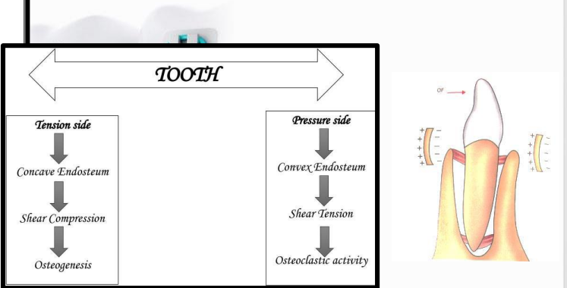

Slide 59

THANK
YOU

