Slide 1
Department of periodontology
UG PRACTICAL-2020
REGULAR BATCH –FINAL BDS

Slide 2
MARKS DISTRIBUTION FOR UG PRACTICAL EXAM
Max Marks 90
1.Case History Scenario- 50 Marks
2. Spotters -30 Marks
3.OSCE/OSPE -10 Marks
TOTAL- 90 Marks

Slide 3
Case histories: Max Marks 50
CASE 1: Generalized Chronic Periodontitis
CASE 2: Chronic Gingivitis with localized Periodontitis
in the Anterior teeth
CASE 3: Chronic generalized Gingivitis with localized chronic Periodontitis in the Posterior teeth
CASE 4:Chronic generalized Gingivitis

Slide 4
2. Spotters 30
INSTRUMENTS
MATERIALS
INTERDENTAL AIDS

Slide 5
INSTRUMENTS

Slide 6
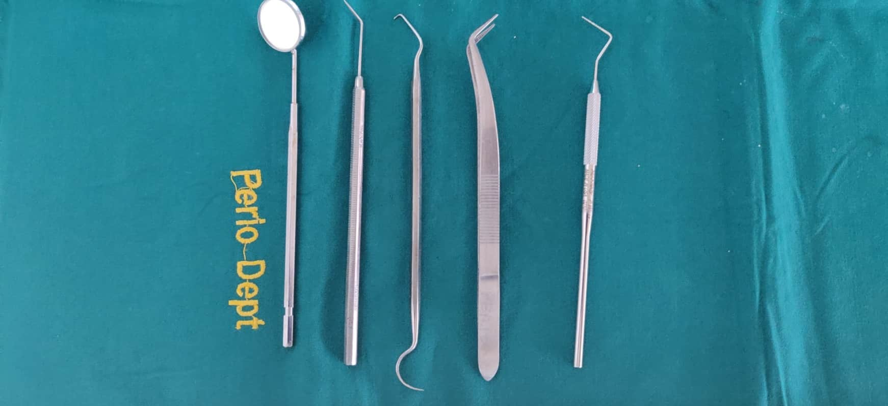
Diagnostic Instruments 1. Mouth mirror, 2. Straight probe, 3. Explorer,4. Tweezers, 5. William’s probe.

Slide 7
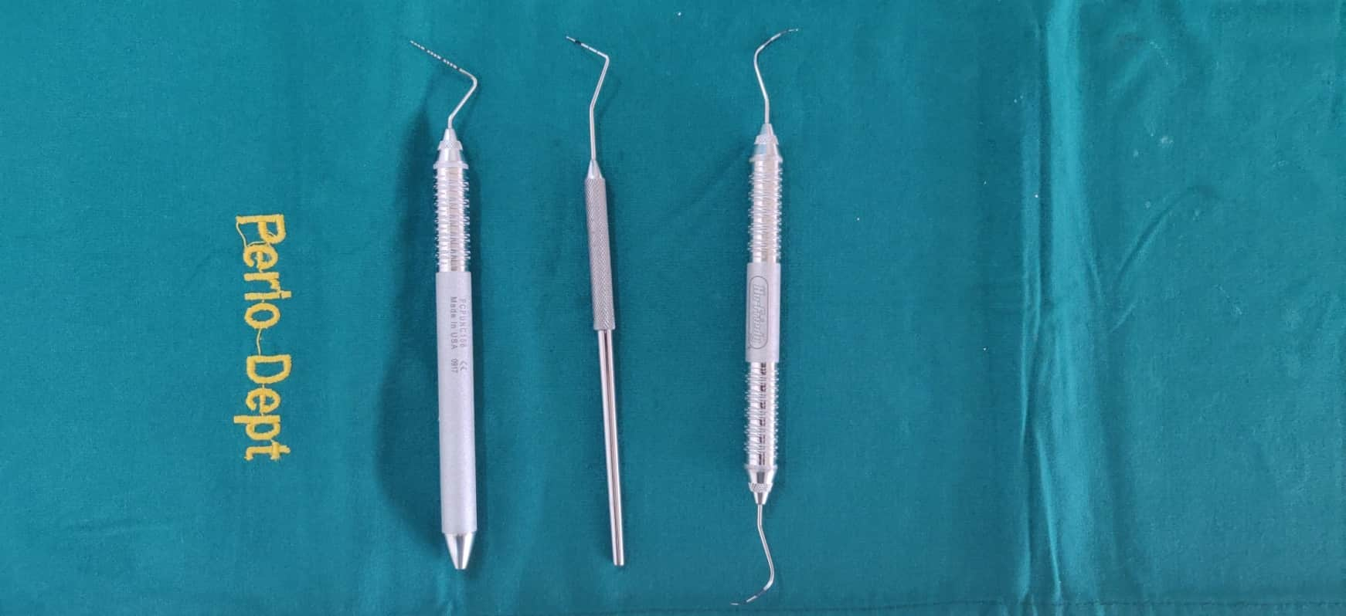
Types of Probes 1. UNC 15 2. William’s 3. Naber’s

Slide 8
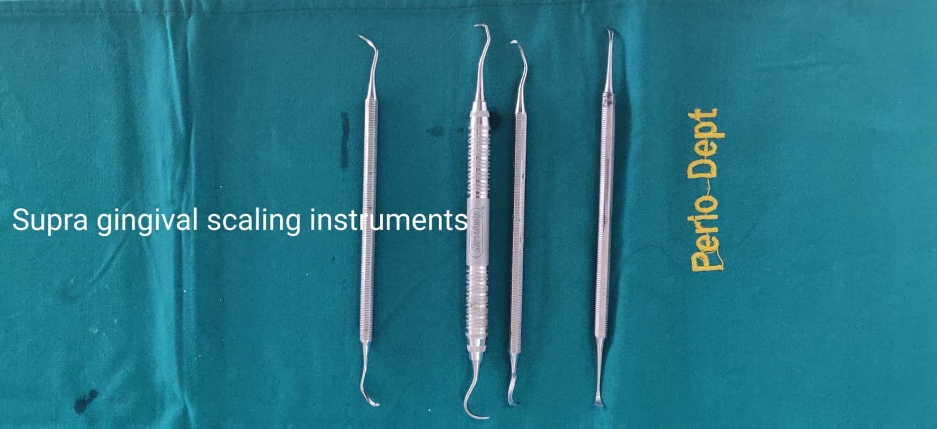
Supra-gingival Scaling Instruments 1. Surface scaler, 2. Interdental, 3. Posterior

Slide 9
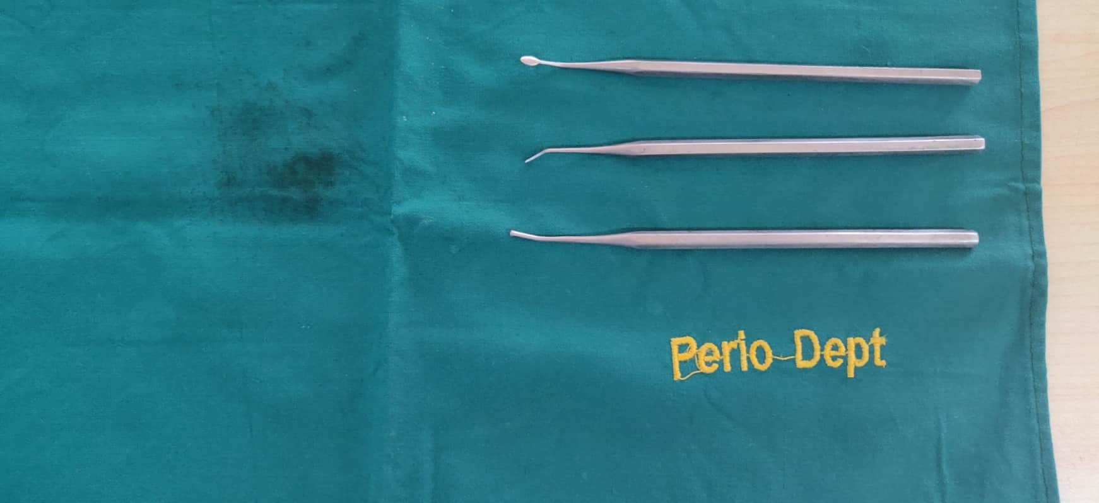
Sub- Gingival Scaling Instruments 1. File 2. Chisel 3. Hoe

Slide 10
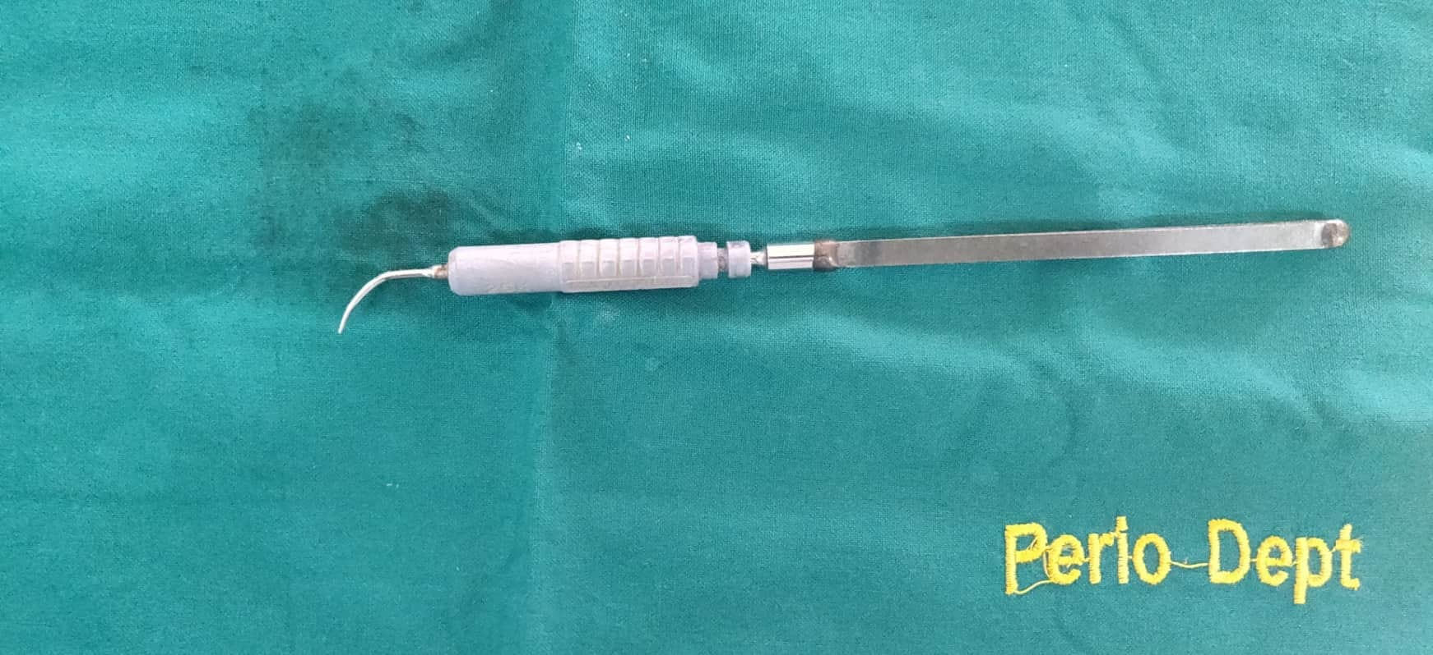
Ultrasonic Magnetostrictive Scalar

Slide 11
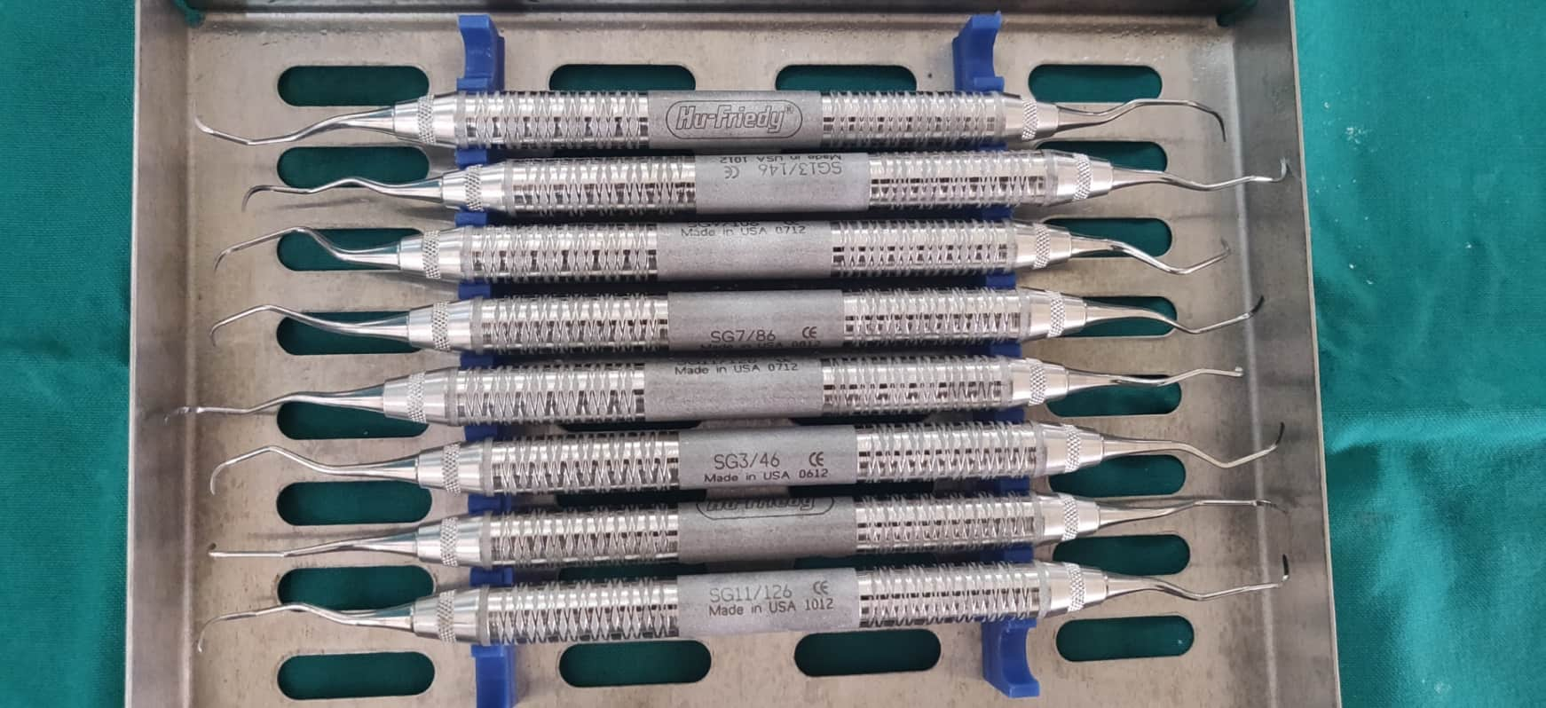
Gracey Curettes (nos. 1-14)

Slide 12
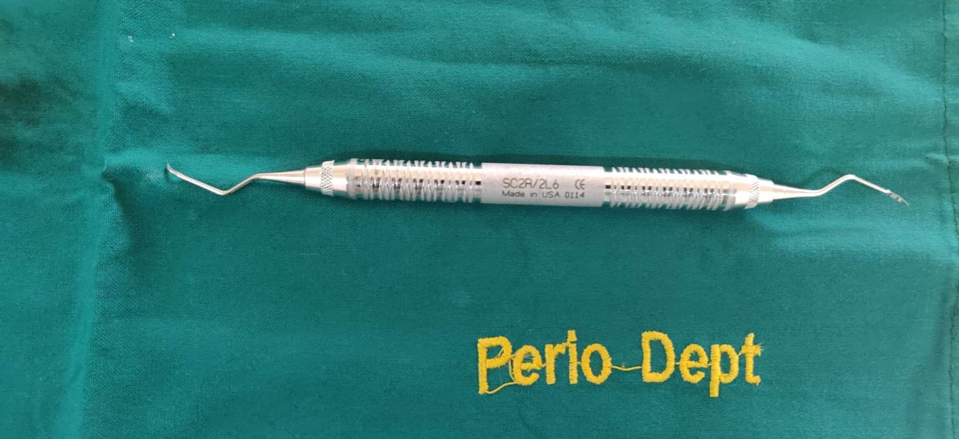
Universal Curette- Double ended

Slide 13
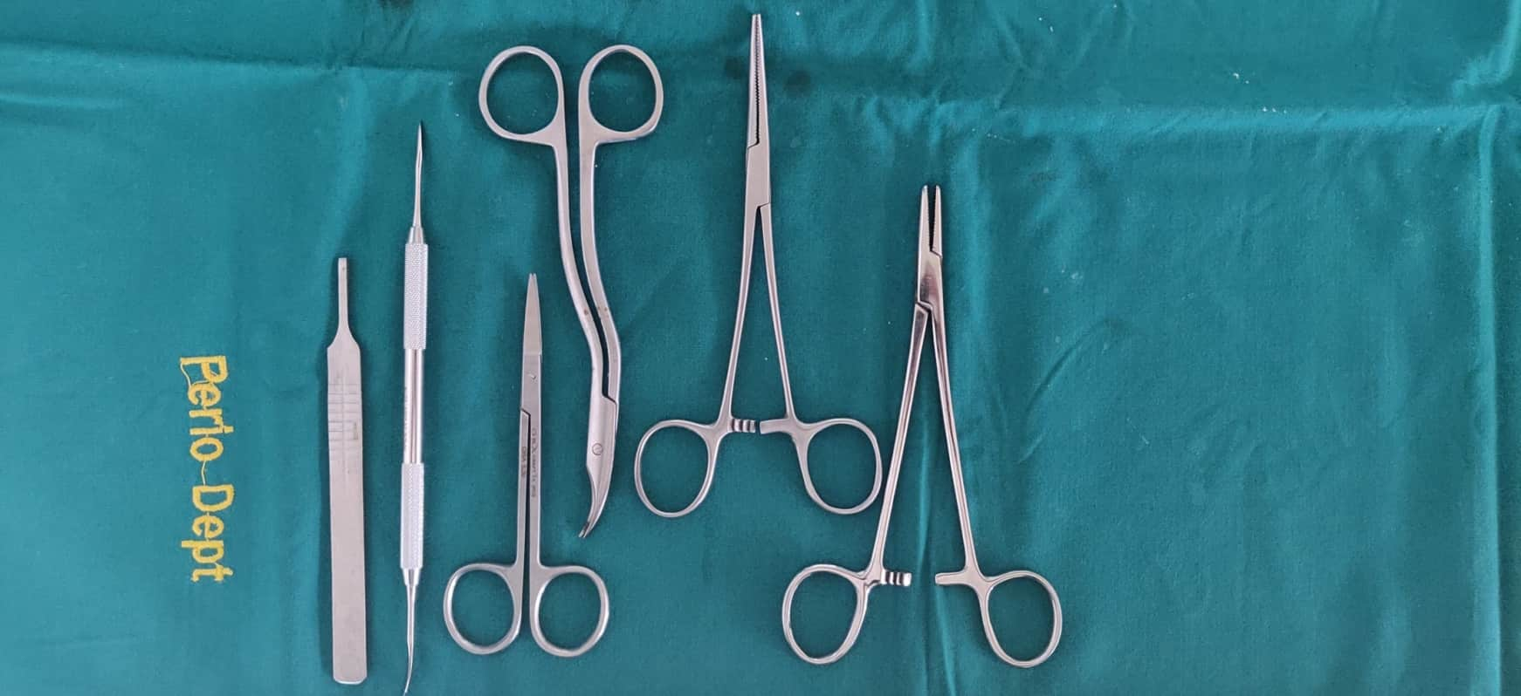
Surgical Instruments 1.BP handle 2. Periosteal elevator 3. Scissors- straight & curved 4. Artery forceps 5. Needle holder

Slide 14
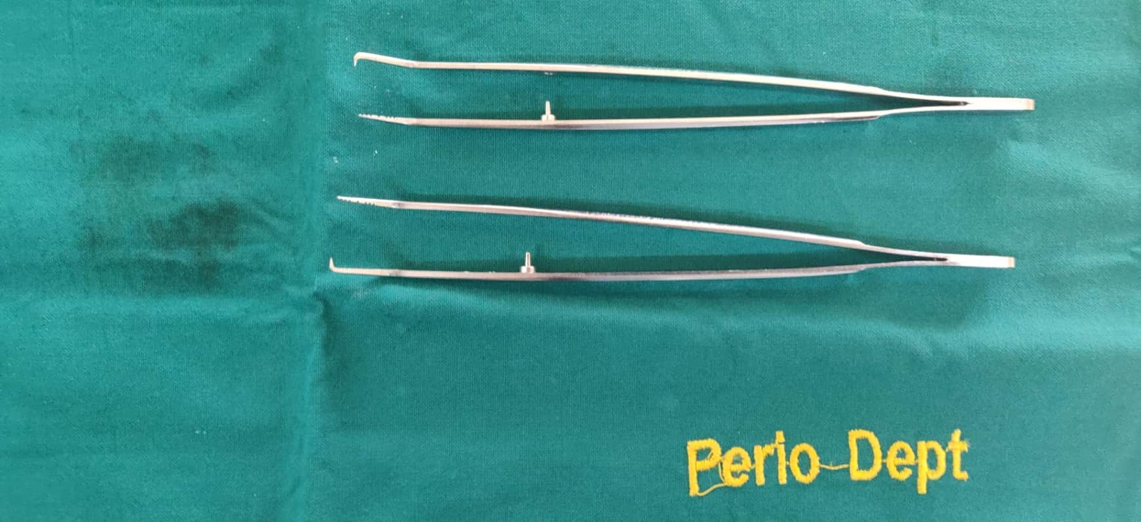
Pocket markers (2)

Slide 15
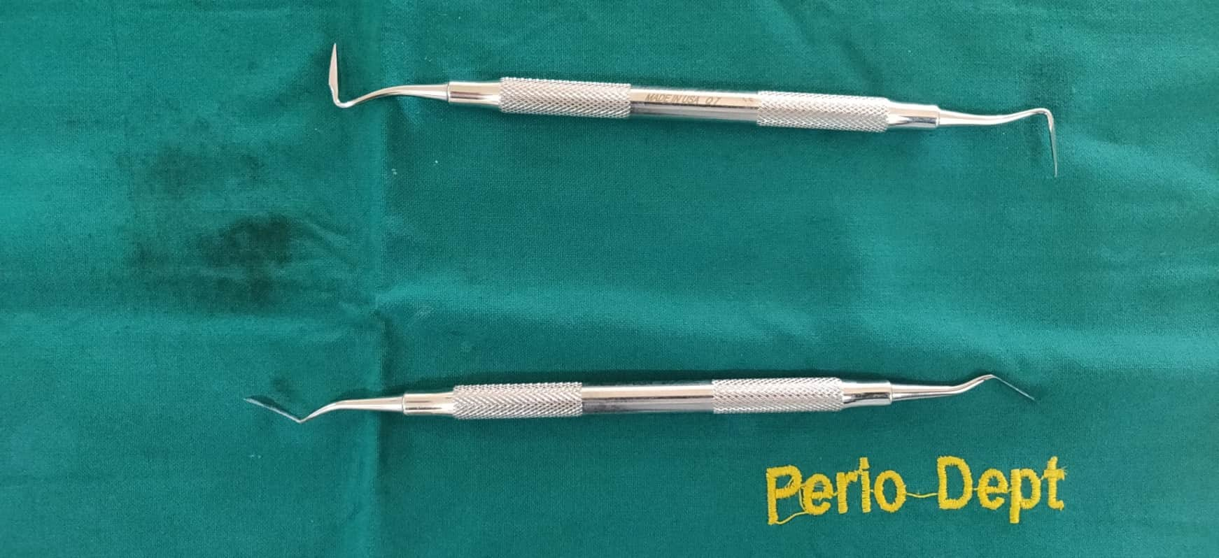
Gingivectomy Knives 1. Orban’s 2. Kirkland

Slide 16
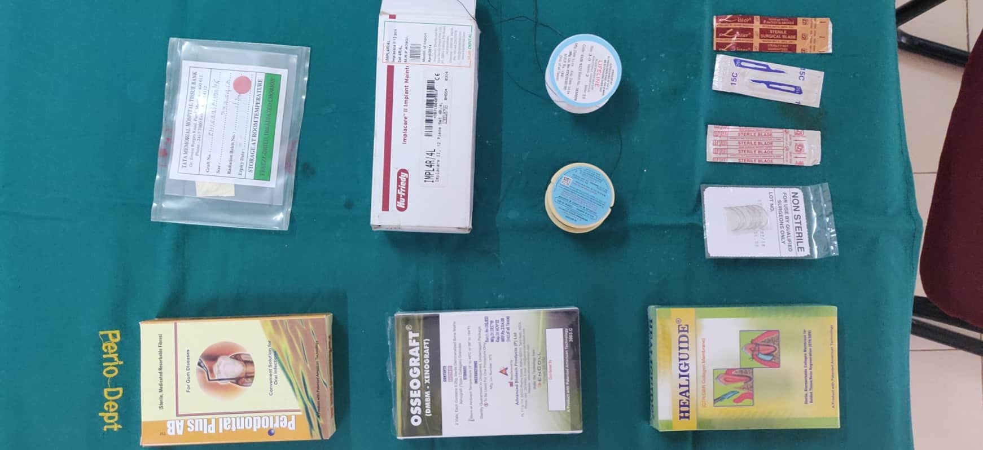
Materials 1. Local drug delivery- Tetracycline fiber, 2.Bone graft- xenograft, 3. GTR membrane, 4. Suture needles, 5. Surgical blades, 6. Suture materials, 7. Implant maintenance kit, 8. Collagen membrane- tissue graft.

Slide 17
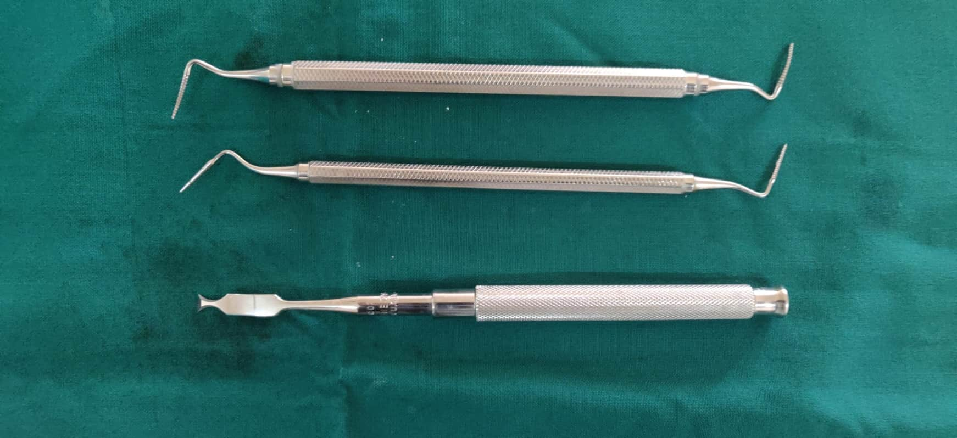
Osseous Surgical Instruments 1.Bone Files (2) 2. Oseinben chisel

Slide 18
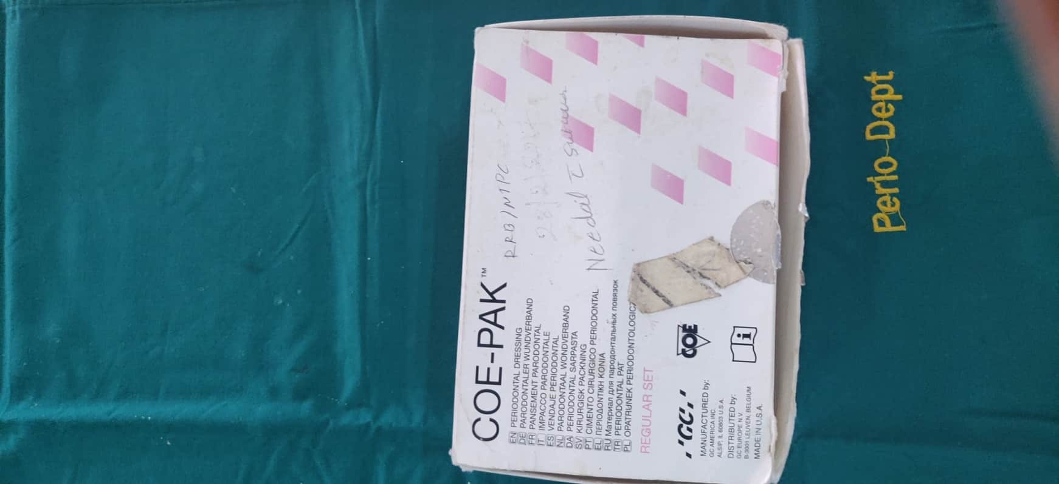
Surgical Periodontal Pack

Slide 19
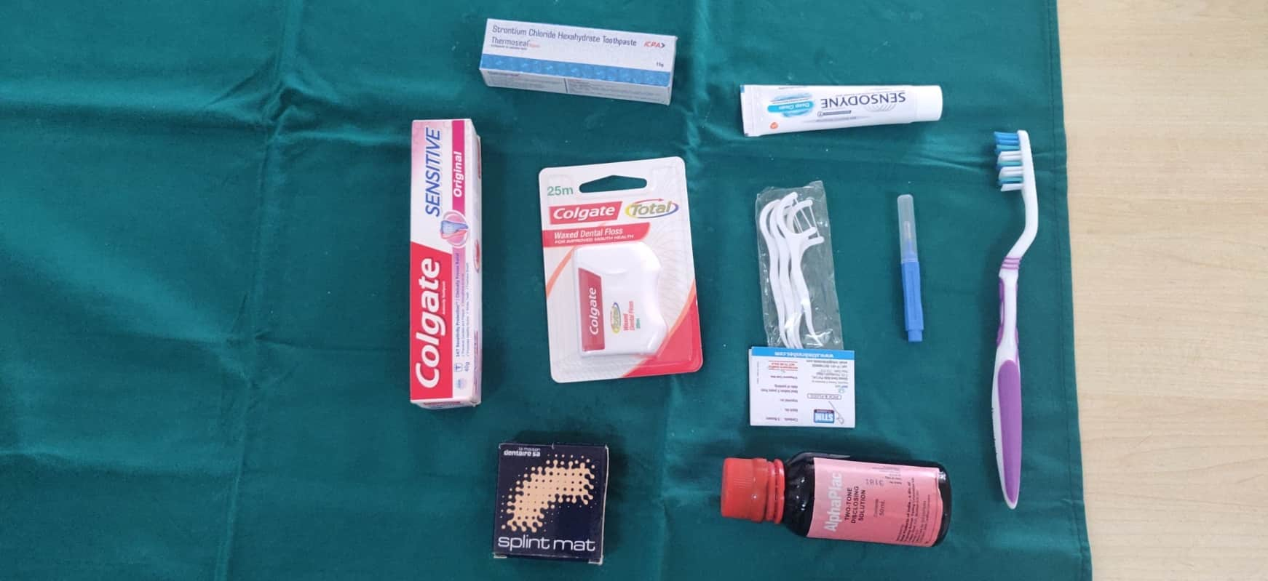
Oral Hygiene Aids 1. Toothpastes (3 medicated),2. Dental floss,3. Floss holder,4. Interdental aids, 5.Toothbrush, 6. Disclosing agent, 7. Splinting material

Slide 20
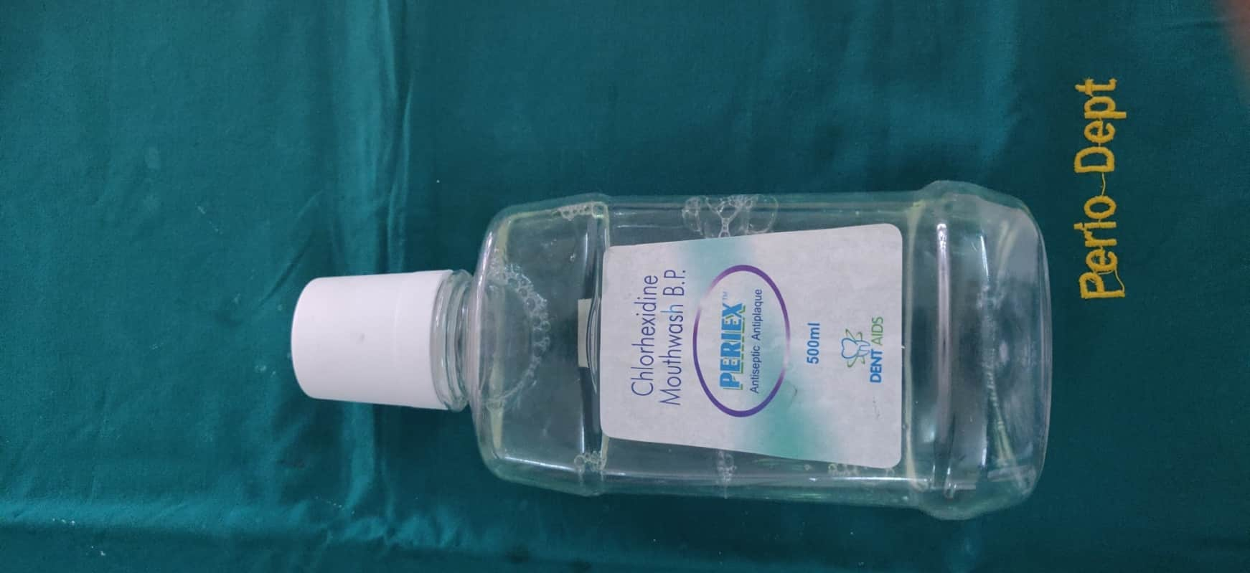
Mouth wash

Slide 21
OSCE/OSPE TOTAL: 10 Marks
Station 1: 5 Marks
Station 2: 5 Marks

Slide 22
Station 1:OSCE/OSPE Marks 5
Supragingival Scaling Procedure on tooth number 16:
Checklist: (1 mark each)
Chooses the correct instrument used
Adaptation of instrument
Correct finger rest used
Correct scaling stroke used
Included all surfaces

Slide 23
Station 2:OSCE/OSPE Marks 5
Modified Bass Tooth brushing Technique in 4th Quadrant-posterior teeth:
Checklist: (1 mark each)
Correct placement of brush head in the area
Three teeth included
20 back and forth strokes given
Sweeping stroke given in occlusal directi0n
Included all surfaces ( buccal, lingual & occusal)

Slide 24
VIVA
Questions
Viva cards

Slide 25
Thank you

