Slide 1
cell
Dr. Shivanand Pattan
Lecturer
Department of Physiology

Slide 2
CONTENT
INTRODUCTION
STRUCTURE OF THE CELL
CELL MEMBRANE
CYTOPLASM
ORGANELLES IN CYTOPLASM
ORGANELLES WITH LIMITING MEMBRANE
ORGANELLES WITHOUT LIMITING MEMBRANE
NUCLEUS
DEOXYRIBONUCLEIC ACID
GENE
RIBONUCLEIC ACID
GENE EXPRESSION
GROWTH FACTORS
CELL DEATH
CELL ADAPTATION
CELL DEGENERATION
CELL AGING
STEM CELLS

Slide 3
INTRODUCTION
All the living things are composed of cells. A single cell is the smallest unit that has all the characteristics of life. Cell is defined as the structural and functional unit of the living body.

Slide 4
STRUCTURE OF THE CELL
Each cell is formed by a cell body and a membrane covering the cell body called the cell membrane. Cell body has two parts, namely nucleus and cytoplasm surrounding the nucleus (Fig. 1.1). Thus, the structure of the cell is studied under three headings:
1. Cell membrane
2. Cytoplasm
3. Nucleus.

Slide 5
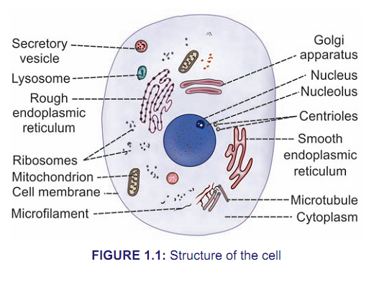

Slide 6
CELL MEMBRANE
Cell membrane is a protective sheath, enveloping the cell body. It is also known as plasma membrane or plasmalemma. This membrane separates the fluid out­ side the cell called extracellular fluid (ECF) and the fluid inside the cell called intracellular fluid (ICF). The cell membrane is a semipermeable membrane. So, there is free exchange of certain substances between ECF and ICF. Thickness of the cell membrane varies from 75 to 111Å (Fig. 1.2).

Slide 7
CYTOPLASM
Cytoplasm of the cell is the jelly­like material formed by 80% of water. It contains a clear liquid portion called cytosol and various particles of different shape and size. These particles are proteins, carbohydrates, lipids or electrolytes in nature. Cytoplasm also contains many organelles with distinct structure and function.
Cytoplasm is made up of two zones:
1. Ectoplasm: Peripheral part of cytoplasm, situated
just beneath the cell membrane
2. Endoplasm: Inner part of cytoplasm, interposed
between the ectoplasm and the nucleus.

Slide 8
ORGANELLES IN CYTOPLASM
Cytoplasmic organelles are the cellular structures embedded in the cytoplasm. Organelles are considered as small organs of the cell. Some organelles are bound by limiting membrane and others do not have limiting membrane (Box 1.1). Each organelle is having a definite structure and specific functions (Table 1.1).

Slide 9
BOX 1.1: Cytoplasmic organelles
Organelles with limiting membrane
1. Endoplasmic reticulum
2. Golgi apparatus
3. Lysosome
4. Peroxisome
5. Centrosome and centrioles
6. Secretory vesicles
7. Mitochondria
8. Nucleus
Organelles without limiting membrane
1. Ribosomes
2. Cytoskeleton

Slide 10
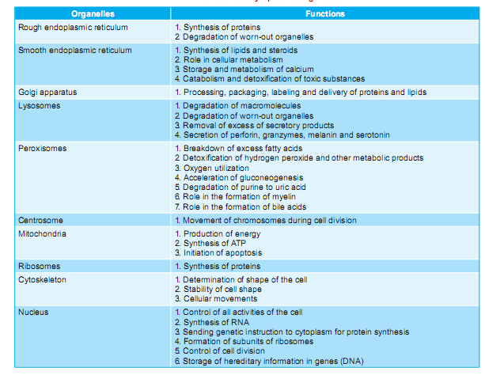
TABLE 1.1: Functions of cytoplasmic organelles

Slide 11
ORGANELLES WITH LIMITING MEMBRANE
ENDOPLASMIC RETICULUM
Endoplasmic reticulum is a network of tubular and microsomal vesicular structures which are interconnected with one another. It is covered by a limiting membrane which is formed by proteins and bilayered lipids. Thelumen of endoplasmic reticulum contains a fluid medium called endoplasmic matrix. The diameter of the lumen is about 400 to 700Å. The endoplasmic reticulum forms the link between nucleus and cell membrane by connecting the cell membrane with the nuclear membrane.

Slide 12
ORGANELLES WITHOUT LIMITING MEMBRANE
RIBOSOMES
Ribosomes are the organelles without limiting membrane. These organelles are granular and small dot-like structures with a diameter of 15 nm. Ribosomes are made up of 35% of proteins and 65% of ribonucleic acid (RNA). RNA present in ribosomes is called ribosomal RNA (rRNA). Ribosomes are concerned with protein synthesis in the cell.
Types of Ribosomes
Ribosomes are of two types:
i. Ribosomes that are attached to rough endoplasmic reticulum
ii. Free ribosomes that are distributed in the cytoplasm.

Slide 13
NUCLEUS
Nucleus is the most prominent and the largest cellular organelle. It has a diameter of 10 µ to 22 µ and occupies about 10% of total volume of the cell.

Slide 14
DEOXYRIBONUCLEIC ACID
Deoxyribonucleic acid (DNA) is a nucleic acid that carries the genetic information to the offspring of an organism. DNA forms the chemical basis of hereditary characters. It contains the instruction for the synthesis of proteins in the ribosomes. Gene is a part of a DNA molecule.
DNA is present in the nucleus (chromosome) and mitochondria of the cell. The DNA present in the nucleus is responsible for the formation of RNA. RNA regulates the synthesis of proteins by ribosomes. DNA in mitochondria is called non-chromosomal DNA.

Slide 15
GENE
Gene is a portion of DNA molecule that contains the message or code for the synthesis of a specific protein from amino acids. It is like a book that contains the information necessary for protein synthesis. Gene is considered as the basic hereditary unit of the cell.
In the nucleotide of DNA, three of the successive base pairs are together called a triplet or a codon. Each codon codes or forms code word (information) for one amino acid. There are 20 amino acids and there is separate code for each amino acid. For example, the triplet CCA is the code for glycine and GGC is the code for proline.
Thus, each gene forms the code word for a particular protein to be synthesized in ribosome (outside the nucleus) from amino acids.

Slide 16
RIBONUCLEIC ACID
Ribonucleic acid (RNA) is a nucleic acid that contains a long chain of nucleotide units. It is similar to DNA but contains ribose instead of deoxyribose. Various functions coded in the genes are carried out in the cytoplasm of the cell by RNA. RNA is formed from DNA.

Slide 17
GENE EXPRESSION
Gene expression is the process by which the information (code word) encoded in the gene is converted into functional gene product or document of instruction (RNA) that is used for protein synthesis.
Gene expression involves two steps:
1. Transcription.
2. Translation.

Slide 18
GROWTH FACTORS
Growth factors are proteins which act as cell signaling molecules like cytokines (Chapter 17) and hormones (Chapter 65). These factors bind with specific surface receptors of the target cell and activate proliferation, differentiation and/or maturation of these cells.
Often, the term growth factor is interchangeably used with the term cytokine. But growth factors are distinct from cytokines. Growth factors act on the cells of the growing tissues. But cytokines are concerned with the cells of immune system and hemopoietic cells.

Slide 19
CELL DEATH
Cell death occurs by two distinct processes:
1. Apoptosis
2. Necrosis

Slide 20
Apoptosis
Apoptosis is defined as the natural or programed death of the cell under genetic control. Originally, apoptosis refers to the process by which the leaves fall from trees in autumn (In Greek, apoptos is means ‘falling leaves’). It is also called ‘cell suicide’ since the genes of the cell play a major role in the death.
This type of programmed cell death is a normal phenomenon and it is essential for normal development of the body. In contrast to necrosis, apoptosis usually does not produce inflammatory reactions in the neighboring tissues.

Slide 21
Necrosis
Necrosis (means ‘dead’ in Greek) is the uncontrolled and unprogramed death of cells due to unexpected and accidental damage. It is also called ‘cell murder’ because the cell is killed by extracellular or external events. After necrosis, the harmful chemical substances released from the dead cells cause damage and inflammation of neighboring tissues.

Slide 22
CELL ADAPTATION
Cell adaptation refers to the changes taking place in a cell in response to environmental changes.
Normal functioning of the cell is always threatened by various factors such as stress, chemical agents, diseases and environmental hazards. Yet, the cell survives and continues the function by means of adaptation. Only during extreme conditions, the cell fails to withstand the hazardous factors which results in destruction and death of the cell.
Cellular adaptation occurs by any of the following mechanisms.
1. Atrophy 2. Hypertrophy 3. Hyperplasia
4. Dysplasia 5. Metaplasia.

Slide 23
CELL DEGENERATION
Cell degeneration is a process characterized by damage of the cells at cytoplasmic level, without affecting the nucleus. Degeneration may result in functional impairment or deterioration of a tissue or an organ. It is common in metabolically active organ like liver, heart and kidney. Degenerative changes are reversible in most of the cells.

Slide 24
CELL AGING
Cell aging is the gradual structural and functional changes in the cells that occur over the passage of time. It is now suggested that cell aging is due to damage of cellular substances like DNA, RNA, proteins and lipids, etc. when the cell becomes old. When more cellular substances are damaged, the cellular function decreases. This causes deterioration of tissues, organs or parts of the body. Finally, the health of the body starts declining and this leads to death. So, the cell aging determines the health and life span of the body.

Slide 25
STEM CELLS
Stem cells are the primary cells capable of reforming themselves through mitotic division and differentiating into specialized cells. These cells serve as repair system of the body and are present in all multicellular organisms.
TYPES OF STEM CELLS
Stem cells are of two types:
1. Embryonic stem cells derived from embryo
2. Adult stem cells derived from adults.

Slide 26
Thank you,,,,,,,,,,,,,,,,,,,,,,,,,,,

