Slide 1
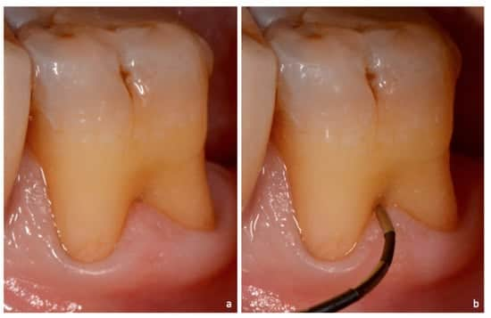
MINESS MEDICINE
PRESENTATION
FURCATION INVOLVEMENT
Here is where your presentation begins!
PRESENTED BY:
Dr. Sheetal Sanikop
Dept. of Periodontology

Slide 2
CONTENTS
Introduction
Basic terminology
Etiologic factors
Classifications
Diagnosis
Treatment of furcation
Prognosis
Conclusion
Reference

Slide 3
01
INTRODUCTION

Slide 4
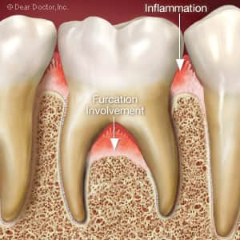
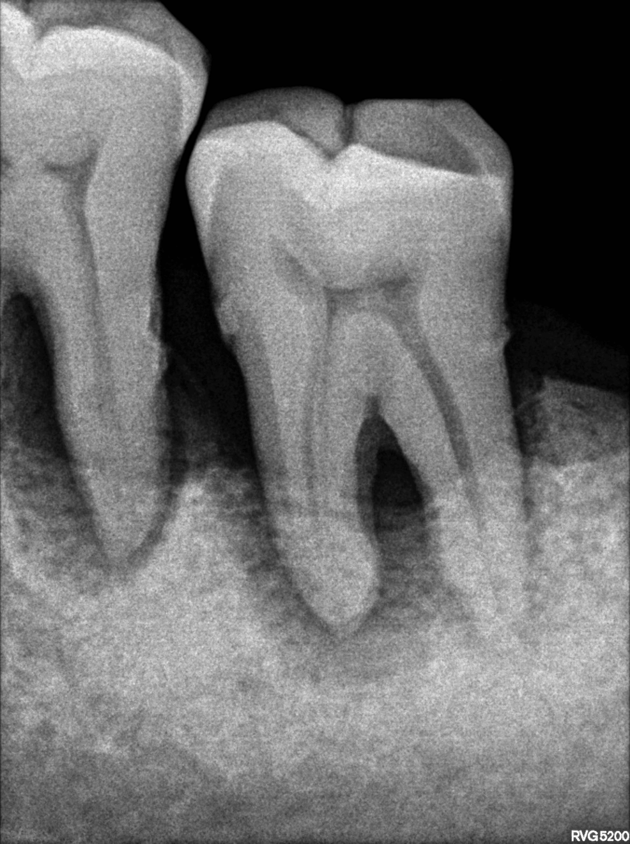
Inflammatory periodontal disease - attachment loss - affect the bifurcation or trifurcation of multirooted teeth.
Furcation area
Routine home care methods
Furcation involvement is a clinical finding that can lead to a diagnosis of advanced periodontitis
Furcation involvement - diagnostic and therapeutic dilemmas
Notes:
furcation is an area of complex anatomic morphology that may be dificult or impossible to debride by routine periodontal instrumentation.2

Slide 5
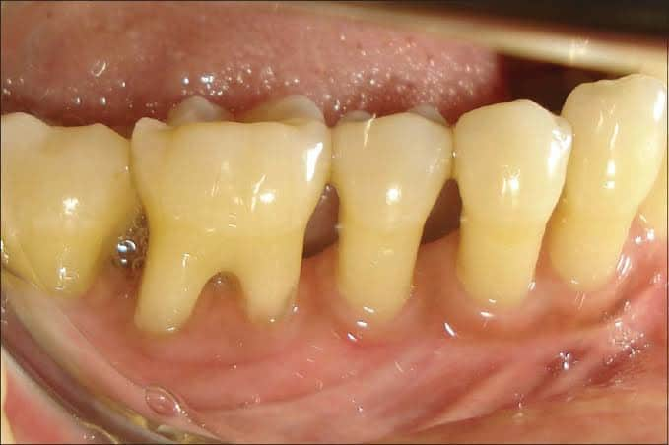
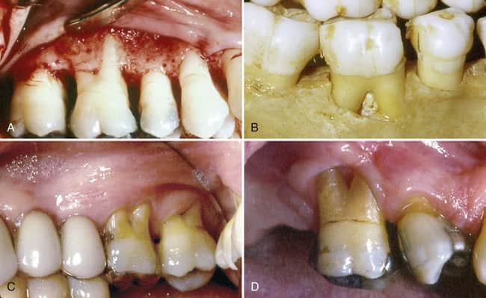
FURCATION
A furcation is defined as "the anatomic area of a multirooted tooth where the roots diverge", and furcation invasion refers to the "pathologic resorption of bone within a furcation“
~ AAP 1992
Glickman (1950): Commonly occurring condition in which the bifurcation and trifurcation of multi-rooted teeth are denuded by periodontal disease
Prichard (1965): Bifurcation and trifurcation involvements are common periodontal lesions which occur as a result of gingival inflammation and bone resorption adjacent to and within the furcation of multi-rooted teeth.
Goldman & Cohen (1968): Extension of pocket into the inter-radicular area of bone in multi-rooted teeth.

Slide 6
02
BASIC TERMINIOLOGIES

Slide 7
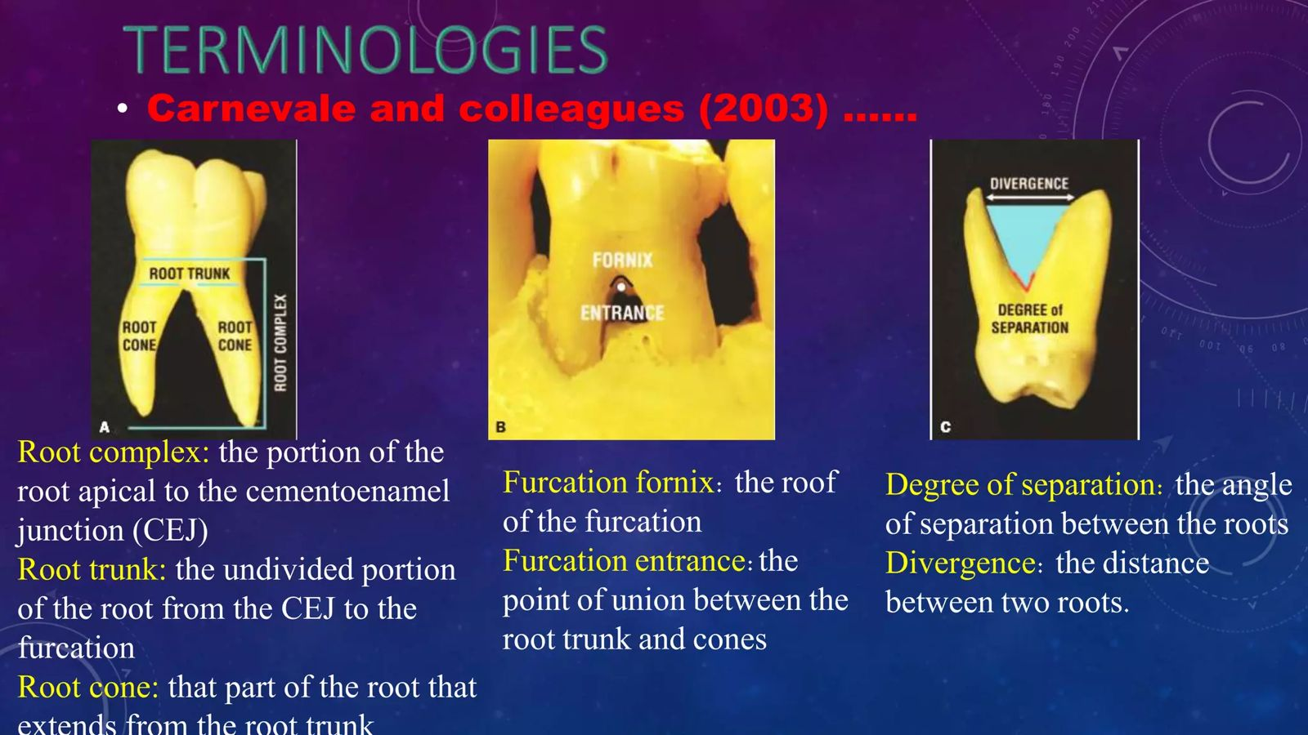
ROOT COMPLEX: the portion of the root apical to the cementoenamel junction (CEJ)
ROOT TRUNK: the undivided portion of the root from the CEJ to the furcation
ROOT CONE: that part of the root that extends from the root trunk
FURCATION ENTRANCE: It is the transitional area between the undivided and divided part of the root.
FURCATION FORNIX: Roof of the furcation

Slide 8
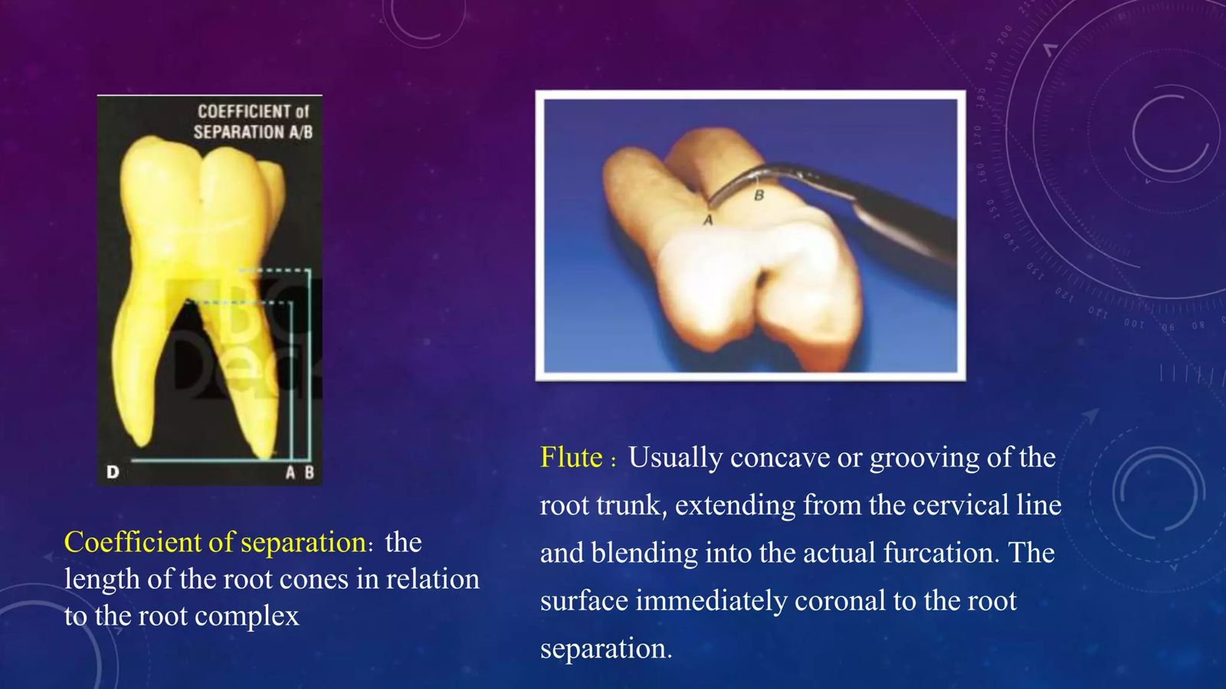
DIVERGENCE: Distance between the roots
DEGREE OF SEPERATION:
It is the angle of separation between two root cones.
CO EFFICIENT OF SEPERATION: Length of root cones in relation to root complex
FLUTE: Concave or grooving of the root trunk, extending from cervical line and blending into furcation area

Slide 9
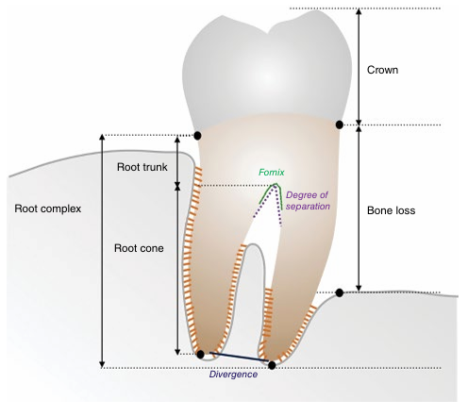

Slide 10
03
ETIOLOGY

Slide 11
Primary etiologic factor - bacterial plaque Extent of attachment loss -→ furcation defect -- local anatomic factors and local developmental anomalies Dental caries and pulpal death
Notes:
Dental caries and pulpal death may also affect a tooth with furcation involvement or even the area of the furcation

Slide 12
Local Anatomic Factors
Many local anatomic factors will affect the result of therapy (prognosis)
Important local factors include anatomic features of the affected teeth
A. TOOTH
Root trunk length
Root length
Root form
Interradicular dimension
Anatomy of furcation
Cervical enamel projection
B. ANATOMY OF BONY LESIONS
C. OTHER DENTAL FINDINGS

Slide 13
A. TOOTH
ROOT TRUNK LENGTH:
The root trunk is generally defined as the area of the tooth from the CEJ to the furcation fornix.
Gher and Dunlap (1985),
very short root trunks, moderate root trunk length, or roots that may be fused to a point near the apex
shorter the root trunk - less attachment needs to be lost before the furcation is involved - more accessible to maintenance procedures
long root trunks or fused roots – not easily involved – very difficult to manage
Al Shammari et al. (2001)
Notes:
summarized that the root trunk length significantly relates to the prognosis and treatment of molars
. A short root trunk worsens the prognosis with regard to a more likely FI, but once periodontal destruction has occurred, it improves the chances of a successful treatment

Slide 14
ROOT LENGTH:
quantity of attachment supporting the tooth.
long root trunks and short roots - lost a majority of their support by the time that the furcation becomes affected
ROOT FORM:
The mesial root of mandibular first and second molars and the mesiofacial root of the maxillary first molar - curved to the distal side in the apical third
vertical root fracture
INTERRADICULAR DIMENSION:
Closely approximated or fused roots - preclude adequate instrumentation during scaling, root planing, and surgery.
Teeth with widely separated roots - treatment options and are more readily treated.

Slide 15
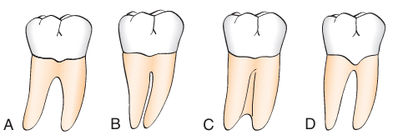
ANATOMY OF FURCATION
Complex
bifurcational ridges
concavity in the dome
accessory canals- complicates not only scaling, root planing, and surgical therapy, periodontal maintenance.
Odontoplasty
Notes:
Odontoplasty to reduce or eliminate these ridges may be required during surgical therapy for an optimal result
(A) Widely separated roots. (B) Roots are separated but close. (C) Fused roots separated only in their apical portion. (D) Presence of enamel projection that may be conducive to early furcation involvement.

Slide 16
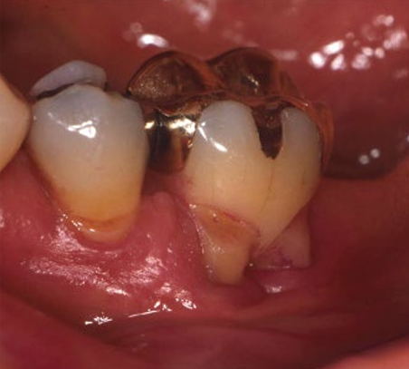
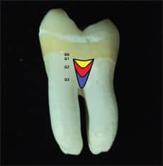
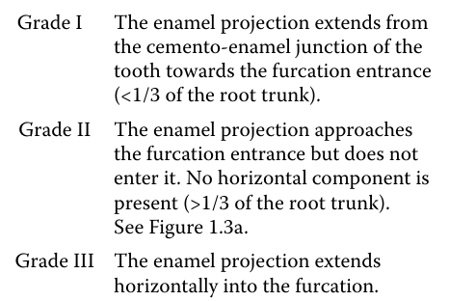
CERVICAL ENAMEL PROJECTIONS:
Atkinson in 1949 - connection between CEPs and periodontal destruction in molars
Bissada and Abdelmalek (1973) detected a CEP prevalence of 8.6%.
MASTERS AND HOSKINS (1964)
Masters DH, Hoskins SW: Projection of cervical enamel into molar furcations. J Periodontol 35:49, 1964
Notes:
29% of mandibular and 17% of maxillary molars.

Slide 17
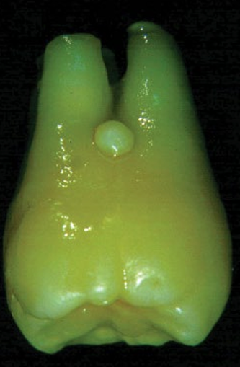
Enamel pearl
Ectopic globules consisting mostly of enamel, often containing a core of dentine, and they adhere to the tooth root surface
Enamel projections prevent connective tissue attachment and thus contribute to the aetiology of periodontal destruction.

Slide 18
B. ANATOMY OF THE BONY LESIONS
Horizontal bone loss - expose the furcation as thin facial or lingual plates of bone - totally lost during resorption
vertical components - thickened bony ledges may persist and predispose to the development of furcations with deep.
Complex multiwalled defects with deep, interradicular vertical components may be candidates for regenerative therapies
C. OTHER DENTAL FINDINGS
combination of furcation involvement and root approximation with an adjacent tooth
removal of the most severely affected tooth or the removal of a root or roots
presence of an adequate band of gingiva and a moderate to deep vestibule will facilitate the performance of a surgical procedure, if indicated.

Slide 19
Periodontal Aetiological Factors
Anatomical factors and may lead to periodontal destruction and attachment loss in molars, and thus result in a furcation defect
According to Al‐Shammari et al. (2001)
Plaque‐associated inflammation
Trauma from occlusion
Pulpal pathology
Vertical root fractures
Iatrogenic factors

Slide 20
1. Plaque‐associated inflammation
Furcations are more prone to plaque adhesion and less likely to stay plaque free
The anatomy of the furcation favours retention of bacterial deposits and renders hygiene procedures difficult (Matthews and Tabesh 2004)
1987, Nordland et al - higher plaque and gingivitis scores
furcation areas are an extension of periodontal pockets - Glickman 1950 Al‐Shammari et al. 2001

Slide 21
2. Occlusal trauma
Glickman and co‐workers as well as Lindhe and co‐workers- Research excessive occlusal forces on molars in dogs and monkeys led to significant periodontal damage, especially in multi-rooted teeth
Glickman et al. (1961) found that the fiber orientation in the furcation area of multi-rooted teeth makes them more vulnerable to occlusal forces
Harrel (2003), suggest that occlusal interferences should be considered a risk factor for periodontal disease, not a direct cause, similar to smoking

Slide 22
3. Vertical Root Fractures
Vertical root fractures- longitudinal direction - are difficult to diagnose because they share symptoms with other dental conditions (Matthews and Tabesh 2004
Mild pain or a dull discomfort is the only clinical symptom of a vertical root fracture (Meister at al. 1980)
Rapid localized loss of attachment and bone (Walton et al. 1984)
Poor prognosis is assigned to teeth exhibiting vertical root fractures (Al‐Shammari et al. 2001; Matthews and Tabesh 2004)

Slide 23
4. Endodontic Origin and Pulpal Pathology
Burch and Hulen (1974) reported ‘openings’ in 76% of the furcations of maxillary and mandibular molars
Canals allow for products of pulpal necrosis to enter the furcation area and cause an inflammatory lesion (Carnevale et al. 1995)
pulpal pathosis can result in FI reported that proximal and inter‐radicular bone destruction of endodontic origin is reversible after root canal treatment (Carnevale et al 1995)

Slide 24
5. Iatrogenic Factors
overhanging dental restorations
orthodontic bands
subgingival microflora document a potential mechanism for the initiation of periodontal disease associated with iatrogenic factors
placement of restorative margins subgingivally results in more plaque, more gingival inflammation and deeper periodontal pockets.

Slide 25
04
CLASSIFICATIONS

Slide 26
1. Glickman (1953)
2. Goldman et al. (1958)
3. Staffileno's classification (1969)
4. Easley and Drennan (1969)
5. Hamp et al. (1975)
6. Rosenberg (1978)
7. Ramfjord & Ash (1979)
8. Goldman and Cohen (1980)
9. Ricchetti (1982)
10. Tal and Lemmer (1982)
11. Tarnow & Fletcher (1984)
12. Eskow and Kapin (1984)
13. Fedi (1985)
14. Grant et al. (1988)
15. Basaraba (1990)
16. Carnevale et al. (1997)
17. Nevins and Capetta (1998
18. Hou et al. (1998)
19. Glossary of periodontal terms (2001)
20. Walter et al. (2009)

Slide 27
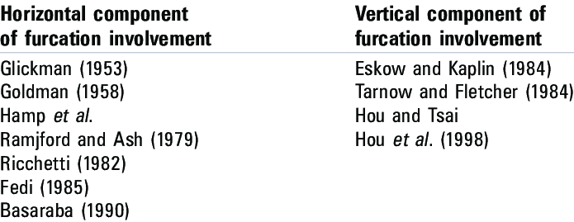

Slide 28
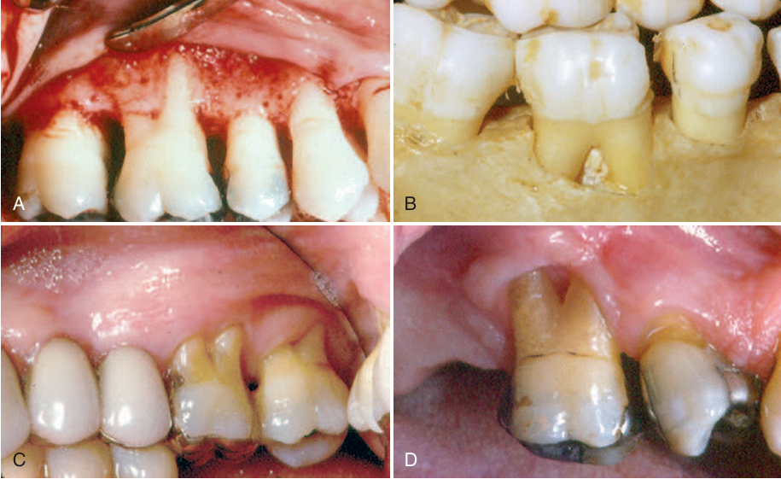
GLICKMAN CLASSIFICATION (1958)
GRADE I:
incipient or early stage of furcation involvement
pocket is suprabony
soft tissues
Early bone loss may have occurred with an increase in probing depth
radiographic changes are not usually found
GRADE III:
bone is not attached to
the dome of the furcation
Through and through
loss of interradicular bone
GRADE IV:
Through and through loss of interradicular bone with
total exposure of furcation – gingival recession
GRADE II:
cul-de-sac - with a definite horizontal component
Vertical bone loss

Slide 29
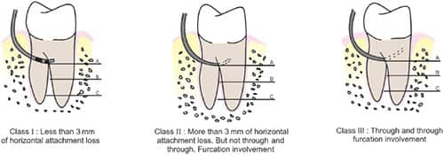
HAMP’S CLASSIFICATION (1975)
Fo : Pocket but without furcation involvement
F1: Furcation can be probed < 3mm in horizontal direction ( within 1/3 rd root width)
F2: Furcation can be probed deeper than 3mm ( beyond 1/3 rd root width)
F3: Through and through furcation involvement

Slide 30
RICCHETTI CLASSIFICATION (1982):
Class I: 1 mm of horizontal invasion. Class Ia. 1–2 mm of horizontal invasion. Class II: 2–4 mm of horizontal invasion. Class IIa. 4–6 mm of horizontal invasion. Class III: >6 mm of horizontal invasion.
GOLDMAN AND COHEN (1958):
Grade I: Incipient lesion.
Grade II: Cul-de-sac lesion.
Grade III: Through-and-through lesion.

Slide 31
RAMJFORD AND ASH CLASSIFICATION(1979)
Class I: Tissue destruction < 2 mm (1/3 of tooth width) into the furcation.
Class II: Tissue destruction > 2 mm (>1/3 of tooth width).
Class III: Through-and-through involvement
FEDI JR (1985)
Glickman + Hamp classifications.
Grades are the same as Glickman’s classification (I–IV).
Grade II is subdivided into degrees I and II.
Degree I: Vertical bone loss 1–3 mm.
Degree II: Vertical bone loss >3 mm, but not communicate through-and-through.

Slide 32
LINDHE CLASSIFICATION (1983)
Grade I: Loss of interradicular bone less than or equal to 1/3 (initial)
Grade II: Loss of interradicular bone > 1/3 but not through and through(partial)
Grade III: Through-and-through loss of inter radicular bone (total)

Slide 33
ESKOW AND KAPIN (1984)
Furcation involvement is classified as grade I subclasses A, B, and C (vertical involvement):
Subclass A: Vertical destruction > 1/3.
Subclass B: Vertical destruction of 2/3.
Subclass C: Vertical destruction beyond apical third of interradicular height.

Slide 34
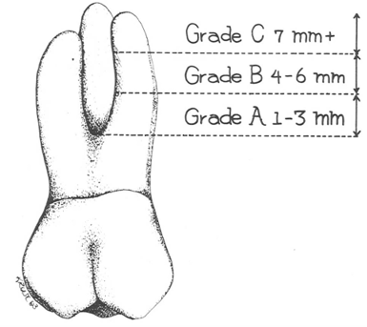
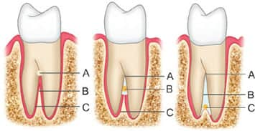
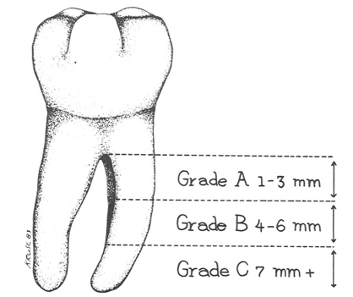
TARNOW AND FLETCHER (1984)
For each class of horizontal classification (I–III), a subclass based on the vertical bone resorption was added:
Subclass A: 0–3 mm.
Subclass B: 4–6 mm.
Subclass C: >7 mm.

Slide 35
HOU, G.L. ET AL. (1998)
Classification based on root trunk length and horizontal and vertical bone loss.
Types of root trunk:
Type A: Furcation involving cervical third of root length.
Type B: Furcation involving cervical third and cervical two thirds of root length.
Type C: Furcation involving cervical two thirds of root length.
Classes of furcation: Class I: Horizontal loss of 3 mm.
Class II: Horizontal loss > 3 mm.
Class III: Horizontal “ through-and-through” loss
Subclasses by radiographic assessment of the periapical view:
Sub-class ‘a’. Suprabony defect.
Sub-class ‘b’. Infrabony defect.
Classification of furcation:
AI, AII, AIII. Type A root trunks with class I, class II and class III furcations.
BI, BII, BIII. Type B root trunks with class I, class II and class III furcations.
CI, CII, CIII. Type C root trunks with class I, class II and class III furcations.

Slide 36
05
DIAGNOSIS

Slide 37
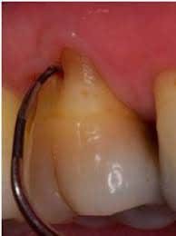
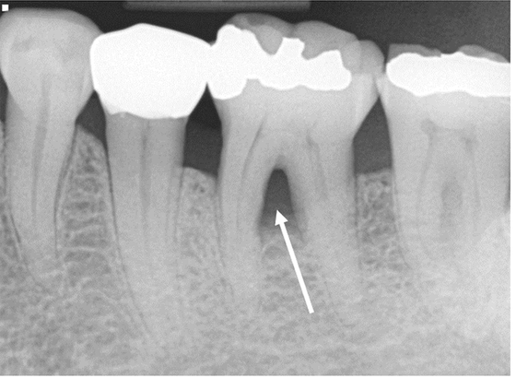
DIAGNOSIS
CLINICAL DIAGNOSIS
RADIOGRAPHIC DIAGNOSIS

Slide 38
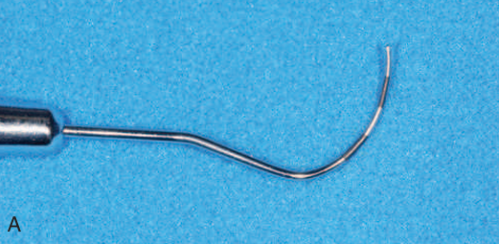
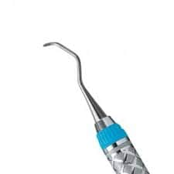
Clinical diagnosis
Careful probing – presence and extent of furcation involvement
Mealy and Beybayer (1994) – role of transgingival probing in determining anatomy of furcation
Bowers R C (1979)
studied the diameter of entrance to various furcations
81% - orifice of < 1 mm
58% < 0.75 mm.
Probing of the furcation.
Instruments: Nabers probe.
Columbia curette 4R / 4L

Slide 39
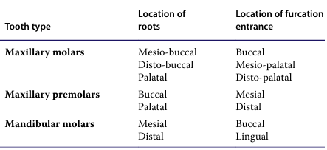
The goals of this examination are to identify and classify the extent of furcation involvement and to identify factors that may have contributed to the development of the furcation defect or that could affect treatment outcome. These factors include
the morphology of the affected tooth,
the position of the tooth relative to adjacent teeth,
the local anatomy of the alveolar bone,
the configuration of any bony defects,
the presence and extent of other dental diseases

Slide 40
Buccal and lingual furcation can be easily probed.
Proximal furcations are difficult for probing.
In maxillary molars mesial furcation is located more palatally than to the buccal tooth surface.
It should therefore be probed from the palatal aspect.
In contrast the distal furcation is located midway bucco-lingually and can therefore be probed either from the buccal or palatal aspect.
Furcation probing in maxillary premolar is very difficult due to the presence of anatomic variations such as longitudinal furrows
In some patients furcation involvement in these teeth may be first identified after the elevation of a soft tissue flap.

Slide 41

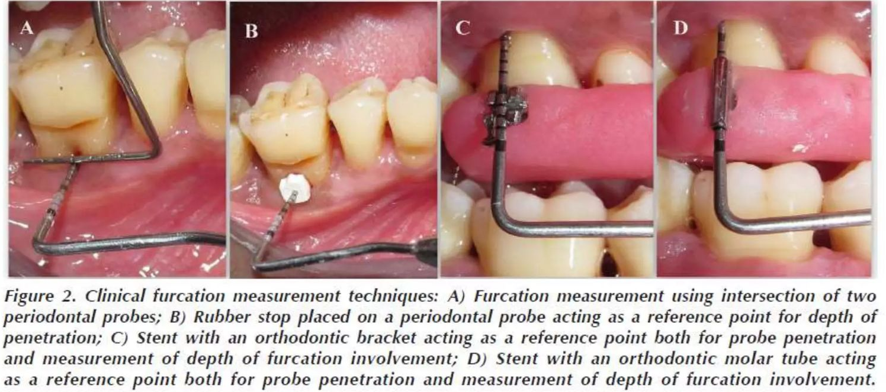

Slide 42
RADIOGRAPHIC DIAGNOSIS
Radiographs tell a substantial part of but not the whole story about furcation involvement.
Using two‐dimensional radiographic techniques (projection radiography: periapical and panoramic radiographs), reliable diagnosis of furcation involvement is not provided (topoll et al. 1988).
Radiographs only provide information on resorption or density of bone
Conventional radiographs may only provide hints for a suspicion of furcation involvement
Digital subtraction radiography
Three‐dimensional radiography
- cone beam computed tomography (CBCT) - walter et al. 2016

Slide 43
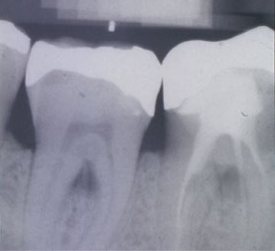
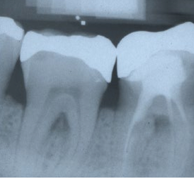
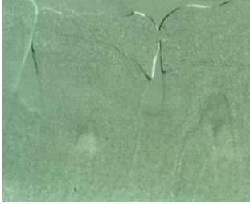
standardized radiograph of teeth 46 and 47 prior to regenerative therapy
standardized radiograph six months after regenerative therapy
subtraction image – increase of bone density within the furcations of 46 and 47
Source: Eickholz (2010)

Slide 44
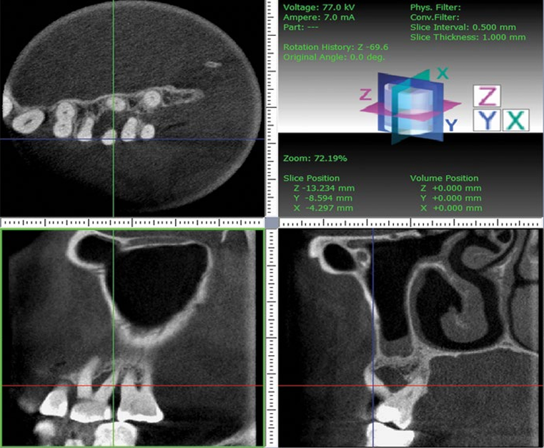
CBCT
Diagnosis and treatment planning using cone‐beam computed tomography (CBCT). CBCT images with horizontal, sagittal, and transversal sections of first and second left maxillary molars. According to the bone loss around the disto‐buccal root and the remaining periodontal attachment around the mesio‐buccal and palatal root, it was decided to extract the distobuccal root
Source: Walter et al. (2010)

Slide 45
To assist in detection of furcation, following radiographic diagnostic criteria are suggested:
1. Slight change in the furcation area investigated clinically, especially if there is bone loss on adjacent roots.
2. Diminished radiodensity in furcation area in which outlines of bony trabeculae are visible.
3. When there is marked bone loss in relation to single molar root, furcation is usually involved

Slide 46
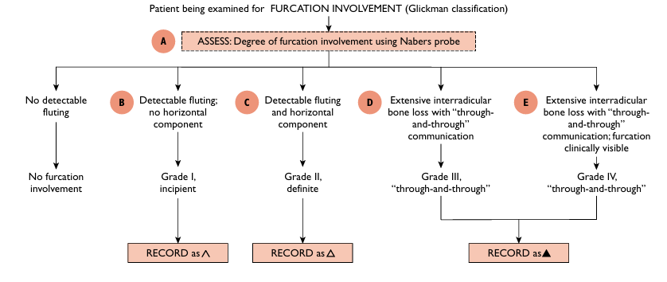

Slide 47
06
TREATMENT

Slide 48
DEGREE I | DEGREE II | DEGREE III
Scaling and root planing | Flap curettage | Flap curettage
Flap curettage | Root resection | Root resection
Apically positioned flap | Hemisection | Hemisection
Odontoplasty | Flap curettage with barrier membrane | Flap curettage with barrier membrane
Osteoplasty , ostectomy |  | Strategic extraction

Slide 49
Kalkwarf et al (1988)
Maintain the furcation
Increase the access to furcation
Removal of furcation
Closure of furcation with new attachment

Slide 50

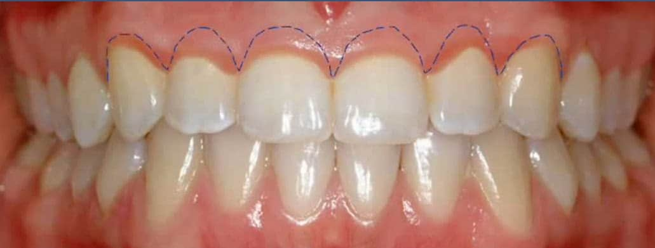
TREATMENT OF GRADE I FURCATION

Slide 51
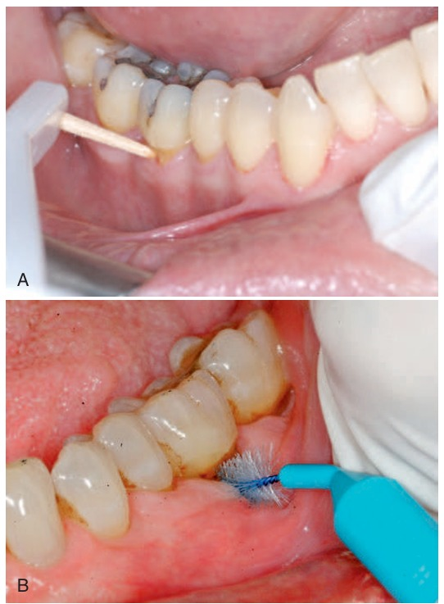

Slide 52
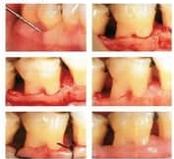
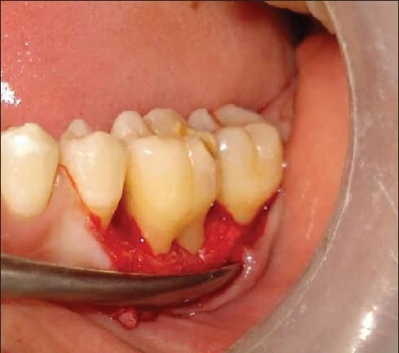
TREATMENT FOR FURCATION INVOVEMENT : GRADE II

Slide 53
FURCATION PLASTY
Reflection of flap
Removal of inflammatory soft tissue
Scaling and rootplaning
Odontoplasty
Osteoplasty
Positioning and suturing the mucosal flaps

Slide 54
TUNNELLING TECHNIQUE
Tunnel preparation is the process of deliberately removing bone from the furcation to produce an open tunnel through the furcation

Slide 55
INDICATIONS | CONTRAINDICATIONS
Moderate to severe furcation involvement (Grade II and III) | Short root trunk
long, divergent roots | Narrow furcation entrance
Good patient compliance | Severe bone loss (Grade IV furcation)
Early stages of furcation involvement | Poor oral hygiene habits
 | Extensive root caries
 | Patient inability to cooperate

Slide 56
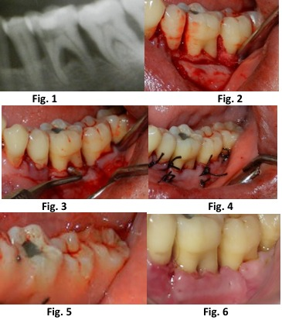
TUNNELLING TECHNIQUE

Slide 57
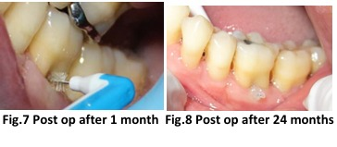

Slide 58
THERAPY FOR ADVANCED FURCATION DEFECTS : GRADE II - IV
Periodontal surgery
Endodontics
Restoration of the tooth to retain it

Slide 59
SURGICAL THERAPY FOR FURCATION INVOLVEMENT
ROOT RESECTION
After appropriate LA, a full-thickness mucoperiosteal flap is elevated.
debridement
resection begins..
A cut is then directed from just apical to the contact point of the tooth, through the tooth, to the facial and distal orifices of the furcation
After sectioning, the root is elevated from its socket..-

Slide 60
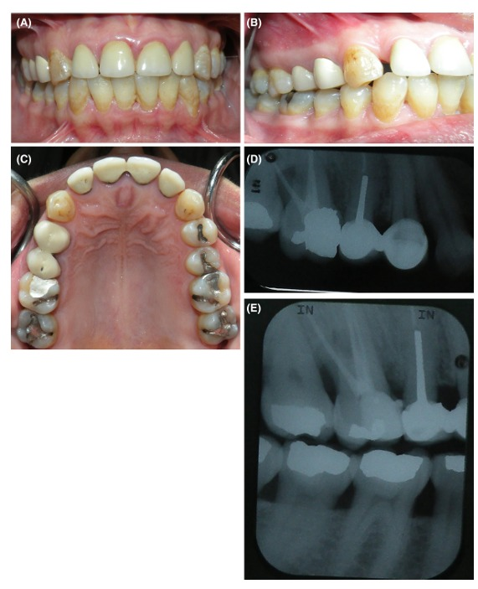
CASE REPORT
33 year old woman
For crown lengthening wrt 16
Probing depth – (6-7) mm (distally)
- grade II furcation involvement

Slide 61
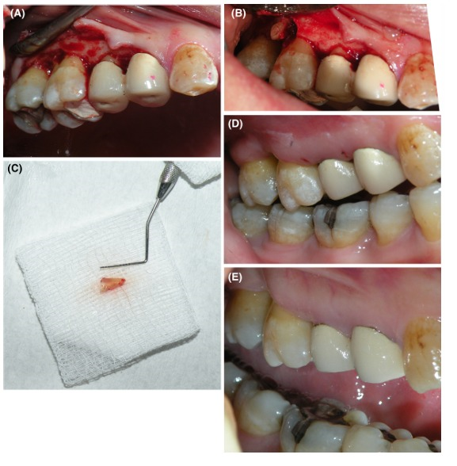
Flap reflection
Distal root amputation
1 week follow up
Resected root
3 months follow up

Slide 62
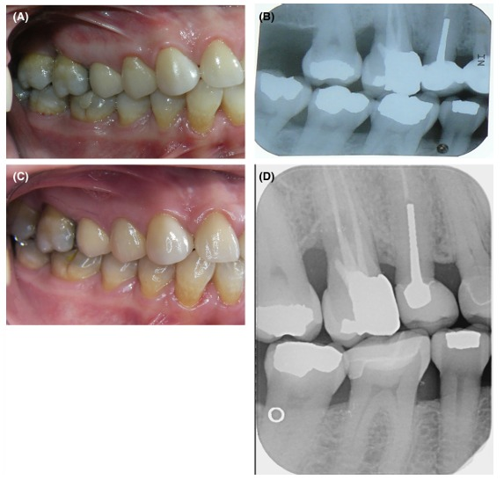
1 year follow up
1 year radiographs
6 years follow up clinical review
10 years bitewing radiograph

Slide 63
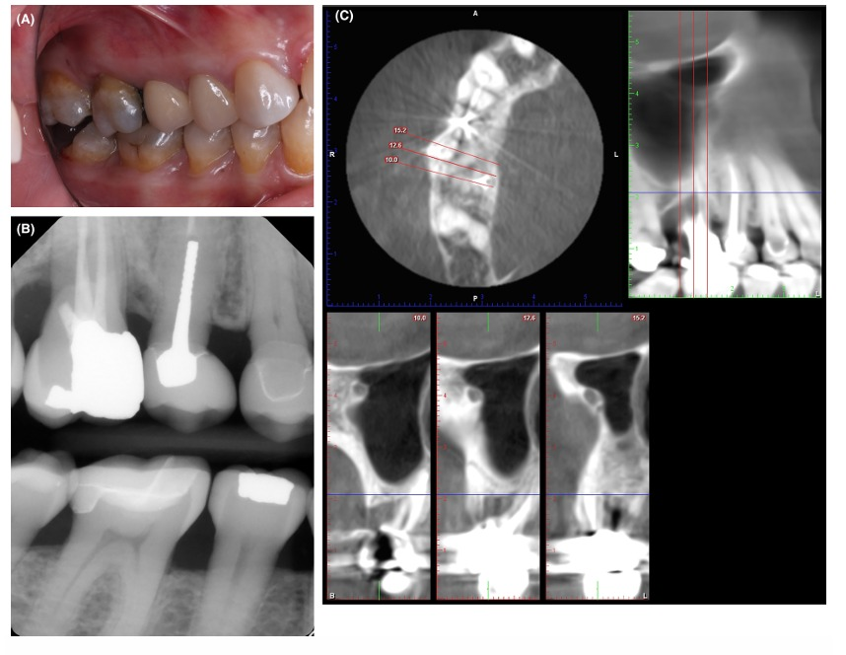
14 years bitewing radiograph
Probing depth increased up to 9mm

Slide 64


Slide 65
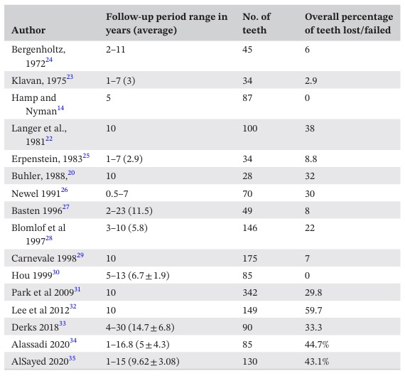

Slide 66
HEMISECTION

Slide 67
INDICATIONS | CONTRAINDICATIONS
Severe periodontal disease affecting one root of a molar | Fused roots
Extensive caries confined to one root | Poorly shaped roots
Vertical root fracture in a single root | Insufficient tooth structure
Failed endodontic treatment in one root | Patient non-compliance
Trauma causing significant damage to one root

Slide 68
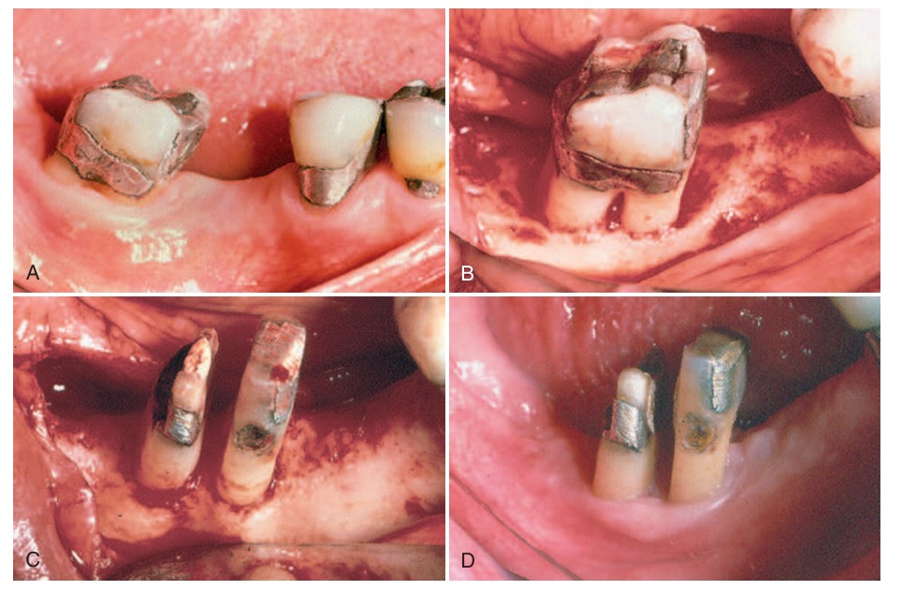
GRADE II FURCATION WRT 47

Slide 69
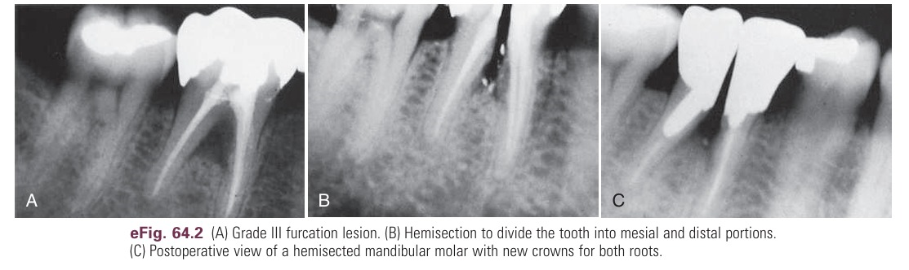

Slide 70
For hemisection a vertically oriented cut is made facial and lingual through buccal and lingual developmental grooves of the tooth ,through pulp chamber and through furcation

Slide 71
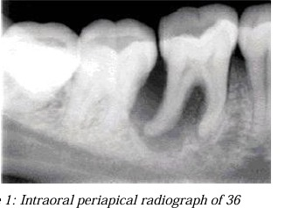
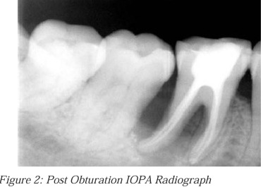
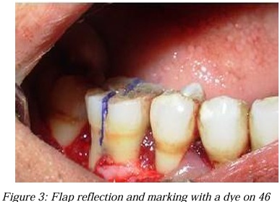
Notes:
Grade ii mobility class ii furcation distal root there was a pocket

Slide 72
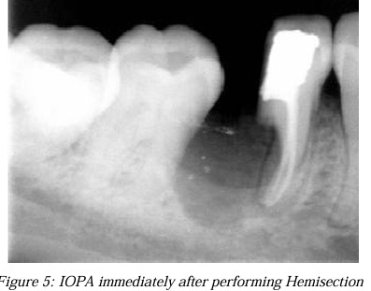
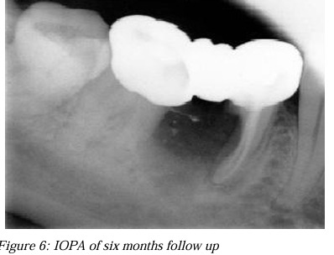
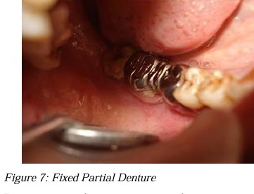

Slide 73


Slide 74
REGENERATION

Slide 75
Many surgical procedures using a variety of grafting materials have been tested on teeth with different classes of furcation involvement
GTR in the treatment of degree Il furcations in maxillary molars.
28 patients, age: 21-59 yrs-advanced periodontal disease were included & had bilateral defects . After basic therapy defects were randomly assigned to test and control groups

Slide 76
Flap was elevated,
SRP, degranulation done
EPTFE membrane used to cover defect and adjacent bone and retained with sling sutures.
Mucoperiosteal flaps covered the entire membrane.
Prior day and > 4 days post operative
Amoxicillin 1-0-1 (1 gm)
Sutures removed after 10 days.
At test sites membranes were removed after 6 weeks.
Re-entry after 6 months . The addition of GTR enhanced the result by promoting probing attachment and bone gain and decrease soft tissue recession

Slide 77
GTR in the treatment of degree IlI furcation defects in max. molars
11 subjects with generalized periodontitis and advanced lesions in the maxillary molar regions,-bilateral mesial distal, but not buccal degree III furcation defects in 1st and 2nd molars were recruited for the study.

Slide 78
Elevation of a mucoperiosteal flap,
.Post operative care. Amoxicillin 1gm x 2 / day for 8 days, Chlorhexidine mouth wash, Oral prophylaxis once every 2 weeks.
GTR membranes removed after 6 weeks . Patients examined 6 months later in addition all sits had surgical re-entry.
Contra lateral molars were treated in an identical way but without membrane
Root surface debridement and placement of EPTFE at the two entrances of the furcation defects.
Final examination showed that although some reduction in PD and some gain in CAL had occurred at both test and control sites none of the furcation defects had closed, but retained the characteristics of degree III furcation defects

Slide 79
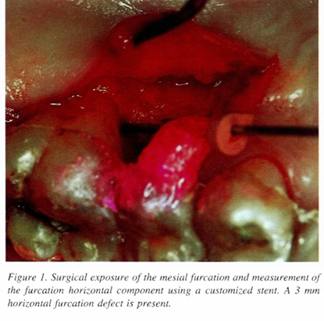


Slide 80



Slide 81



Slide 82



Slide 83
EXTRACTION OF FURCATION INVOLVED TEETH

Slide 84
Attachment loss is so extensive that no root can be maintained
when treatment would result in a tooth form where plaque control by the patient is difficult to achieve.
carious lesions or endodontic problems may cause the preserved tooth to be a future risk with regard to long term prognosis.
The extraction of teeth is done in class III and IV furcation involvement in patients who cannot perform adequate plaque control or have increased caries activity.
Patients who are reluctant.

Slide 85
07
PROGNOSIS

Slide 86
5 year study of hamp et al 1975
175 teeth , 100 patients were noted
175 - 32(18%) SRP
- 49(28%) SRP + FURCATION PLASTY
- 87(50%) ROOT RESECTION
- 7 (4%) TUNNEL PREPARATION
Maintenance program of 3-6 months
None of teeth during 5 years of study

Slide 87
CONCLUSION
Furcation involvement is a significant indicator of advanced periodontal disease, often impacting the prognosis of affected teeth due to the difficulty in cleaning these complex anatomical areas; careful diagnosis and appropriate treatment planning are crucial for managing furcation involvement, considering the severity of the defect and potential need for specialized procedures to improve tooth survival and function

Slide 88
REFERENCES
Newman and Carranza clinical periodontology , 13 edition
Pretzl, B. (2018). Anatomy of Multi-rooted Teeth and Aetiopathogenesis of the Furcation Defect. In Diagnosis and Treatment of Furcation-Involved Teeth, L. Nibali (Ed.).
Tarnow D, Fletcher P. Classification of the vertical component of furcation involvement. J Periodontol. 1984 May;55(5):283-4.
Eickholz, Peter & Walter, Clemens. (2018). Clinical and Radiographic Diagnosis and Epidemiology of Furcation Involvement. 10.1002/9781119270638.ch2.
Hall’s Critical Decisions in Periodontology and Dental Implantology, Fifth Edition

Slide 89
Nibali, L. (2018). Furcations. In Diagnosis and Treatment of Furcation-Involved Teeth, L. Nibali (Ed.).
Carnevale G, Pontoriero R, Hürzeler MB. Management of furcation involvement. Periodontol 2000. 1995 Oct;9:69-89.
Ajlan SA. Maxillary root amputation: Case report with a 14-year-follow-up and updated mini review. Clin Case Rep. 2024 Mar 1;12(3):e8553.
Avera JB, Camargo PM, Klokkevold PR, Kenney EB, Lekovic V. Guided tissue regeneration in Class II furcation involved maxillary molars: a controlled study of 8 split-mouth cases. J Periodontol. 1998 Sep;69(9):1020-6.

Slide 90


